Slide 1
Confusion

Slide 2
21 yo male
3 days fever
PCP – strep/influenza
Decreased urine output and pain
Confusion, unsteady gait
Sent from UC
-U/a
-Strep

Slide 3
VS
BP 125
Temp 39.2
Resp 20
HR 125

Slide 4
Labs
CBC nml
CMP nml
Mono neg
Lactate Nml
CSF 45 nucleated cells, 70 protein, nml glucose

Slide 5
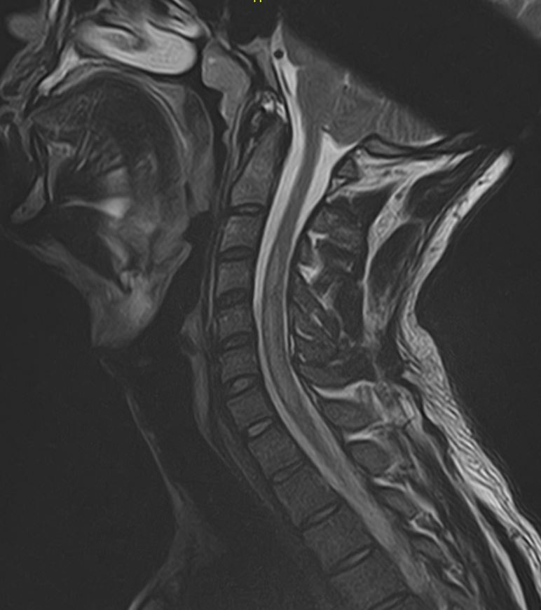

Slide 6
D/C Diagnosis
Viral meningoencephalitis
C3-T1 transverse myelitis due to above
Ataxia and LLE weakness due to myelitis
Urinary retention, resolved
Diplopia

Slide 7
Transverse Myelitis
30-60% idiopathic
Usually preceded by viral illness
Can precede MS
TM longitudinally spinal 3+ vertebral segments + bilateral optic neuritis=neuromyelitis optica
Peak between the ages of 10 to 19 years

Slide 8
Typical sensory symptoms
Pain
Paresthesia
Autonomic symptoms
urinary urgency/bladder and bowel incontinence
Difficulty or inability to void
Incomplete evacuation and bowel constipation
Sexual dysfunction
Urinary retention may be the first sign of myelitis/myelopathy

Slide 9
Outcomes
Most patients have partial recovery
Improvement 1-3 months, and continues over years.
40 percent have persistent symptoms
Rapid onset with complete paraplegia associated with poor outcomes

