Slide 1
Cough

Slide 2
36 yo male
Shortness Of Breath
Chest Pain
Cough X 2 Days
Worse Lying Flat/Improved With Sitting Up
No Fever, Chills, Vomiting, Diarrhea, Leg Pain, Leg Swelling
History Of Asthma Prior Pneumonia 2 Years Ago

Slide 3
VS
BP 110/64
Pulse 62
Temp 36 °C
Resp 18
SpO2 97%

Slide 4
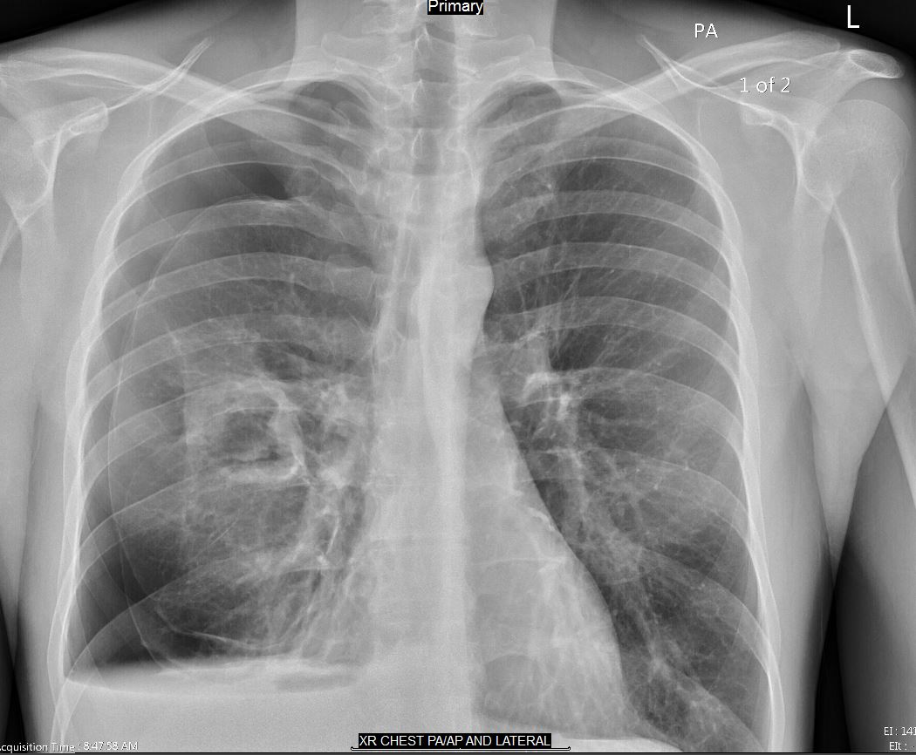

Slide 5
Labs
-Flu
-Trop
Transferred to ER

Slide 6
ER Labs
CMP nml
Sed rate 25
CRP 25
CBC nml

Slide 7
Inpatient
Pig tail cath inserted by Pulmonary
Wedge resection of lung
Bx shows 2+ Aspergillus fumigatus

Slide 8
Aspergilosis
Frequently from inhalation
Tissue invasion suggests immunosuppression
Hallmark of infection is vascular invasion with subsequent infarction and tissue necrosis

Slide 9
Risk Factors
Severe and prolonged neutropenia
Receipt of high doses of glucocorticoids
Drugs or conditions with Immunosuppression

Slide 10
Signs and symptoms
Fever
Chest pain
Shortness of breath
Cough/hemoptysis
Skin

Slide 11
Disseminated Infection
Brain
Eyes
Liver
Kidneys
Tracheobronchitis
Rhinosinusitis
Brain Abscess
Endophthalmitis
Endocarditis
Gastrointestinal Disease
Disseminated infection is associated with a very poor prognosis

