Slide 1
DentaL Procedures
By Ross Klein

Slide 2
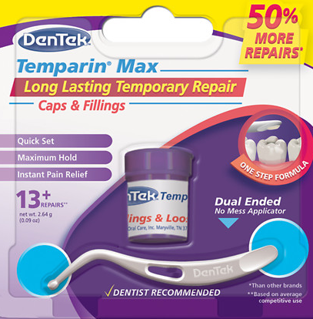
Dental Procedures
Dental Blocks
Dental Cement
Dental Putty
$4.20
Glue

Slide 3
Dental Block
Codable Procedure – 64450
Supraperiosteal
Inferior Alveolar

Slide 4
Supraperiosteal Injection

Slide 5
Supraperiosteal Injection
Dry Area
Topical Lidocaine for 1 minute
Depth 1-2 cm
1.5-2 ml
Lay patient down
Spit Cloth

Slide 6
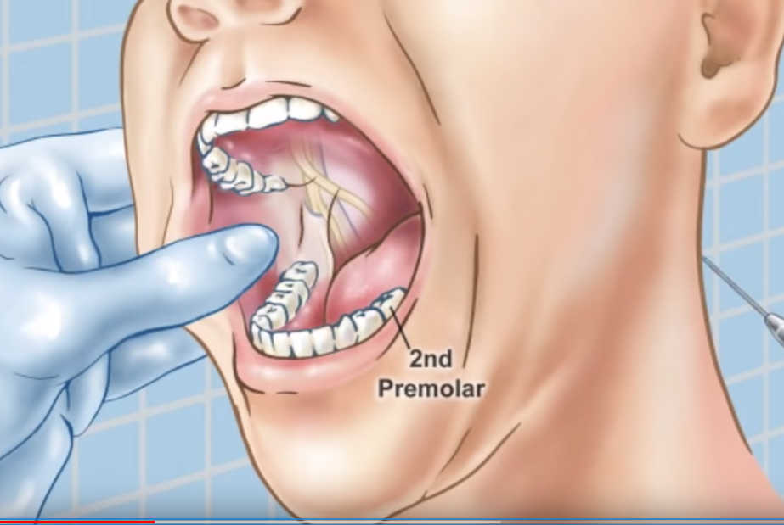
Inferior Alveolar

Slide 7
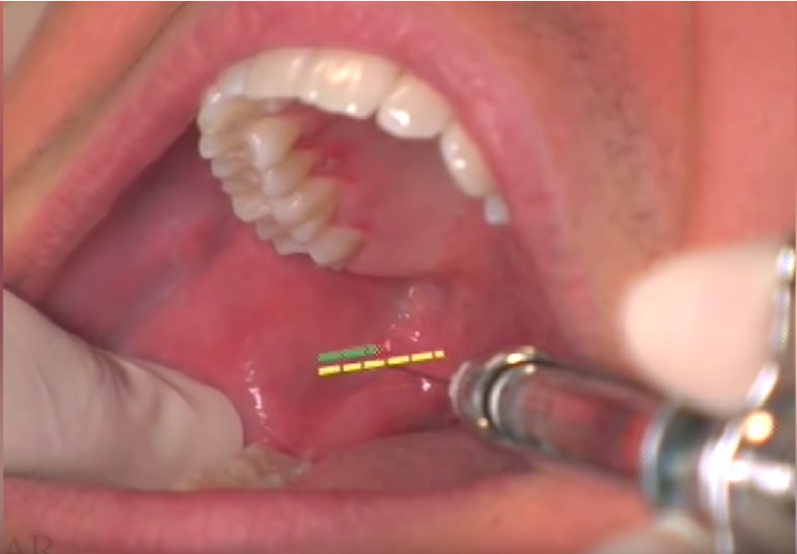
Inferior Alveolar

Slide 8
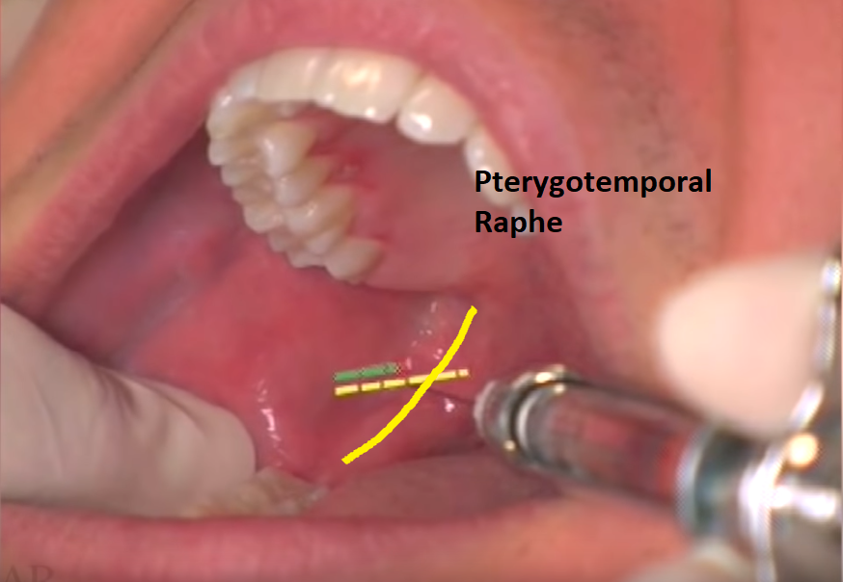

Slide 9
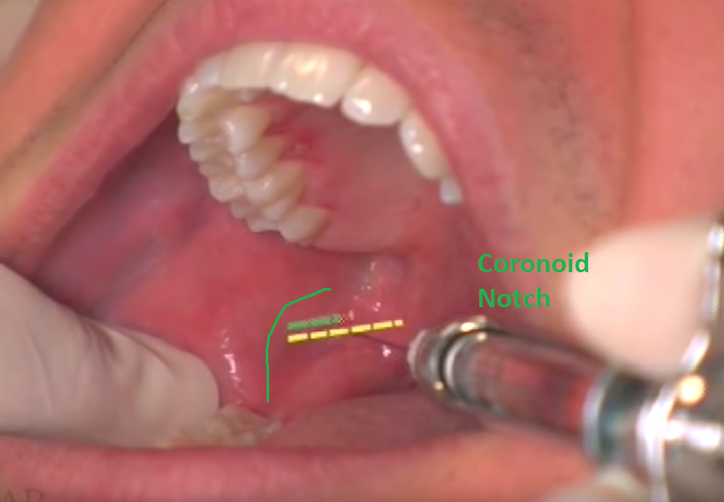

Slide 10
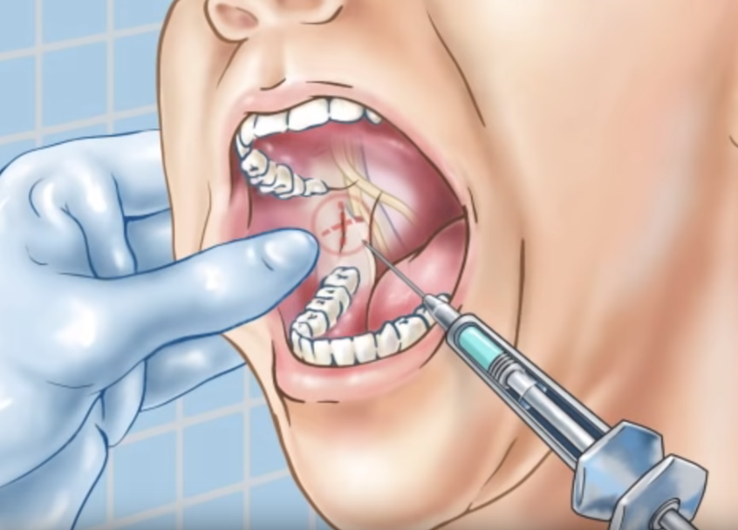
Inferior Alveolar

Slide 11
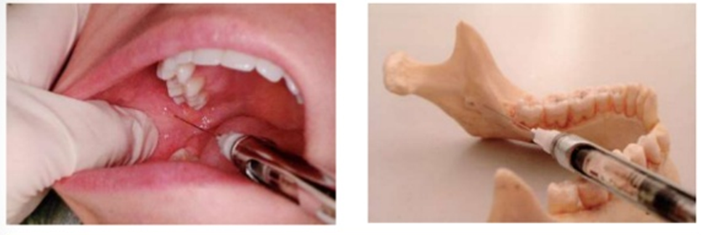

Slide 12
Inferior Alveolar
Topical Lidocaine for 1 minute
Depth 2-2.5 cm
Bone is contacted
1.5-2 ml
Lay patient down
Spit Cloth

Slide 13
Cement

Slide 14
Ratio
1cm (or scoop) to 3 or 4 drops.
Should be the consistency of toothpaste
Mix thoroughly
Cover the dental carie completely.
Paste dries 10-15 minutes
Bite block of gauze
Filling with cement is considered a “dental replacement”

Slide 15
Painful Carries

Slide 18
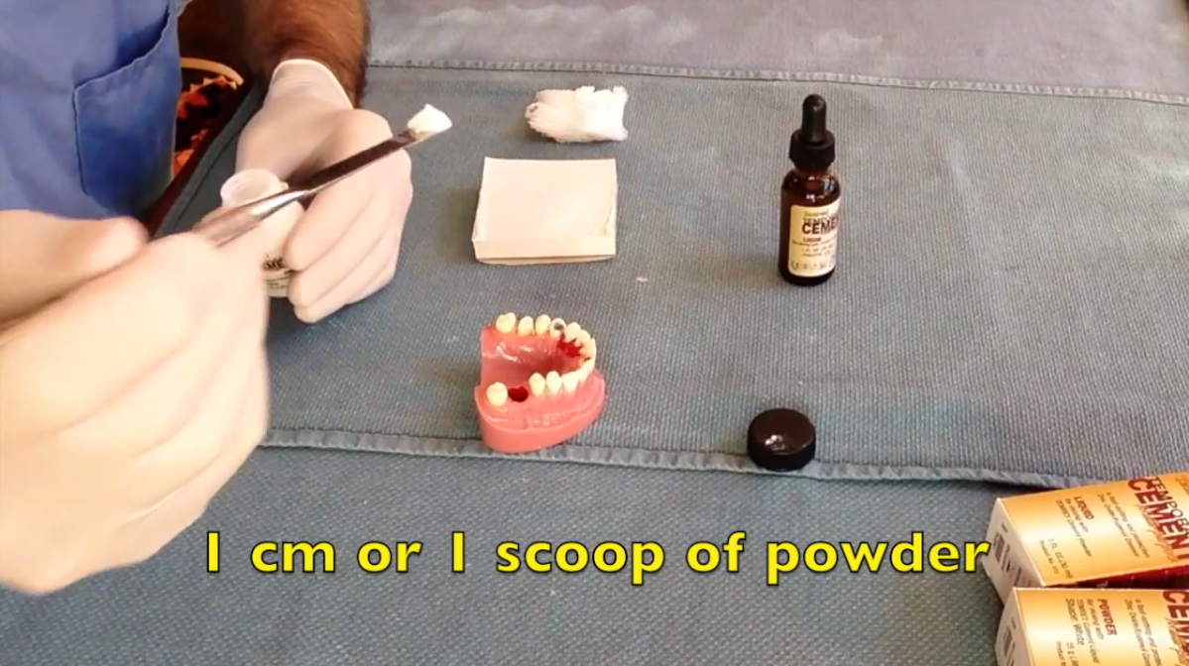

Slide 20
Video
https://www.youtube.com/watch?v=_FxTlWsAOPE

