Slide 1
Cardiac stuff
For Entertainment Purposes only

Slide 2
Walkthrough on an EKG Normal sinus rhythm. heart rate 76 No ST elevation or depression. No T-wave inversion. Normal R Wave progression No Idioventricular block No ectopy. QTc interval 0.393 QRS axis 75

Slide 3
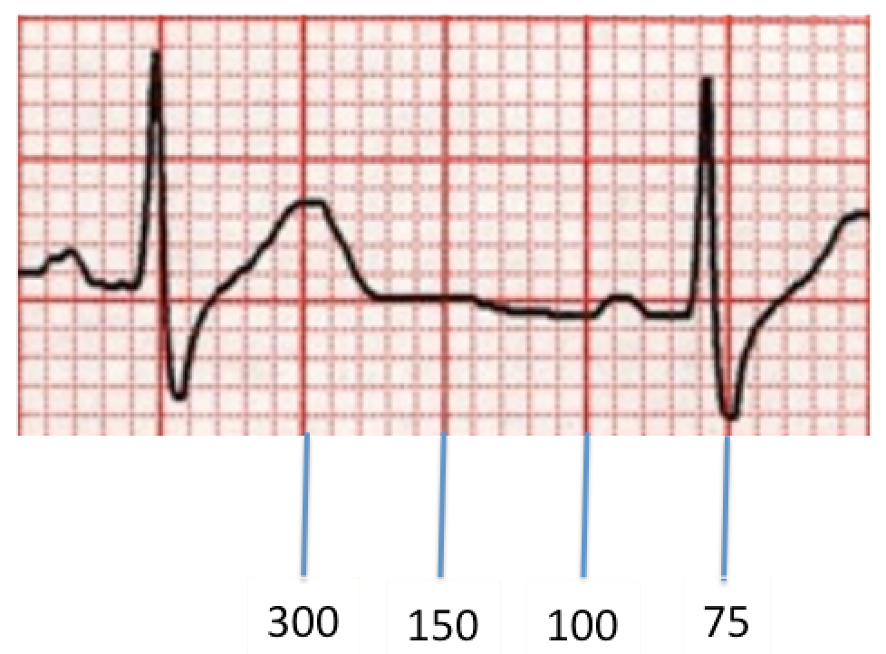
Establishes Tachycardia and Bradycardia
Heart rate is calculated for you. No need to use boxes, but here they are just in case:

Slide 4
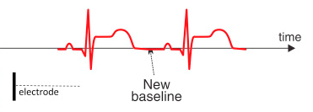
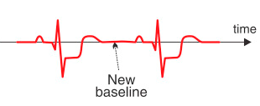
Potential Mycardial Infacrtion
ST Elevation ST Depression

Slide 5
T Wave Inversion MI, Pericarditis when Diffuse

Slide 6
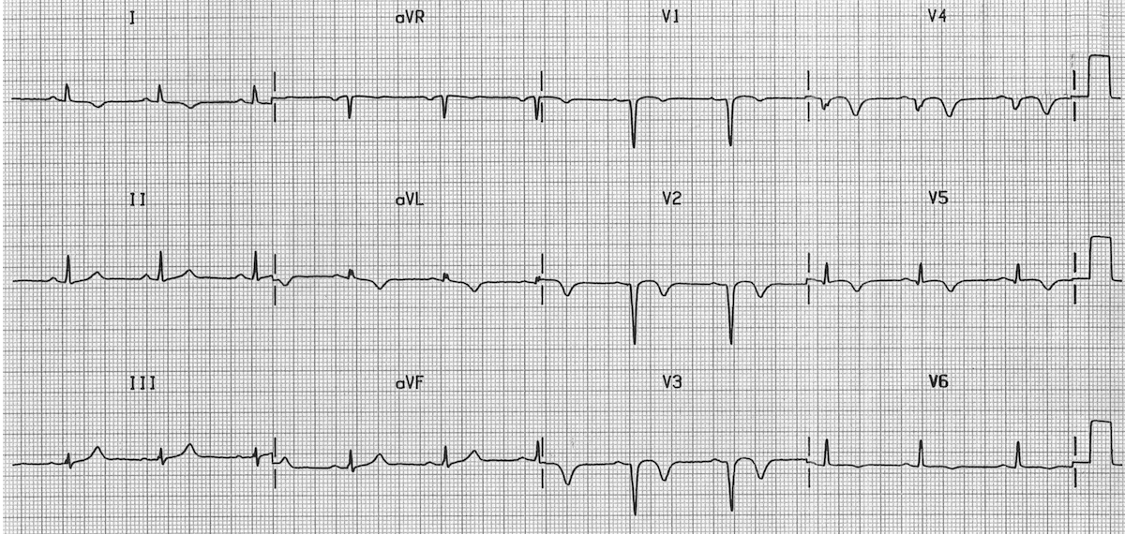
Poor R Wave Progression ? Anterior MI

Slide 7
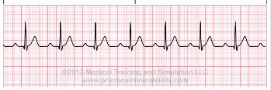
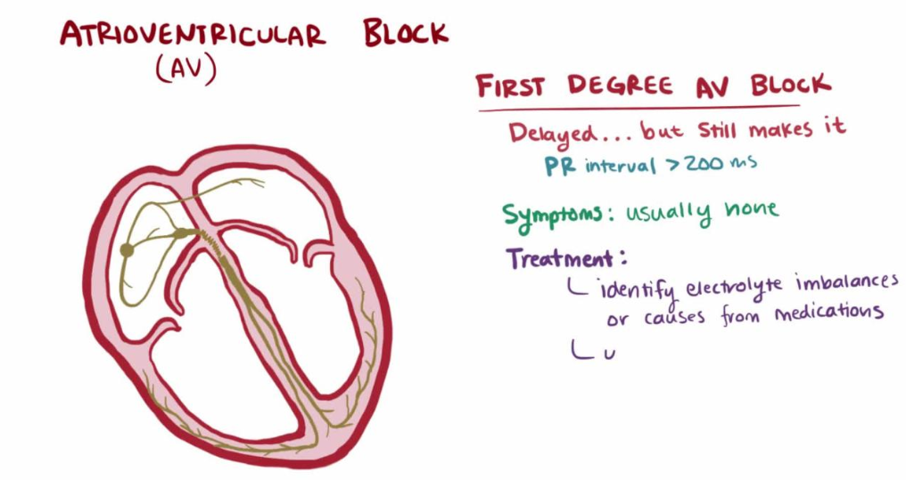
First Degree Block AV Conduction Delay

Slide 8
Second Degree Block PR Interval gradually increasing until a beat is dropped.

Slide 9
Second Degree Block ii PR interval is the same, but occasionally blocked

Slide 10
Third Degree Block Oh Crap!

Slide 11
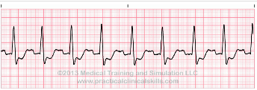
Bundle Branch Block With this conduction block, either the left or right bundle branch is blocked intermittently or fixed. The QRS complex is wider than normal (> 0.12 sec.). Using a 12 lead EKG, blocks in either the left or right bundle branch may be diagnosed.

Slide 12
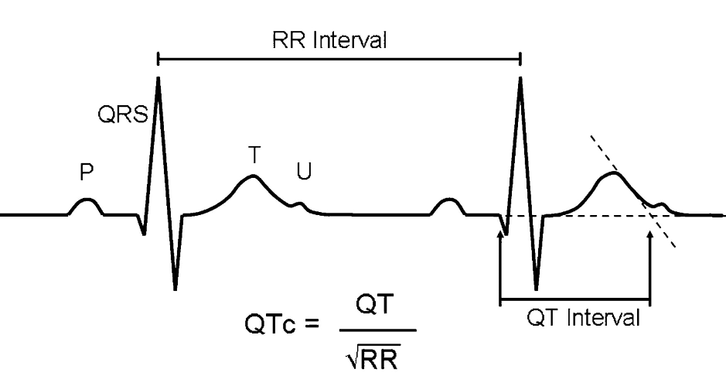
QTc Interval
Long QTc 1/2500
Greater than or equal to 500

Slide 13
Ectopy Premature atrial contractions (PAC) Premature ventricular contractions (PVC)

Slide 14
Qrs axis

Slide 15
