Slide 1
The SlIT Lamp
(You Don’t Know What You’re Missing…)

Slide 2
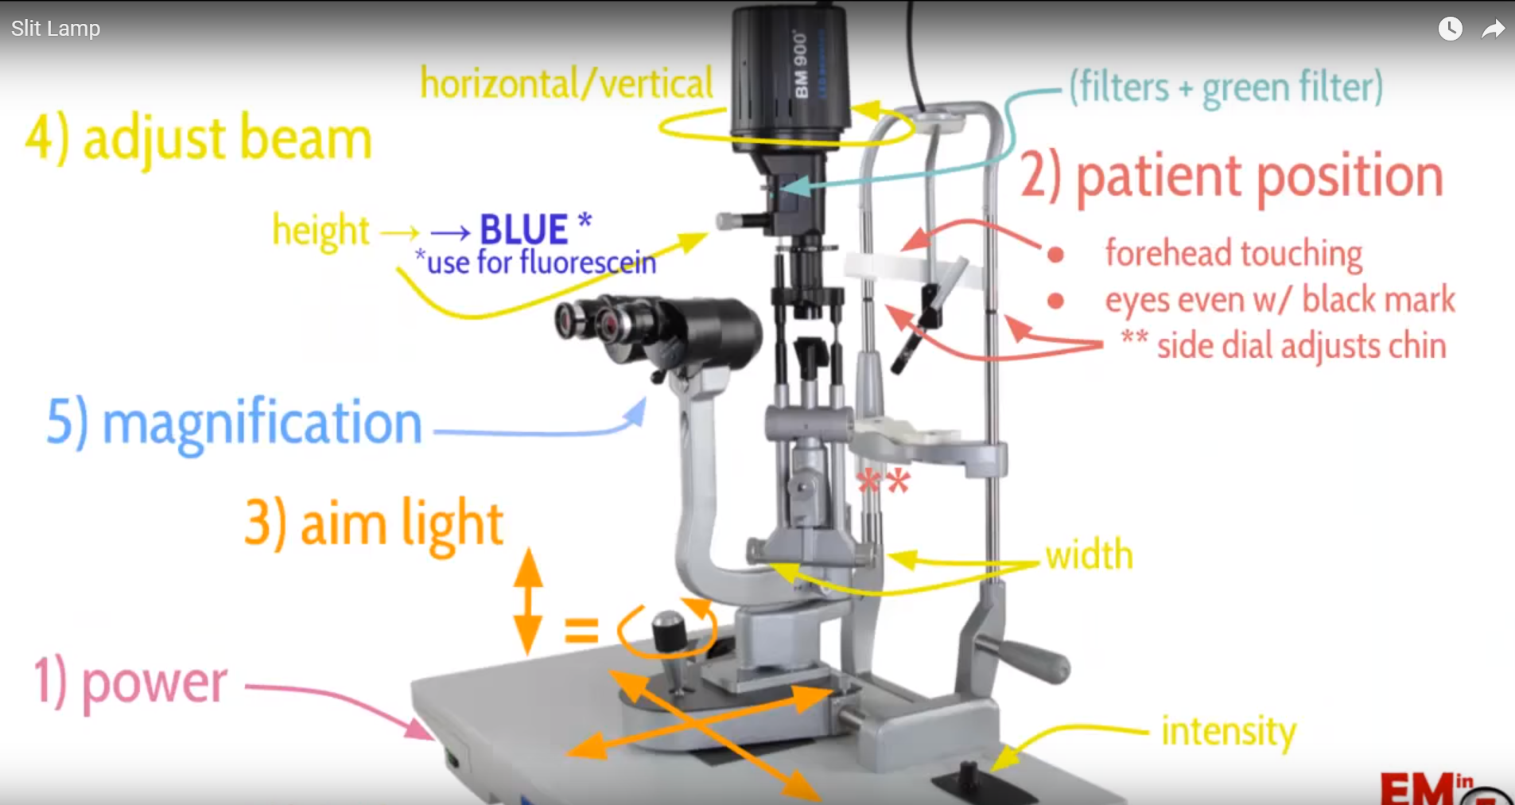

Slide 3
Turn Machine On

Slide 4
Adjust EyePieces
If Wearing Glasses = 0

Slide 5
Raise the Table

Slide 6
Forehead on The headband
Allows you to focus
Black Mark even with patient’ s eyes
Metal adjuster

Slide 7
Aim Light by moving the base or Joy Stick

Slide 8
Beam Adjustment
Height and width
At max height, will turn cobalt blue for fluorescein exam
Teal green is not blue
Magnification, start at 10
Intensity dial

Slide 9
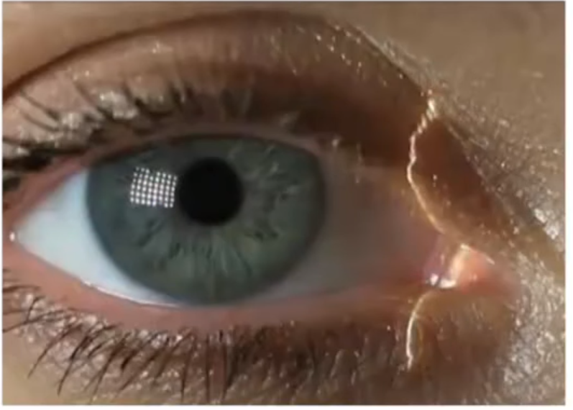
Lids Lashes Lacrima

Slide 10
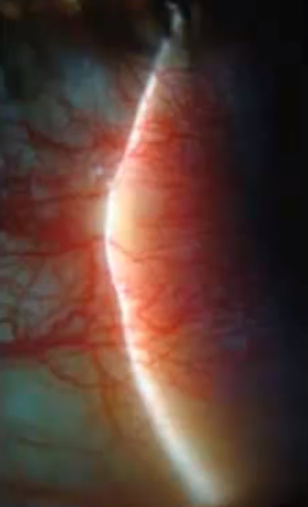
Conjunctiva/Sclera

Slide 11
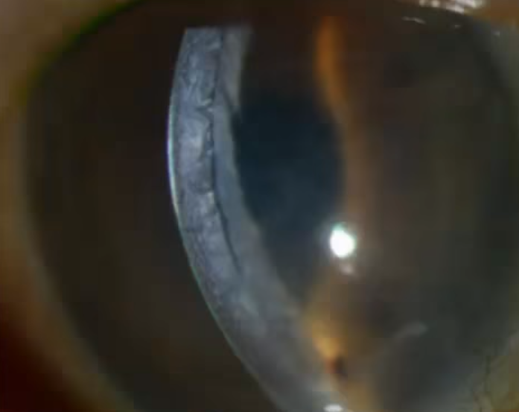
Cornea

Slide 12
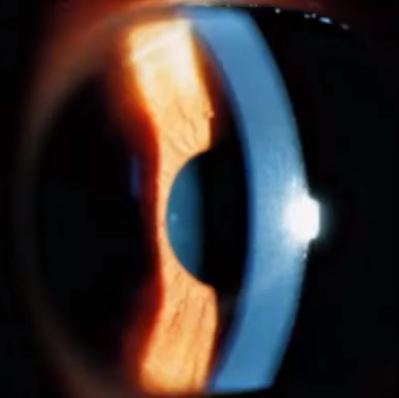
Anterior Chamber

Slide 13
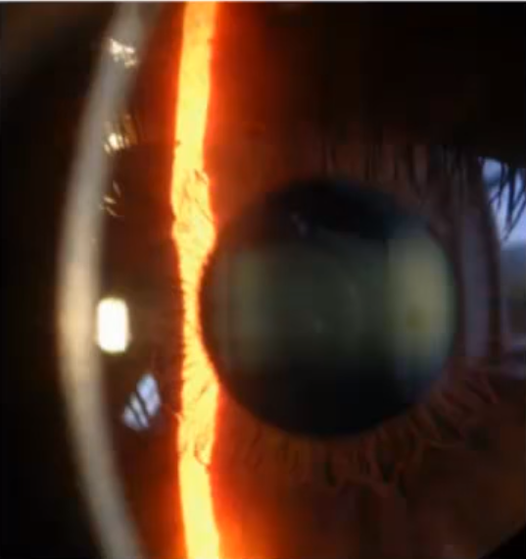
Iris/Lens

Slide 14
Fluorescein Exam

Slide 15
Review
Power
Adjust Eyepieces
Patient Height
Forehead Touching
Adjust Chin
Move light to focus with base and joystick
Change Focus
Cobalt Blue

Slide 16
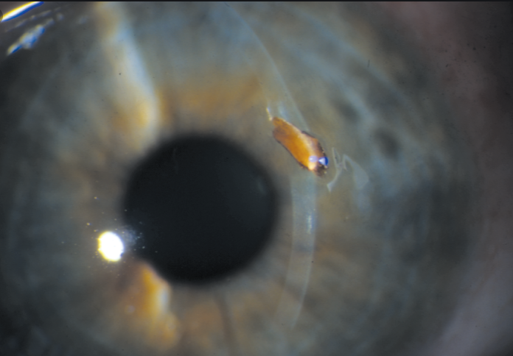
Foreign Body

Slide 17
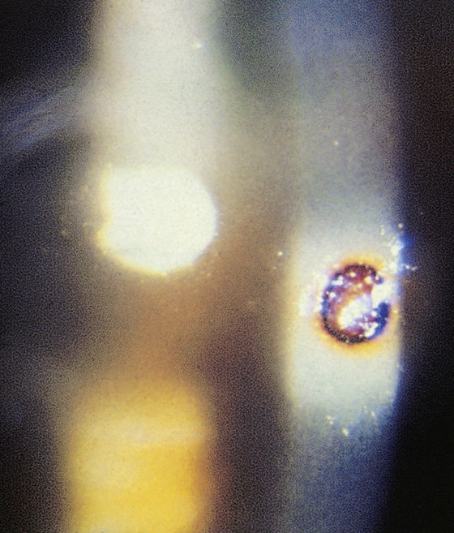

Slide 18
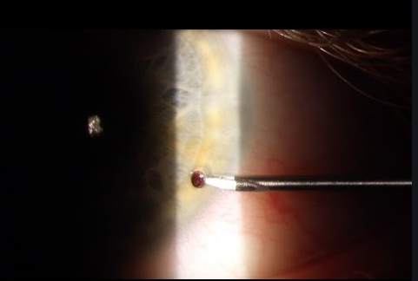
Slit Lamp stabilizes head for foreign body removal

Slide 19
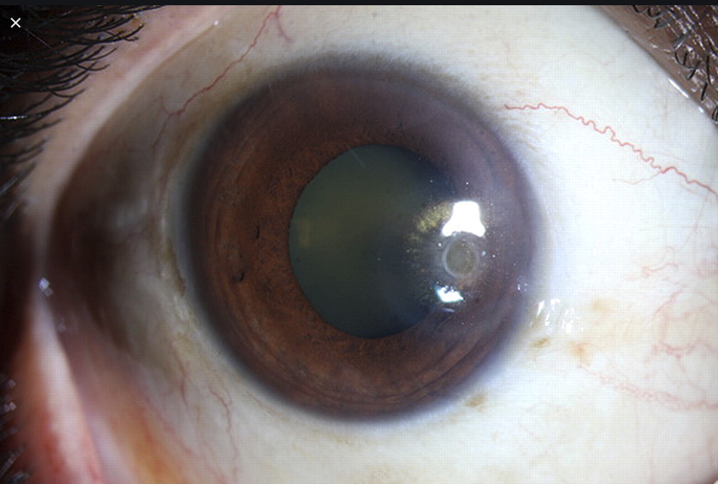
Globe Rupture
(with dye, Positive Seidels sign)

Slide 20
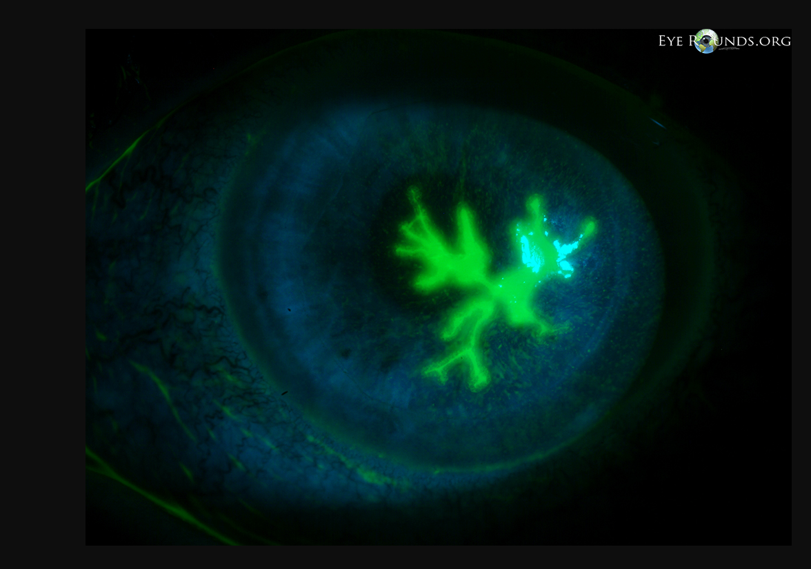
HSV

Slide 21
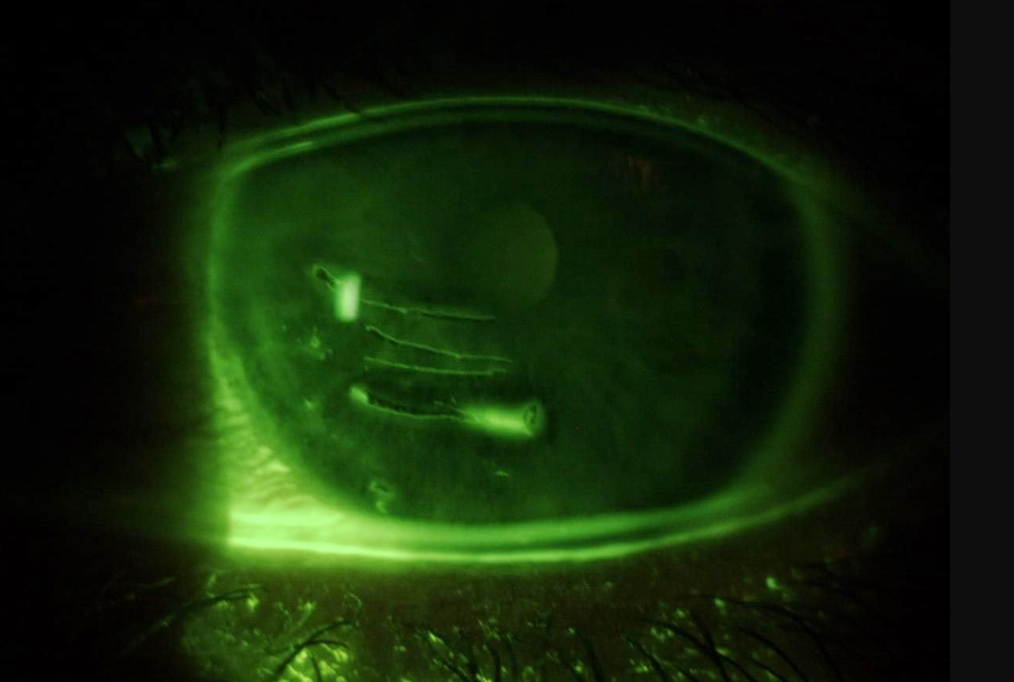
Corneal Abrasion

Slide 22
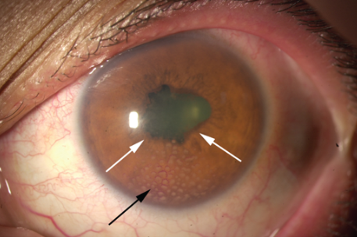
Iritis (white Arrows)
Uveitis (Black Arrows)

