Slide 1





















Emergent Care in the Clinic Setting
December, 2025
Ross Klein PA-C

Slide 2





Who Is This Guy?
Introduction
28 years as a Physician Assistant (Associate, Mid-Level, Advanced Practice Practitioner
Experience in Cardiothoracic Surgery, General and Vascular Surgery
Hospitalist Observation Unit and Urgent Care experience
Primarily work in Emergency Medicine
Disclosure: I created Smarter-Chart.com

Slide 3

Career Before Becoming a PA
Background

Slide 4
Why Teach Students?
Teaching
Mentored by Dr. Ray Conway during PA school application process
Belief in giving back to the profession
Driven by the illusion that I know enough to teach
Always Felt bad for lecturers
Cardiac Surgery Case

Slide 5
Introduction to Emergent Care
Introduction
Cardiac and Pulmonary critical conditions require immediate recognition and intervention
Rapid and effective response is essential to manage life-threatening situations
Preparedness in clinic settings is crucial for patient survival and recovery
Building Confidence

Slide 6

Fired From Burger King for lack of agility on the fry station
Background

Slide 7



Things I will Try Not to Say…
This could be it’s own 4 hour presentation
I’m getting your mom on the phone right now!
We’ll get to that later
There is no such thing as a stupid question.
Let’s just power through the break
Trust me…

Slide 8
Chest Pain (Dyspnea) Overview
Chest Pain
Represents all-comers to the ED with “chest pain,” including low-risk and non-cardiac cases — the broadest denominator
5% → realistic population-wide probability in the ED for serious cardiac events
9–10% → typical for clinically evaluated chest-pain cohorts where the differential diagnosis was narrowed toward possible ACS
Accurate recognition and triage are crucial for timely intervention and appropriate management.

Slide 9
Chest Pain Differential Diagnosis
Cardiac causes
Acute Coronary Syndrome (ACS)
  Angina
  Aortic dissection
  Pericarditis
  Myocarditis
Pulmonary causes
  Pulmonary Embolism (PE)
  Pneumothorax/tension
  Pneumonia
  Bronchitis
  Pleurisy
GI
  Gastroesophageal reflux disease (GERD)
  Esophageal spasm
Musculoskeletal causes
  Chest wall pain/costochondritis
  Muscle strain
  Contusion, Rib Fracture
Other
  Psychiatric
  Shingles (herpes zoster) affecting the chest wall

Slide 10

Raft Guide

Slide 11
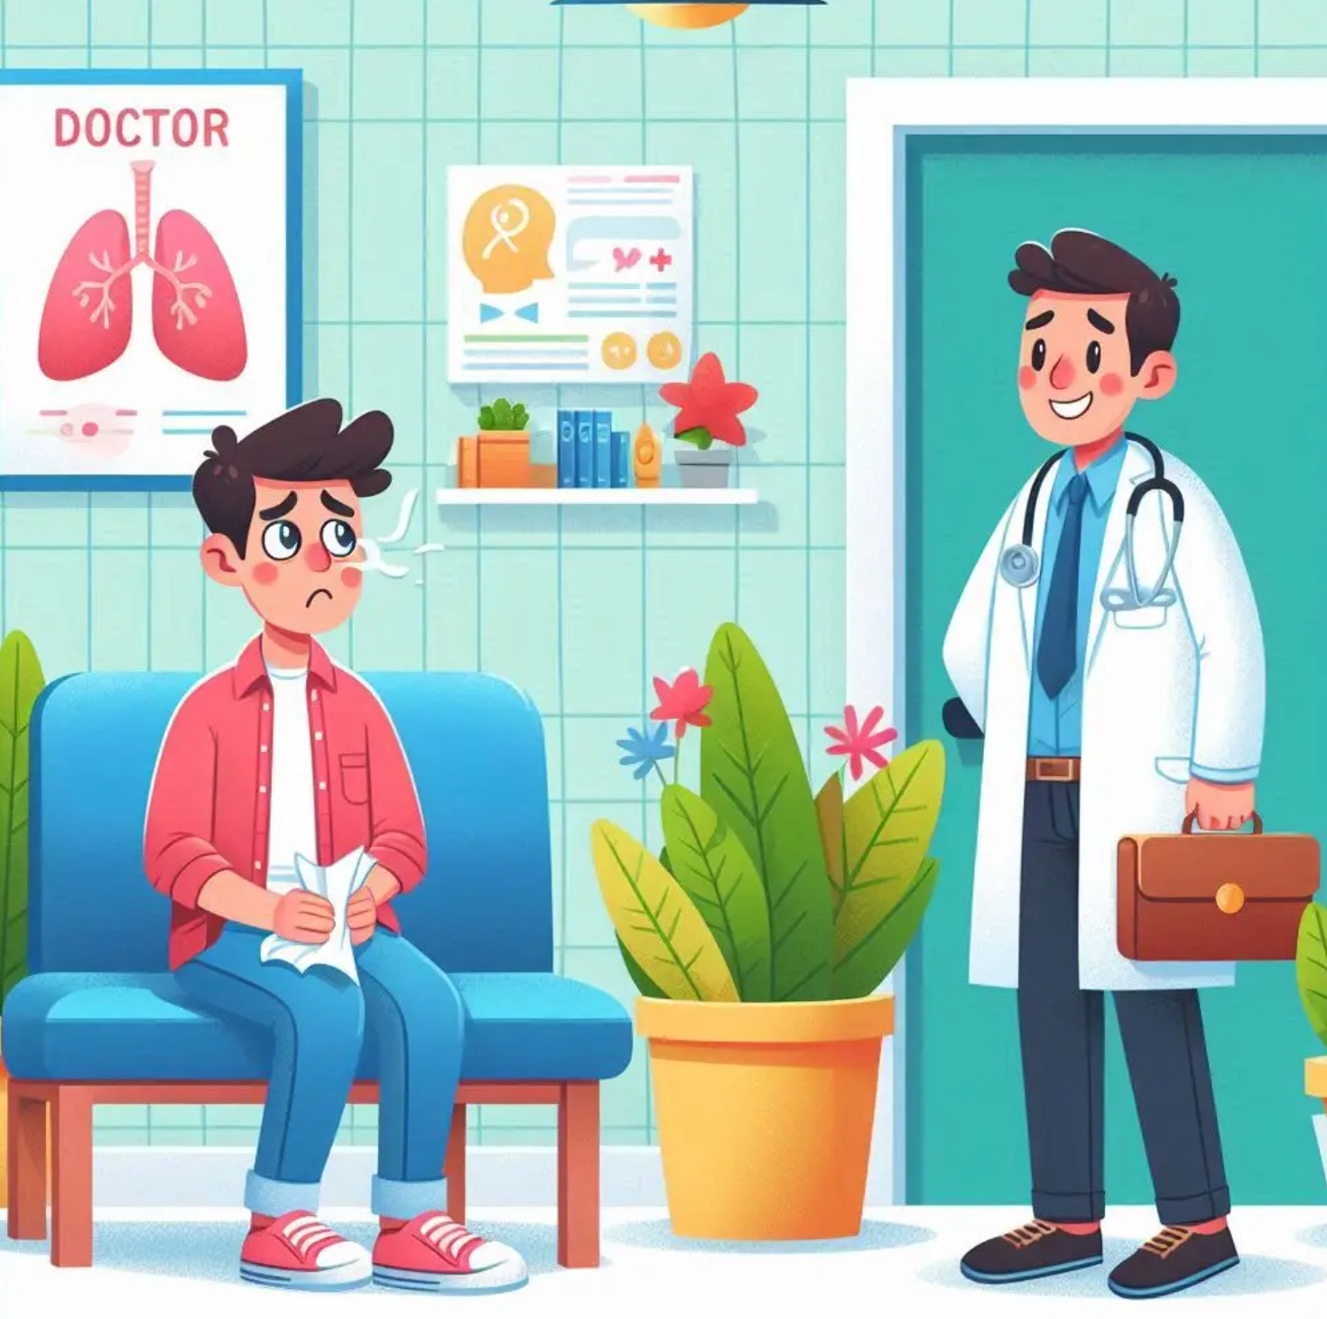
Patient Case #1

Slide 12




Epidemiology Highlights of Asthma and Bronchospasm
24,000,000
Americans diagnosed with asthma
1.2x
Higher prevalence in females
1.5x
Higher incidence in African Americans
500,000
New asthma diagnoses annually

Slide 13


Clinical Manifestations of Bronchospasm
Bronchospasm
Cough
Wheezing
Shortness of breath (dyspnea)
Chest tightnes
Thickened mucus or sputum production

Slide 14



Acute Bronchospasm
Pathophysiology
Sudden constriction of bronchial smooth muscle leads to temporary airway narrowing
Triggered by airway hyperreactivity to inflammatory mediators like viruses, histamine, and leukotrienes.
Inflammatory response causes mucosal edema and increased mucus production
Airway obstruction results from bronchial muscle contraction, swelling, and mucus buildup
Bronchospasm is reversible with appropriate intervention, unlike chronic airway narrowing seen in COPD.
Bronchospasm

Slide 15
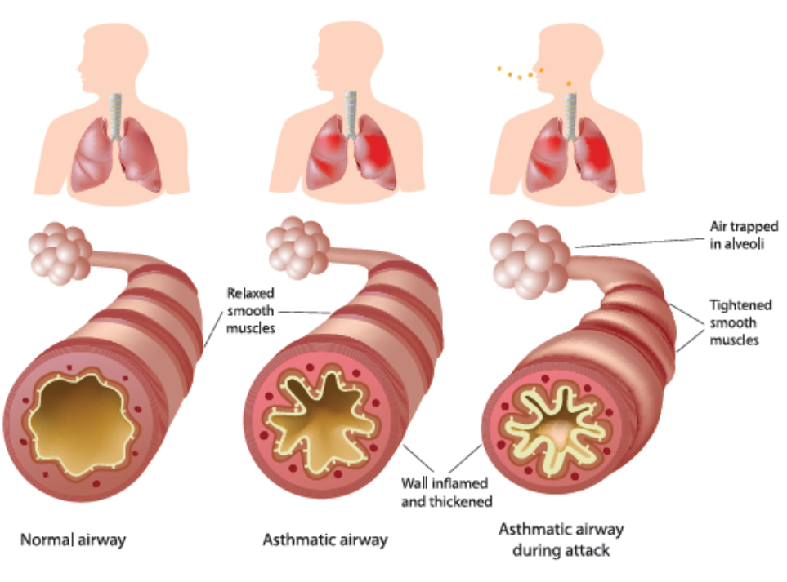

Slide 16
Treatment of Acute Bronchospasm
Treatment
Albuterol
Steroids
  Help prevent relapse after the acute episode
Dextromethorphan
Tessalon Pearls
Narcotics
Antibiotics
NNT no statistical change
NNH 1/37
  NNH 1/8-12 for abx in general
Antibiotics considered if COPD / Immuno-compromised

Slide 17
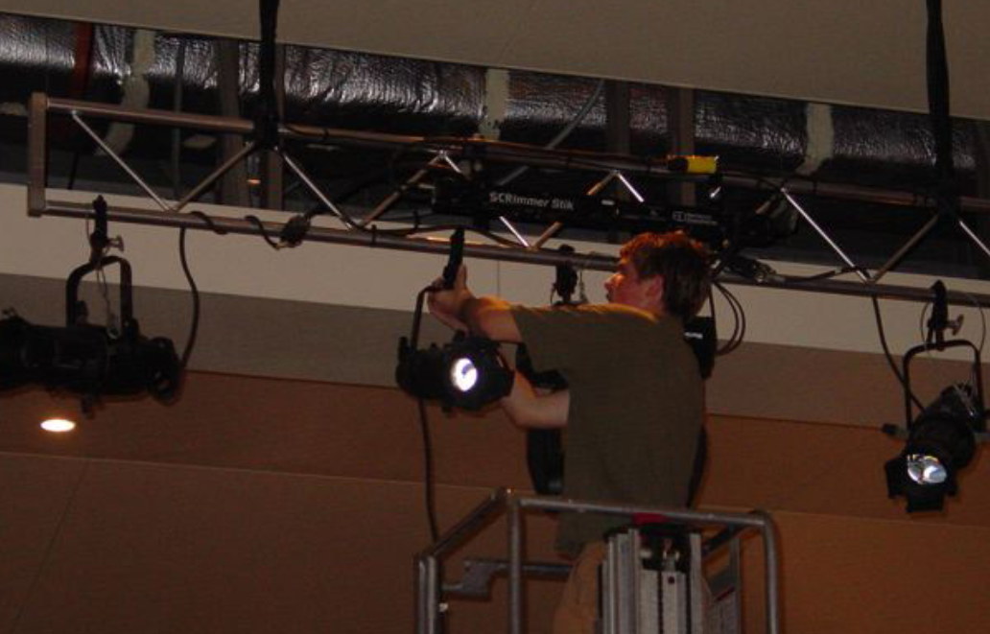
Lighting Design for Theater
Background

Slide 18
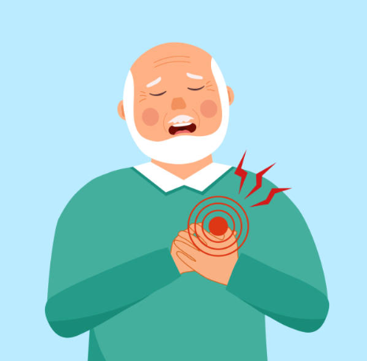
Case #2

Slide 19


ACS: Acute Coronary Syndrome
Types of Acute Coronary Syndrome (ACS)
STEMI and NSTEMI are the most critical forms of ACS, requiring immediate intervention.

Slide 20
Classic Symptoms of Cardiac Events
Prevalence of Classic Cardiac Symptoms in Patients

Slide 21
Atypical Presentations
Frequency of Atypical Presentations by Population Group
Atypical symptoms are most frequently reported in elderly patients and those with diabetes.

Slide 22
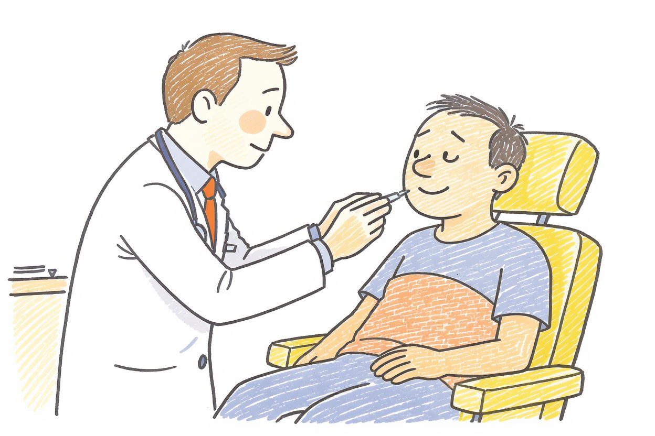
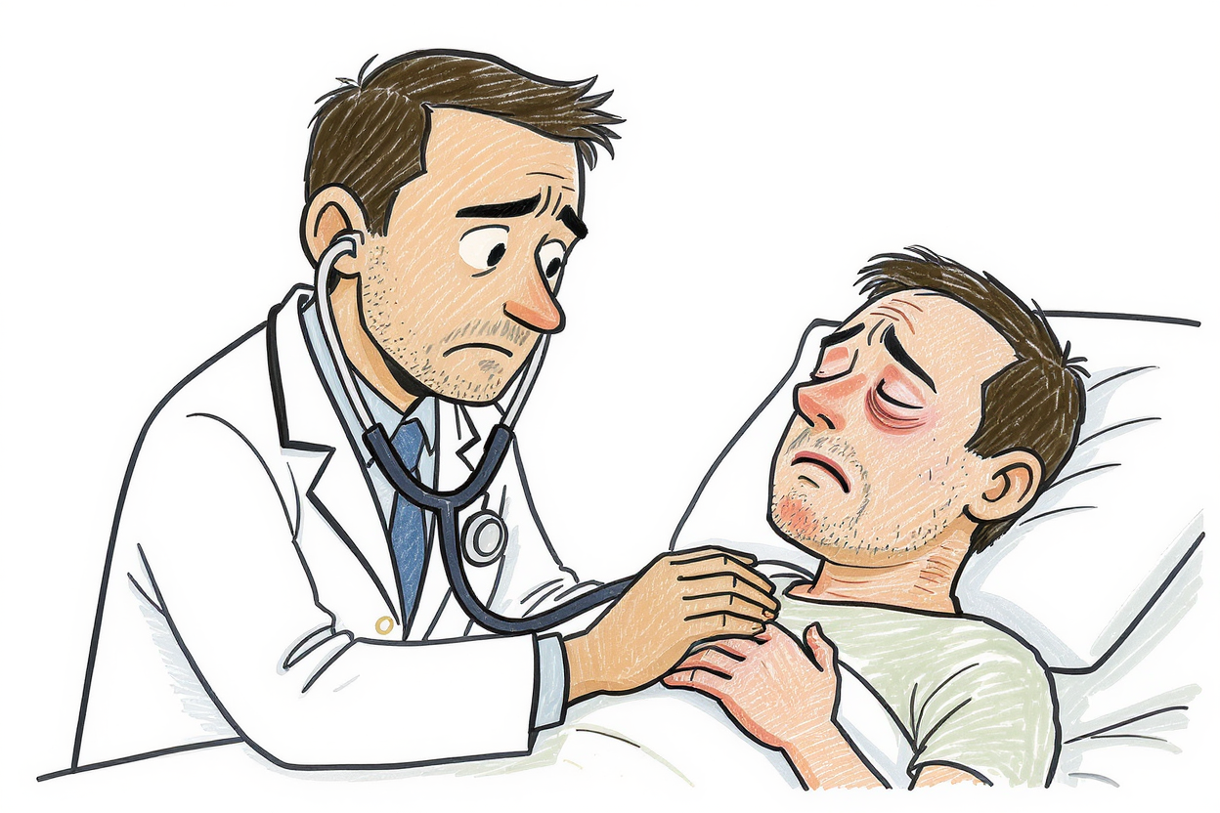

Physical Exam Findings in Angina
Assessment
Normal and Common Findings
Abnormal Signs Indicating Severity
Physical exam is often normal in stable angina. However, pallor, diaphoresis, or anxiety may be observed during episodes.
Look for tachycardia, bradycardia, hypotension (cardiogenic shock), new murmur, or pulmonary crackles, which suggest more severe disease.

Slide 23
Risk Factors for Cardiovascular Complications
Prevalence of Key Cardiovascular Risk Factors

Slide 24

Acute Chest Pain Workup
Diagnosis
12-lead ECG
  STEMI: ST elevation in contiguous leads
NSTEMI
  ST depression or T-wave inversion
  Poor R-Wave
Cardiac biomarkers:
  Troponin ↑ in MI (normal in unstable angina)
  Possible Serial Tests
Heart Score assessment for risk stratification

Slide 25
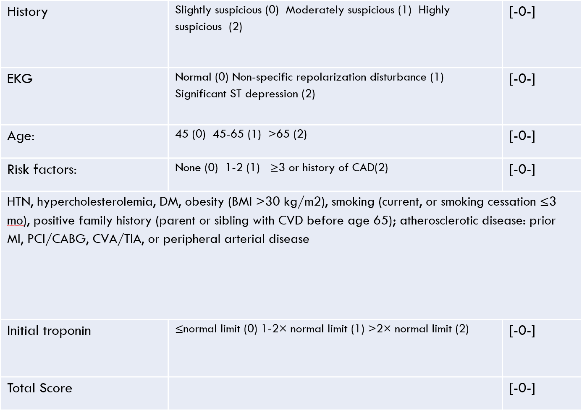
Heart Scale

Slide 26
What Does the Score Mean?
0-3: 0.9-1.7% risk of adverse cardiac event. In the HEART Score, these patients were discharged. (0.99% retrospective) (1.7% prospective)
4-6: 12-16.6% risk of adverse cardiac event. In the HEART Score, these patients were admitted to the hospital. (11.6% retrospective) (16.6% prospective)
≥7: 50-65% risk of adverse cardiac event. In the HEART Score, these patients were candidates for early invasive measures. (65.2% retrospective) (50.1% prospective)
MACE (Major Adverse Cardiac Events) is defined as: all-cause mortality, myocardial infarction, or coronary revascularization.

Slide 27
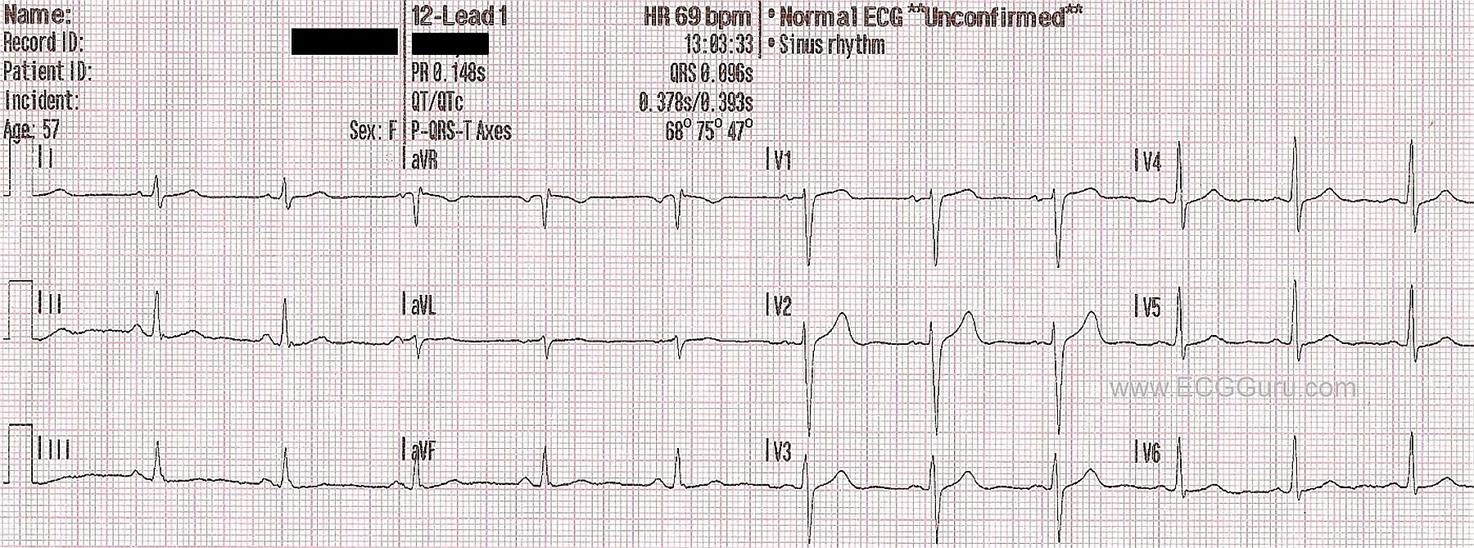
Walkthrough on an EKG
Normal sinus rhythm. heart rate 76
No ST elevation or depression.
No T-wave inversion.
Normal R Wave progression
No Idioventricular block
No ectopy.
QTc interval 0.393
QRS axis 75

Slide 28
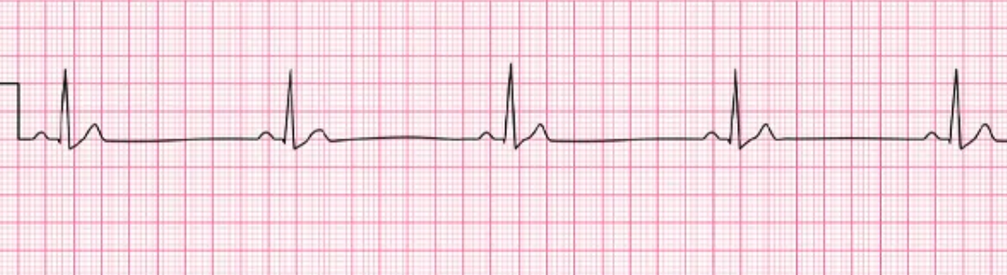
Normal Sinus 1 P-wave for every QRS wave

Slide 29
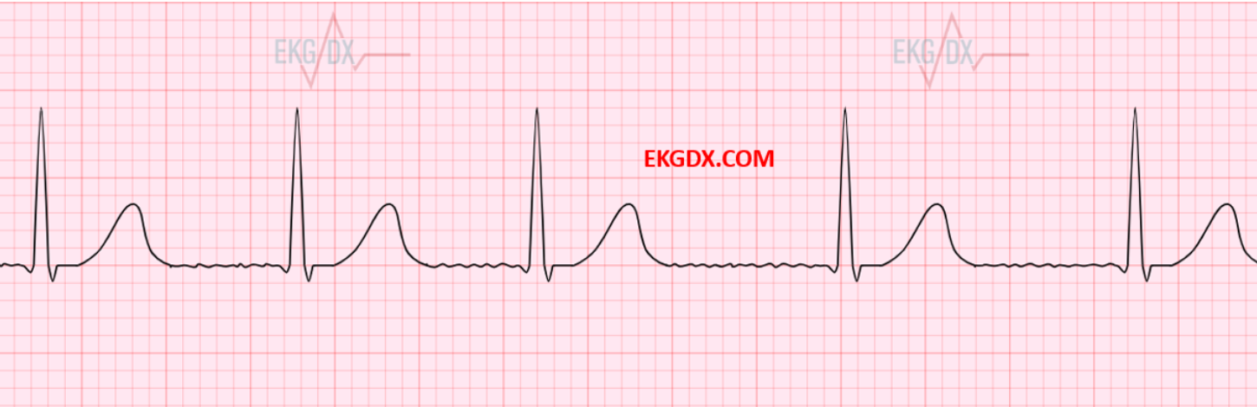
A-fib
No p waves

Slide 30
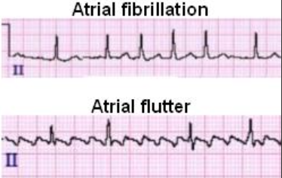

Slide 31
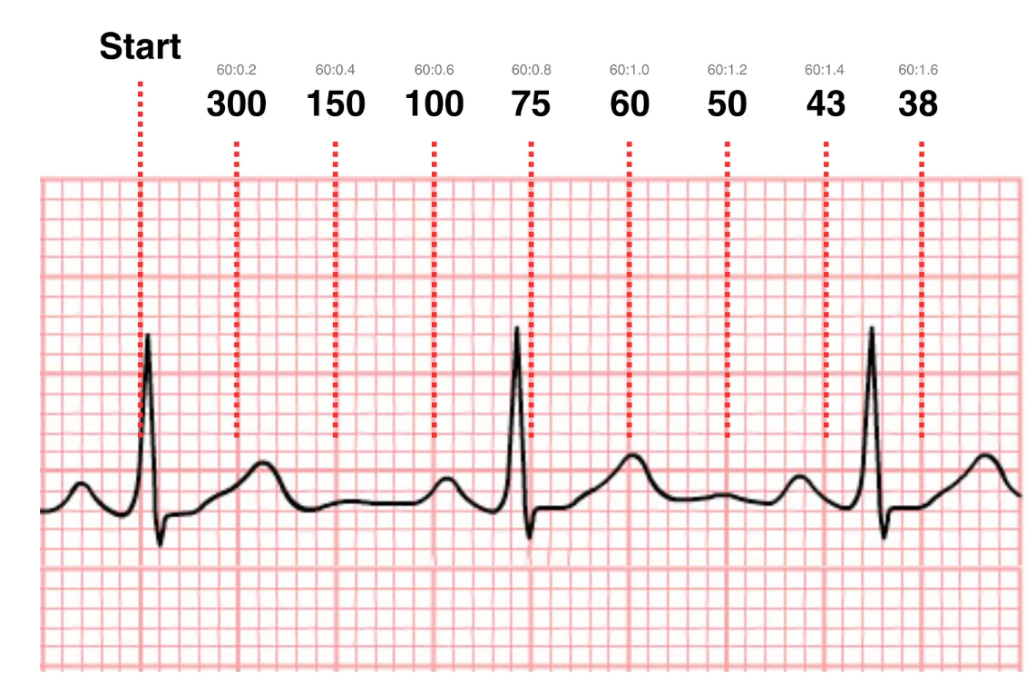
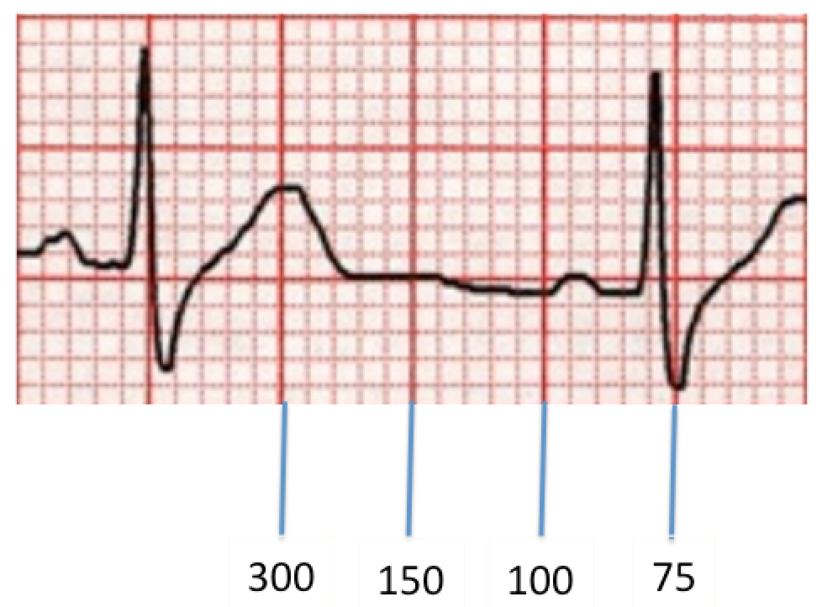
Establishes Tachycardia and Bradycardia
Heart rate is calculated for you. No need to use boxes, but here they are just in case:

Slide 32
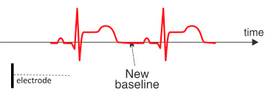

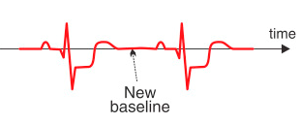
Potential Myocardial Infarctions
ST Elevation
ST Depression

Slide 33
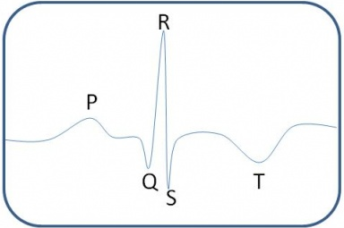
T Wave Inversion
MI
Pericarditis (Diffuse)

Slide 34
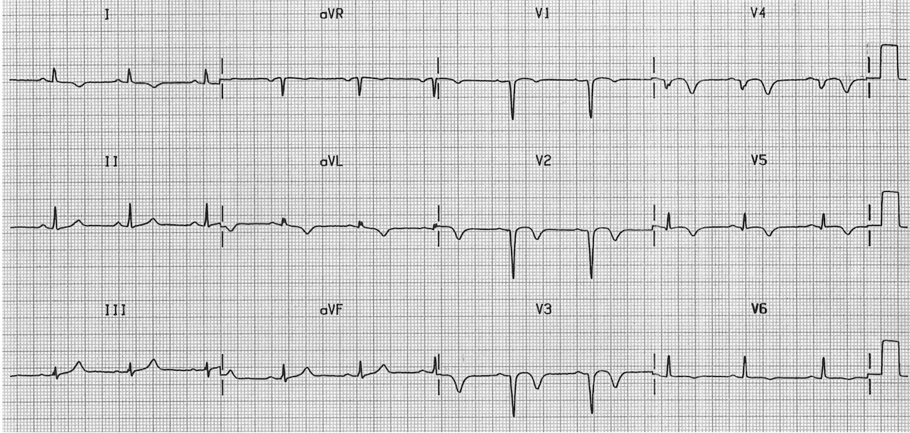
Poor R Wave Progression
? Anterior MI

Slide 35
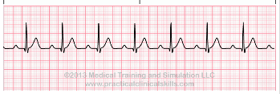
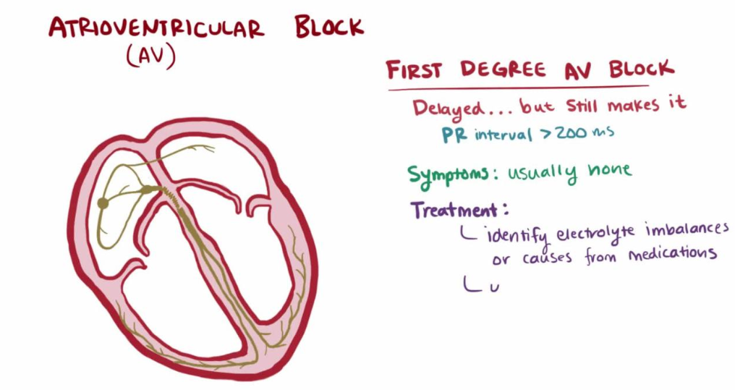
First Degree Block
AV Conduction Delay

Slide 36
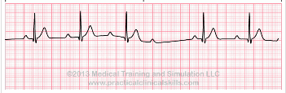
Second Degree Block (type 1 Mobitz-wenckebach)
PR Interval gradually increasing until a beat is dropped
(Winky, Winky, Winky-Back!)

Slide 37
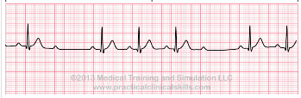
Second Degree Block ii
PR interval is the same, but occasionally blocked

Slide 38
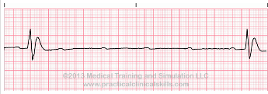
Third Degree Block
Oh Crap!

Slide 39
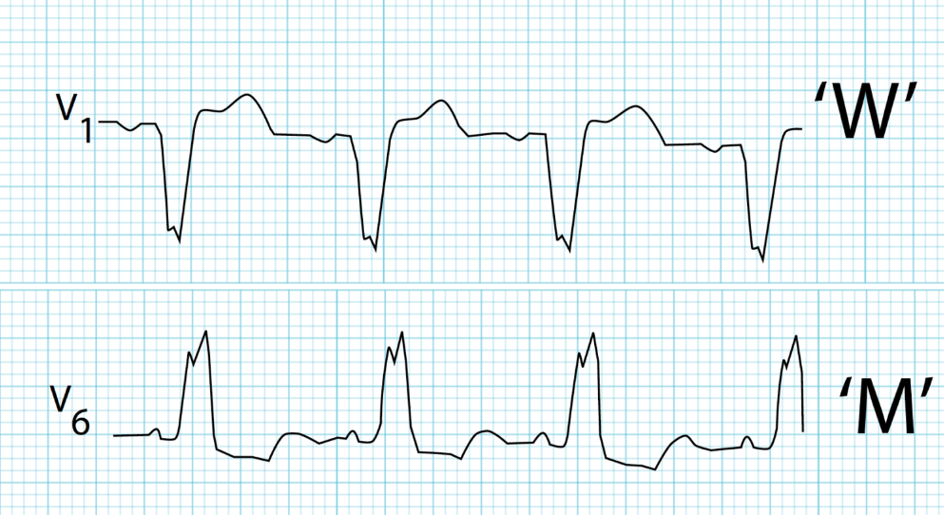
Bundle Branch Block conduction block left or right bundle branch is blocked
LBBB

Slide 40
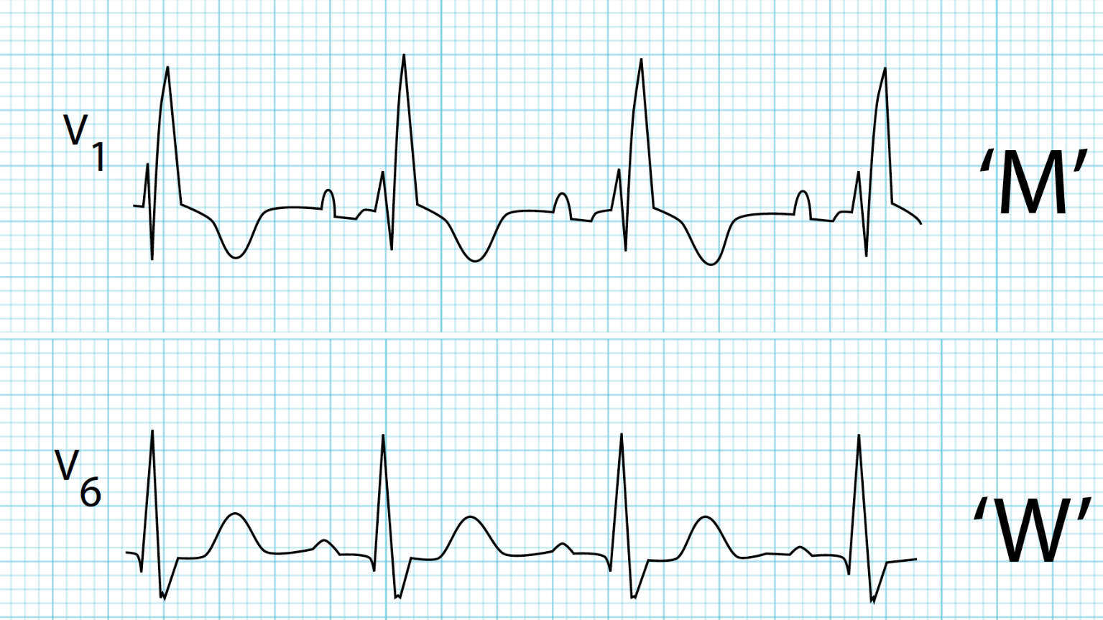
RBBB

Slide 41
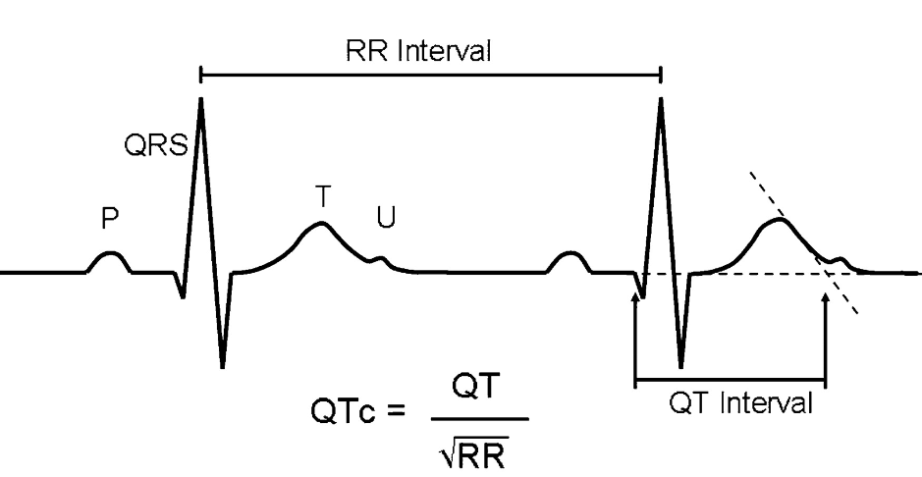
QTc Interval
Long QTc greater than or equal to 500

Slide 42
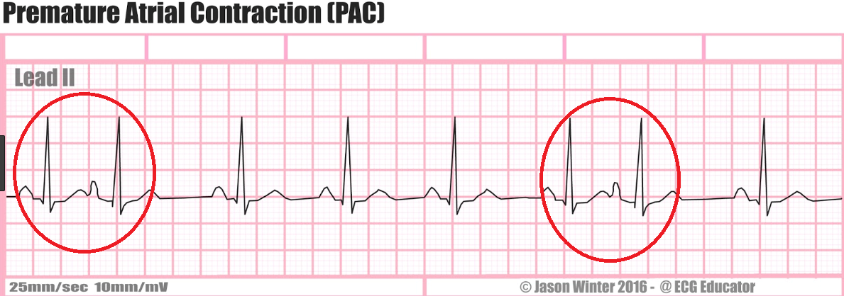
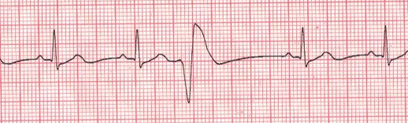
Ectopy
Premature atrial contractions (PAC)
Premature ventricular contractions (PVC)

Slide 43
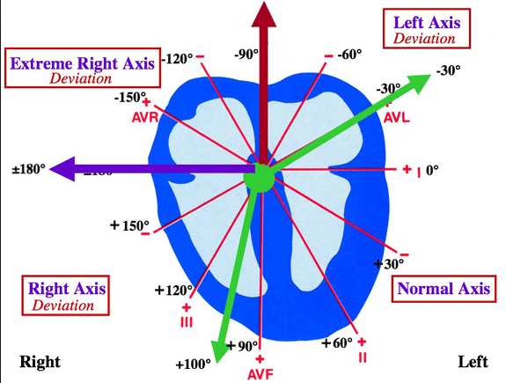
Qrs axis

Slide 44
Let’s Look Again!

Slide 45
Sinus?

Slide 46
Heart Rate?

Slide 47
ST Changes?

Slide 48
T wave inversion

Slide 49
R-Wave
Progression

Slide 50
Blocks?

Slide 51
Ectopy?

Slide 52
QTC Interval?

Slide 53
Axis? (+75)

Slide 54
Normal sinus rhythm.
Heart rate 69
No ST elevation or depression.
No T-wave inversion.
Normal R Wave progression
No Idioventricular block
No ectopy.
QTc interval 0.393
QRS axis 75

Slide 55
Back To Mr. Grumpy Pants

Slide 56
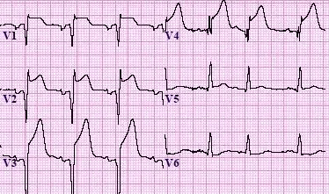

Slide 57
Results
EKG
  Normal Sinus
  ST Elevation (No Depression)
  No T Wave inversion
  No Ectopy
Troponin 68.00

Slide 58



CHF
Case # 2 A
Same Guy…
Swollen Legs

Slide 59
CHF
Heart failure = the heart cannot pump enough blood to meet the body’s needs
  Systolic dysfunction (HFrEF): impaired contraction, reduced EF
    Diastolic dysfunction (HFpEF): impaired relaxation/filling, preserved EF
Leads to fluid buildup in lungs and peripheral tissues
Common causes:
  Coronary artery disease / prior MI
  Hypertension
  Cardiomyopathy (ischemic, toxic, infectious)
  Valvular disease
Symptoms:
  Dyspnea, positional dyspnea
  Fatigue, exercise intolerance
  Edema, weight gain, abdominal distention

Slide 60



Workup for Suspected CHF
History & Physical
  Orthopnea, weight gain, edema
  JVD, crackles, S3, peripheral edema
Vital signs + O₂ saturation
Labs
  BNP or NT-proBNP
  CMP (kidney function, electrolytes)
  CBC
  Troponin (rule out ACS)
Imaging
  Chest X-ray: pulmonary edema, cardiomegaly, pleural effusions
  Echocardiogram: EF, wall motion, valvular status
ECG
  Ischemia, arrhythmias, prior MI, LVH
Consider
  Point-of-care ultrasound: B-lines, Inferior Vena Cava
  Cardiac stress testing or angiography

Slide 61
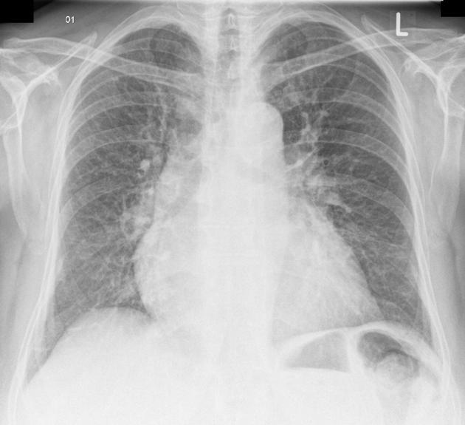

Slide 62
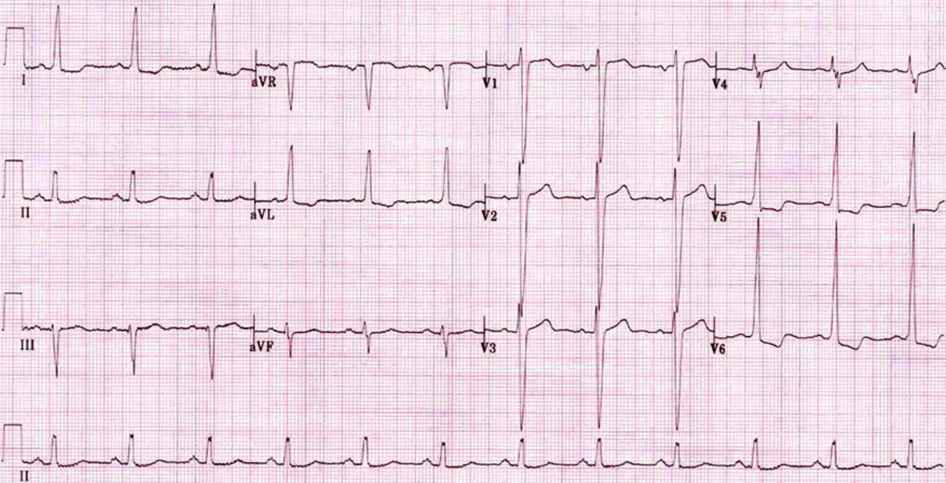

Slide 63



Treatment Options
Acute Decompensated CHF
Oxygen
Diuretics (e.g., IV furosemide)
Nitrates (if hypertensive or ischemic)
Chronic HF Management
ACE inhibitor / ARB / ARNI
Beta-blocker (metoprolol succinate, carvedilol, bisoprolol)
Diuretics
Low-sodium diet; daily weights
Smoking cessation
Fluid restriction
Cardiology or HF clinic when needed

Slide 64
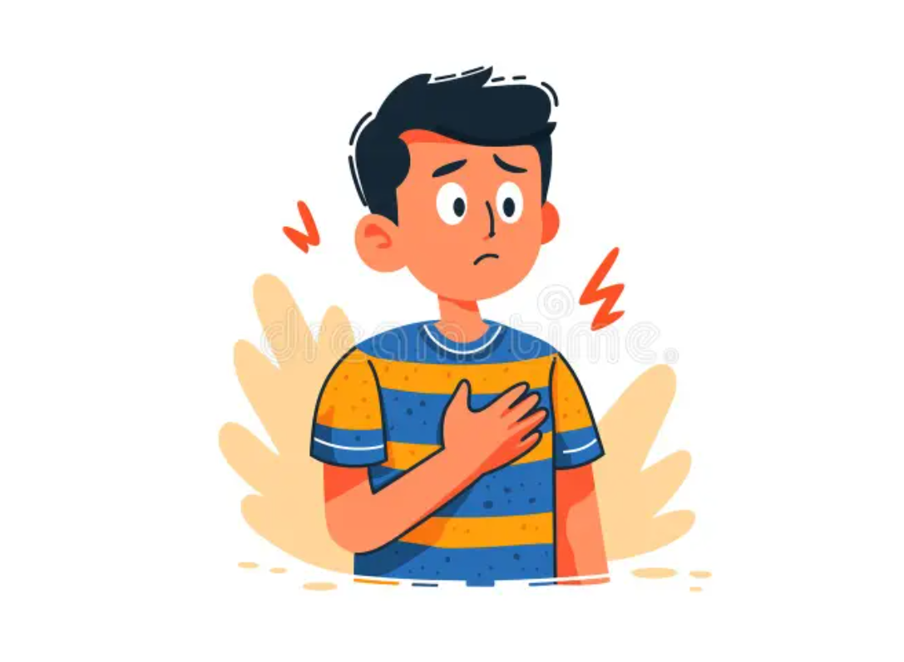
Case #4

Slide 65
Chest Wall Contusion
Chest pain after injury
  Rib contusion
  Intercostal contusion
  Rib fracture
    Chest x-ray
    CT Scan
  Pneumothorax
    Chest x-ray
    CT Scan

Slide 66

Case #5

Slide 67
Pneumothorax v tension pneumothorax
Condition | Definition
Pneumothorax | Presence of air in the pleural space causing partial or complete lung collapse.
Tension Pneumothorax | Life-threatening form where intrapleural pressure exceeds atmospheric pressure → mediastinal shift, decreased venous return, and cardiovascular collapse.

Slide 68
Types of Pneumothorax:
Spontaneous:
  Primary: No underlying lung disease (often tall, thin young men).
  Secondary: Occurs in patients with underlying lung disease (e.g., COPD, cystic fibrosis).
Traumatic: Penetrating or blunt chest injury.
Iatrogenic: From medical procedures (e.g., central line placement, mechanical ventilation).

Slide 69


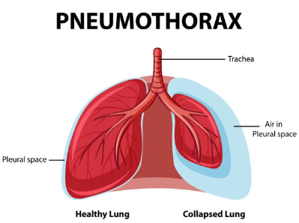

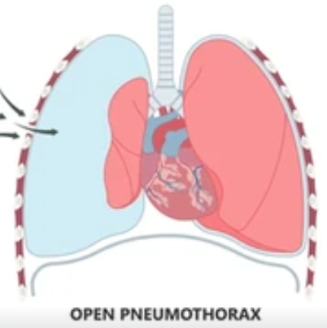
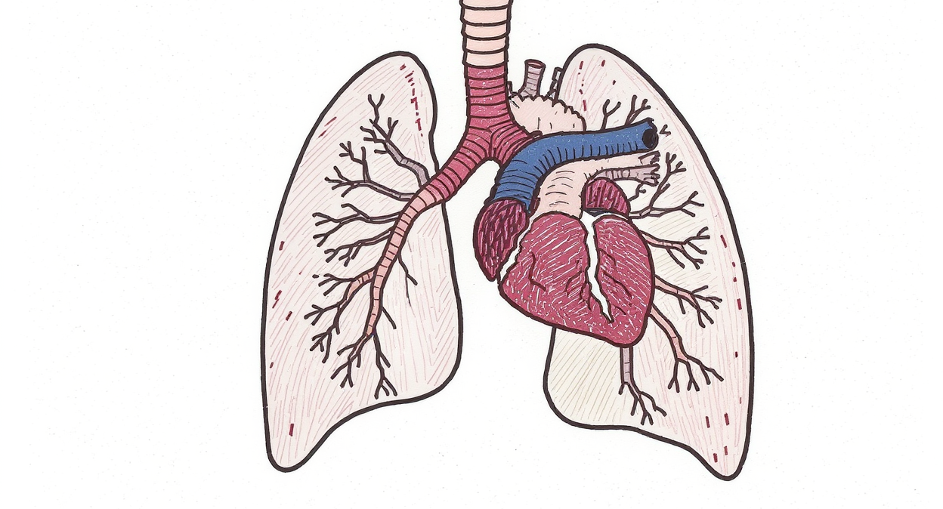

Pathophysiology of Pneumothorax
Loss of Negative Pressure
Air enters the pleural space, causing loss of negative pressure and resulting in lung collapse.
Tension Pneumothorax Mechanism
A one-way valve effect traps air with each breath, increasing intrathoracic pressure.
Physiological Consequences
Compression of the opposite lung, shift of mediastinum, and obstruction of venous return lead to decreased cardiac output and hypotension.

Slide 70

Risk Factors for Pneumothorax
25%
30%
40%
60%
Smoking prevalence
Trauma/chest procedures
COPD, asthma, cystic fibrosis
Tall, thin body habitus cases

Slide 71
Comparison History
Finding | Simple Pneumothorax | Tension Pneumothorax
Onset | Sudden, sharp pleuritic chest pain | Sudden, severe distress, often after trauma or ventilation
Dyspnea | Mild to moderate | Severe, progressive
Cough | Non-productive | May be absent
Anxiety / Agitation | Common | Prominent (impending doom)
Cardiorespiratory compromise | Minimal to moderate | Profound — hypotension, cyanosis, collapse

Slide 72
Comparison Exam
Finding | Simple Pneumothorax | Tension Pneumothorax
Inspection | Unilateral chest expansion ↓ | Distended neck veins (JVD), tracheal deviation away from affected side
Palpation | ↓ Tactile fremitus | Same + subcutaneous emphysema possible
Percussion | Hyperresonance over affected side | Marked hyperresonance
Auscultation | Absent / diminished breath sounds | Absent breath sounds, muffled heart sounds
Vital signs | Mild tachycardia | Tachycardia, hypotension, hypoxia
Late signs | Mild hypoxia | Obstructive shock: cyanosis, pulseless electrical activity (PEA) arrest

Slide 73
Diagnostic Evaluation
Chest X-ray (CXR):
  Simple PTX: Visible visceral pleural line with absent lung markings peripheral to it.
  Tension PTX: Mediastinal shift away from affected side, depressed diaphragm, widened intercostal spaces.
Bedside Ultrasound (FAST or POCUS):
  “Absent lung sliding” or “barcode/stratosphere sign” on M-mode.
  Quick and sensitive in trauma setting.
CT Chest: Most sensitive, used for small or complex pneumothoraces.
Do NOT delay treatment for tension pneumothorax to obtain imaging.

Slide 74
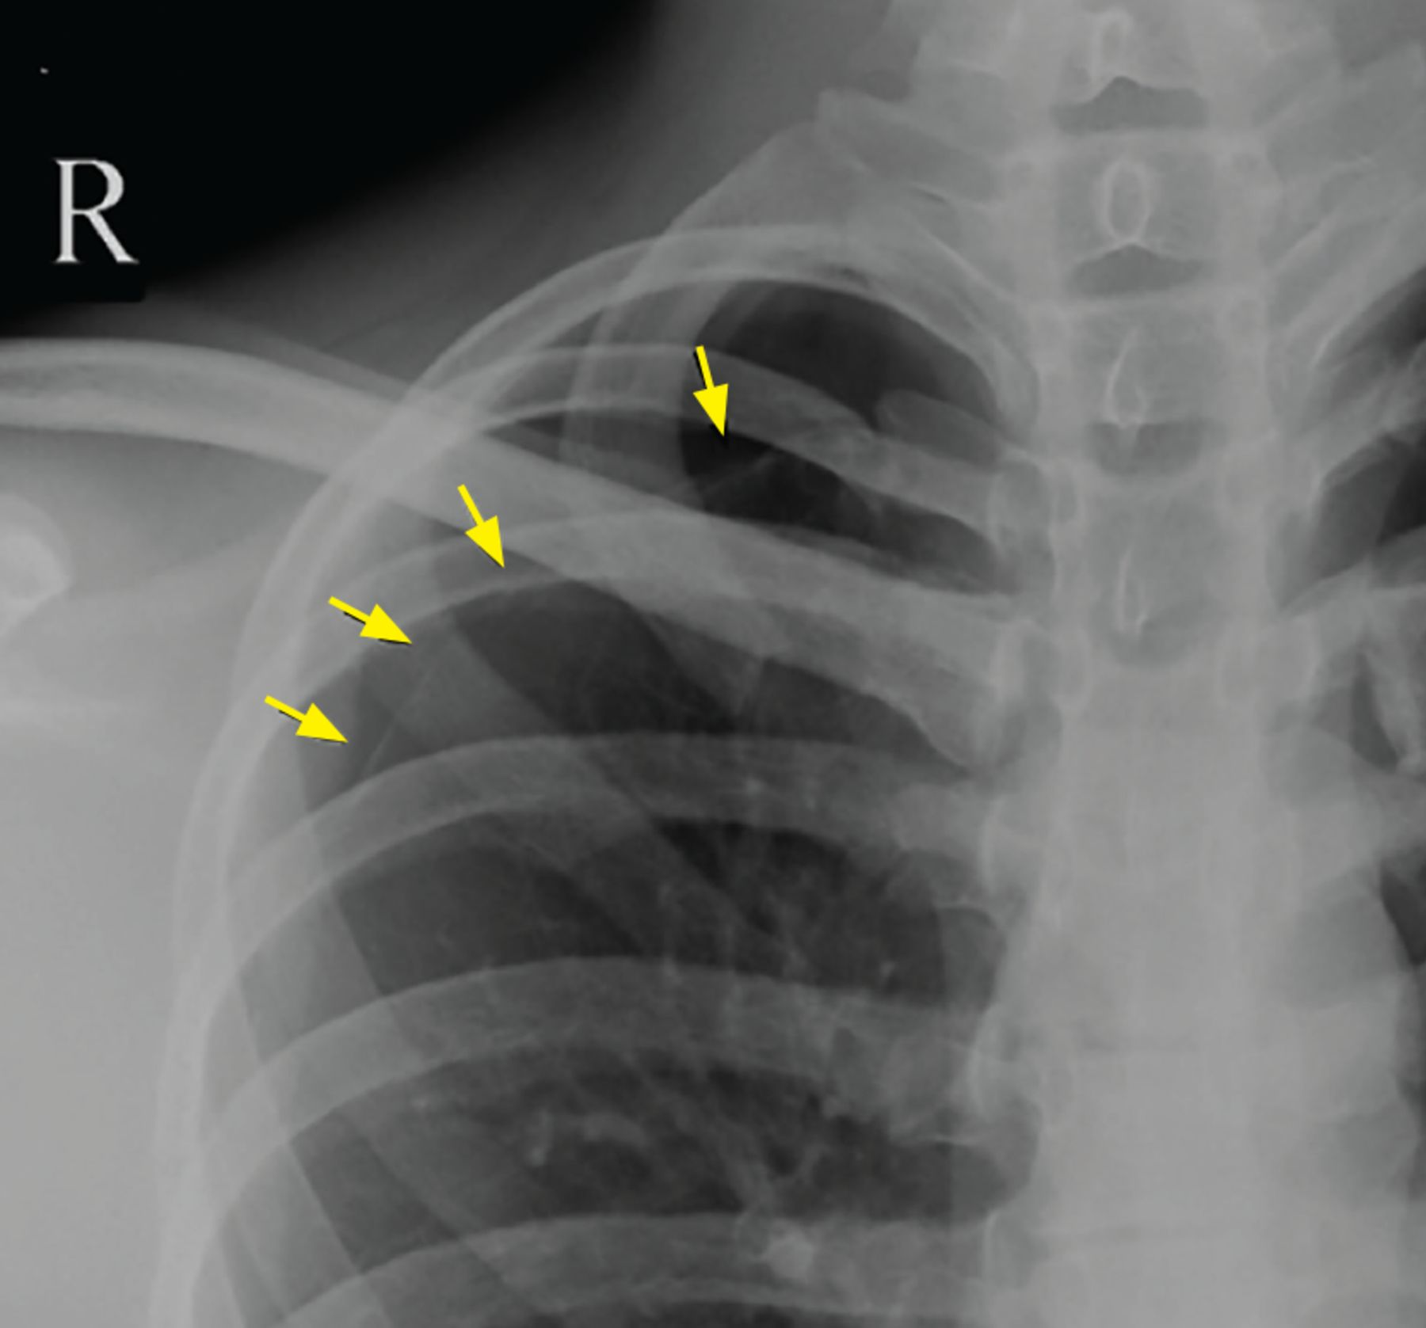

Slide 75
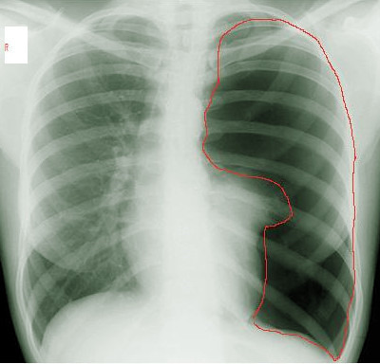

Slide 76
Timeline of Pneumothorax Management Steps
Small Pneumothorax: Observe
Larger/Symptomatic: Intervene
Tension Pneumothorax Emergency
Prevent Recurrence
If <2 cm and asymptomatic:
Observation
Repeat CXR in 4–6 hours.
Needle aspiration or chest tube
Admit
Decompression
Do not wait for imaging!
Needle decompression (large-bore needle 2nd or 5th intercostal space
Followed by chest tube placement
Smoking cessation
Until Follow up: Avoid
  Areobic activity
  Air travel
  Diving

Slide 77
Pleurisy - Costochondritis
Feature | Pleurisy | Costochondritis
Pain reproducible on palpation? | ❌ No | ✅ Yes
Pain worsens with breathing/cough? | ✅ Yes | ✅ (sometimes) but usually with movement
Fever or systemic signs? | ✅ Possible | ❌ Absent
Auscultation finding? | Pleural friction rub possible | Normal
Underlying pathology? | Pulmonary or pleural disease | Musculoskeletal inflammation only

Slide 78
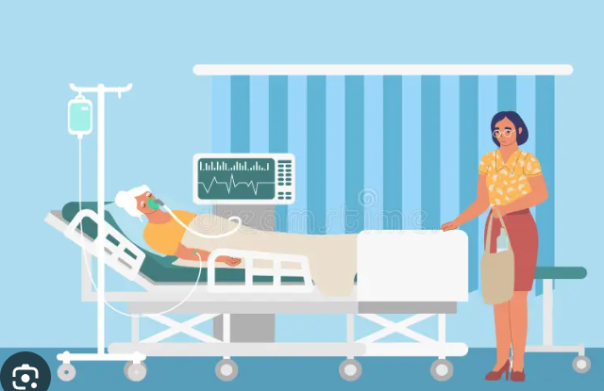
Case #6

Slide 79



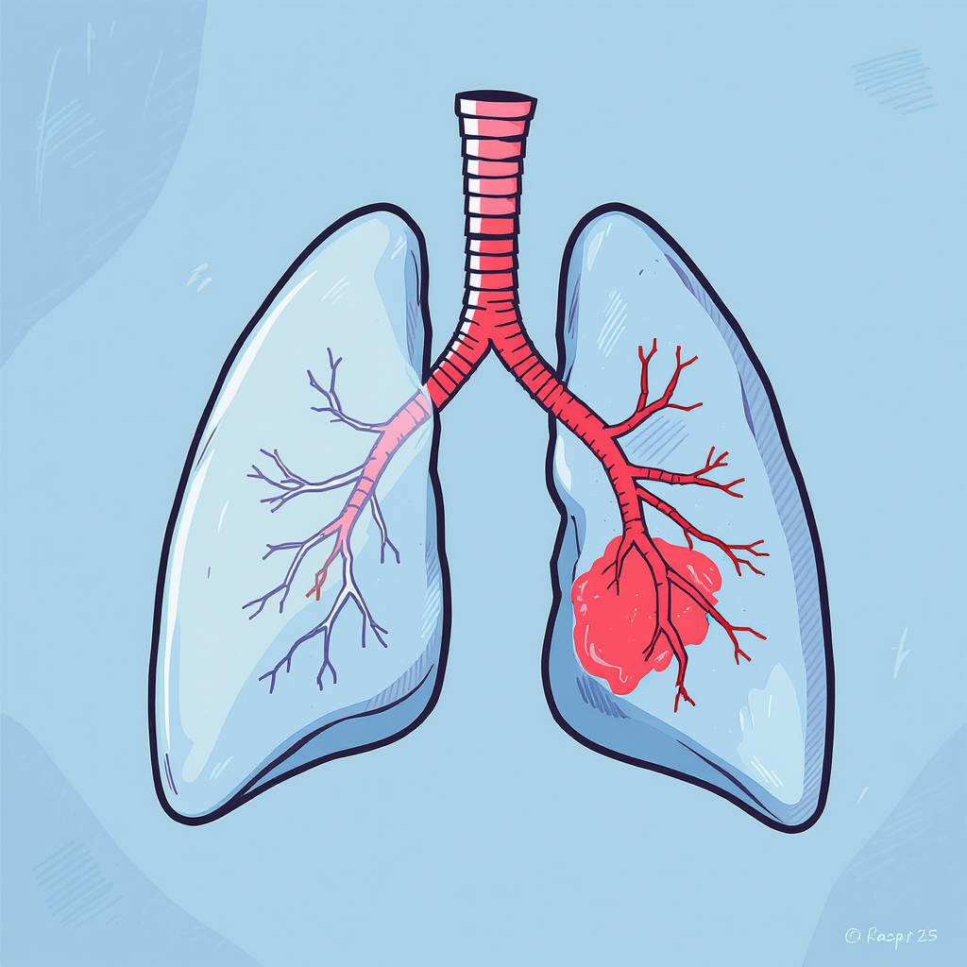
Pulmonary Embolism (PE):
Key Points About Pulmonary Embolism (PE)
Pulmonary Embolism (PE): Obstruction of the pulmonary artery or its branches by a thrombus, fat, air, or amniotic fluid (most commonly a thrombus from deep vein thrombosis).
Causes impaired gas exchange, increased pulmonary vascular resistance, and potential right heart strain or failure.

Slide 80
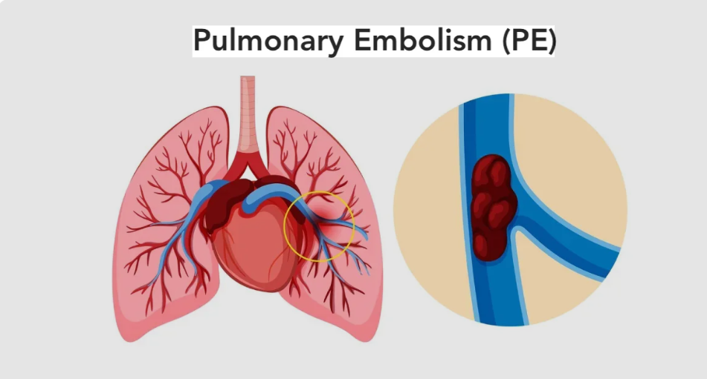

Slide 81
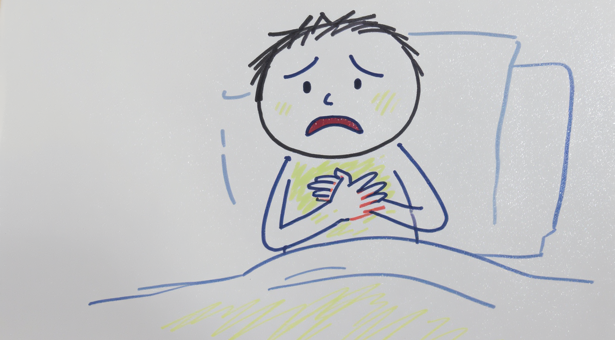
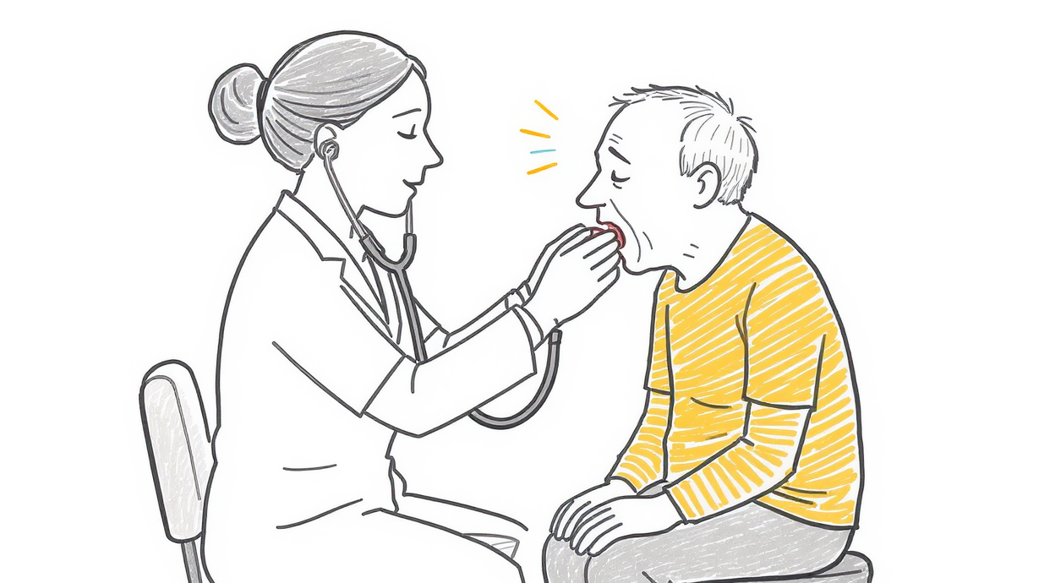
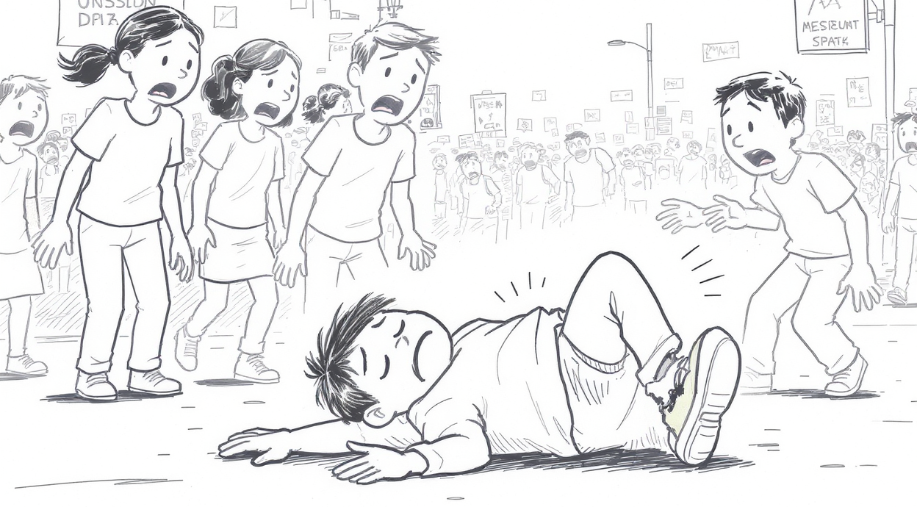



Classic Symptoms of Pulmonary Embolism
Dyspnea & Chest Pain
Cough, Tachypnea & Tachycardia
Severe Presentations
Most common symptom
Sharp Chest Pain, worsens with inspiration or coughing
Cough, sometimes with hemoptysis, and rapid breathing and heart rate are frequent objective signs.
Syncope or hypotension with right heart strain.
Sudden
Mild discomfort to cardiac arrest.

Slide 82
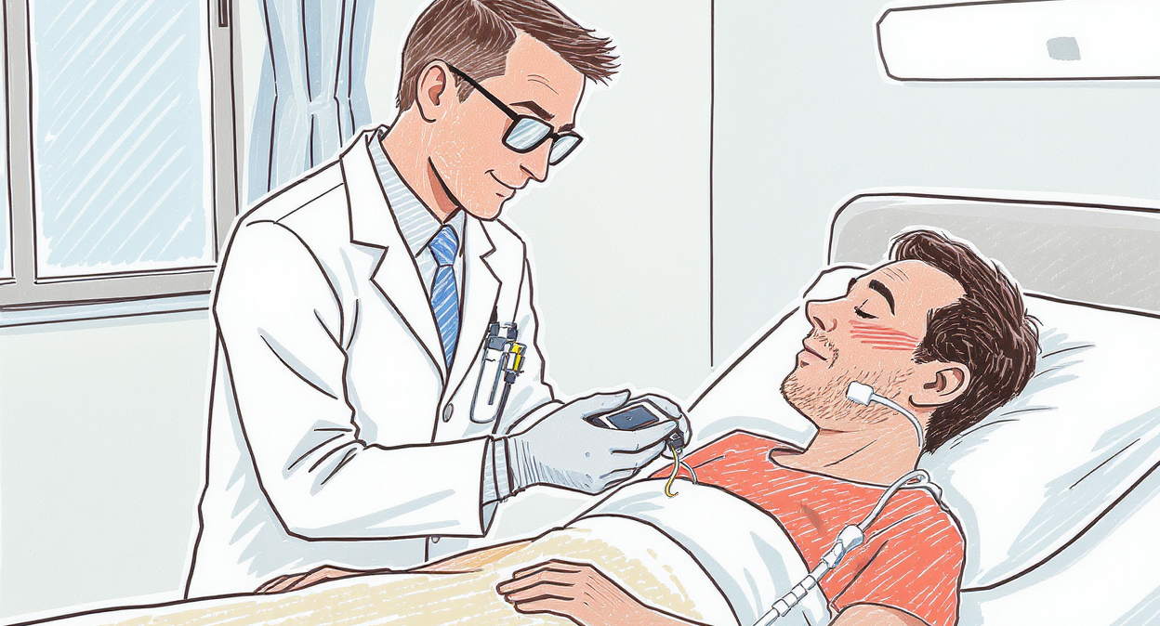
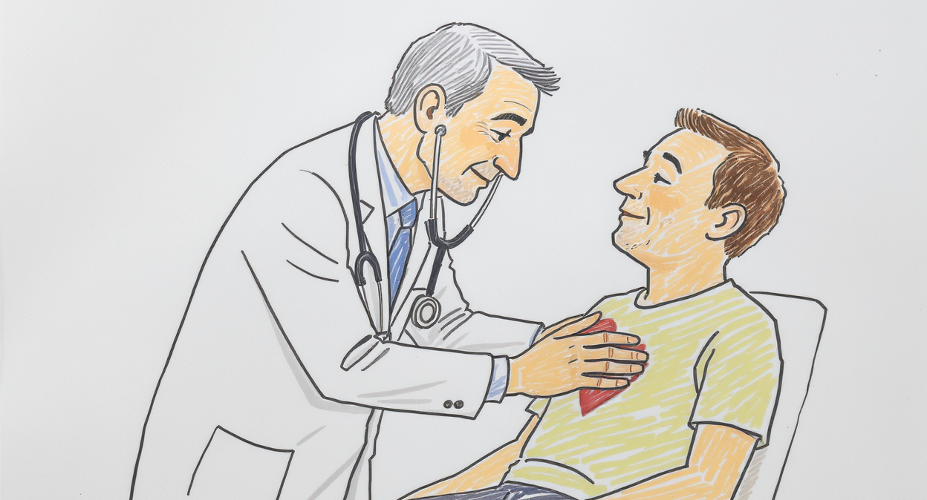
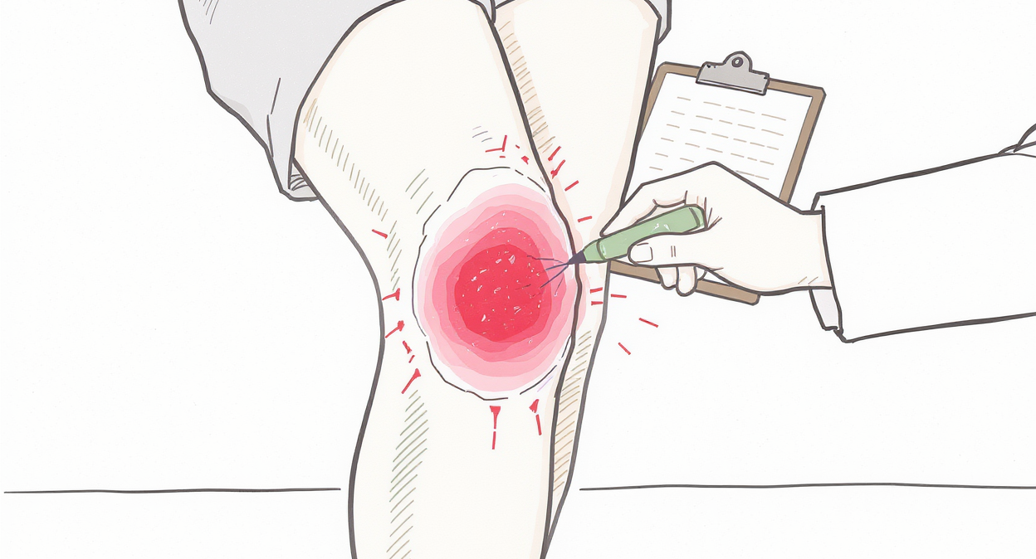
Physical Exam Findings
Vital Signs
Tachycardia, tachypnea, hypoxia (low SpO₂), and possible low-grade fever are important clues.
Cardiac and Respiratory
Loud S2, jugular venous distention, clear lungs, mild crackles, pleural (Could also be normal)
Extremities and Skin
Signs of DVT

Slide 83
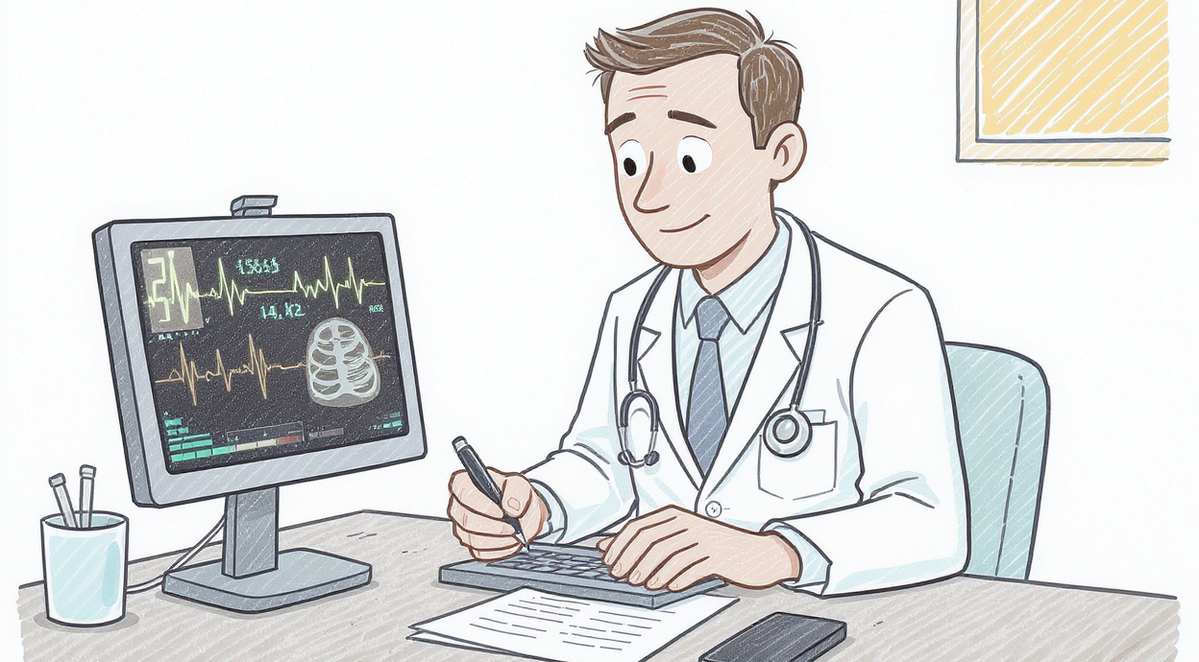
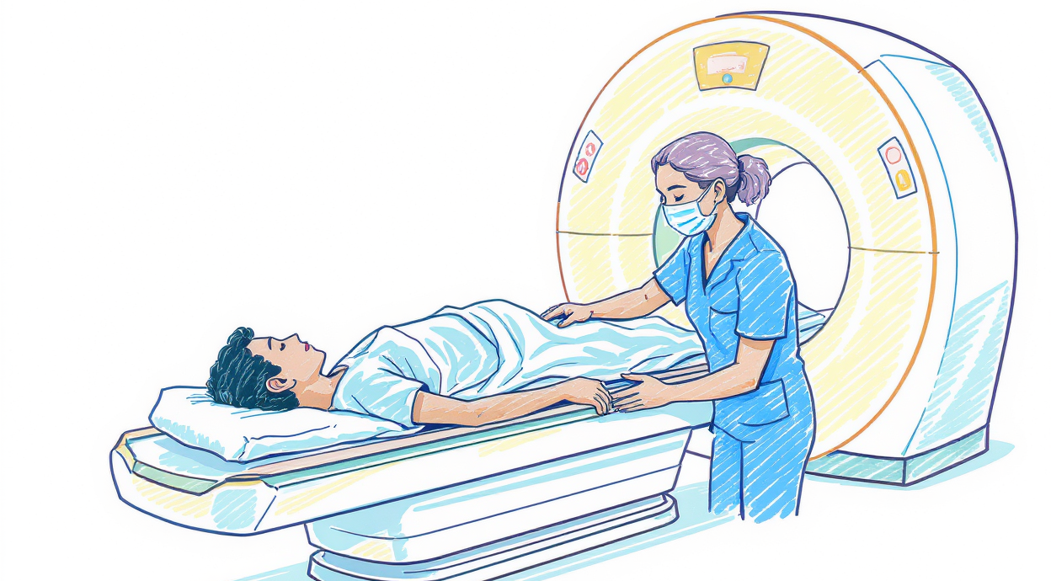
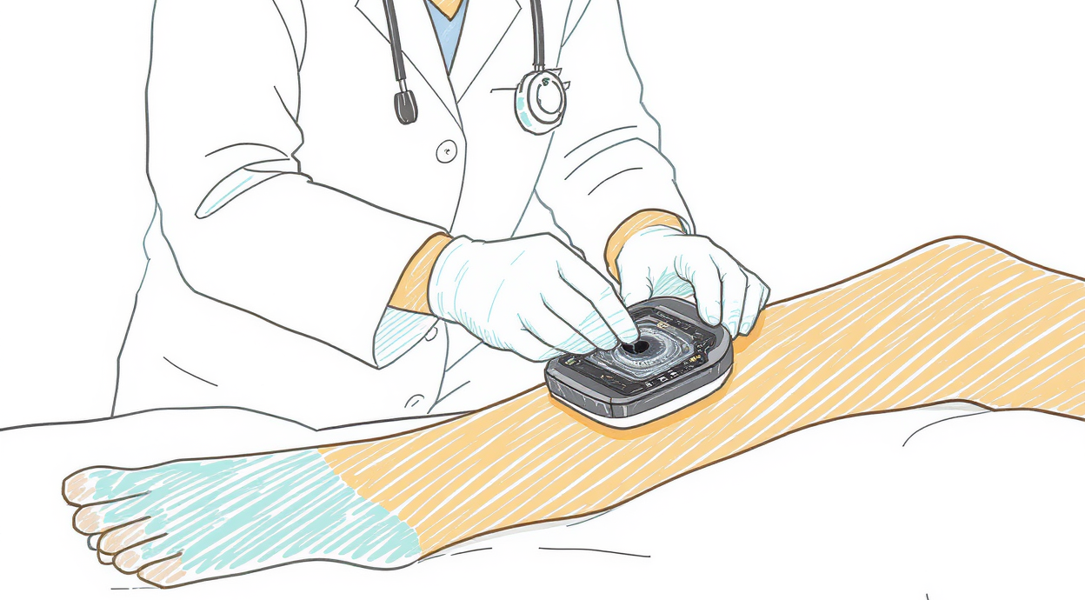
Diagnostic Evaluation
Initial Tests
Definitive Imaging
Bedside and Additional Tests
ECG (Sinus tachycardia)
Chest X-ray: (Often normal)
ABG (Low O2 or CO2,
D-dimer. Non-specific
CT Pulmonary Angiography (CTPA) is the gold standard for diagnosis.
V/Q scan (cannot receive contrast)
Ventilation perfusion mismatch.
Bedside echocardiogram (right ventricular dilation or strain in massive PE.
Lower extremity ultrasound for DVT

Slide 84
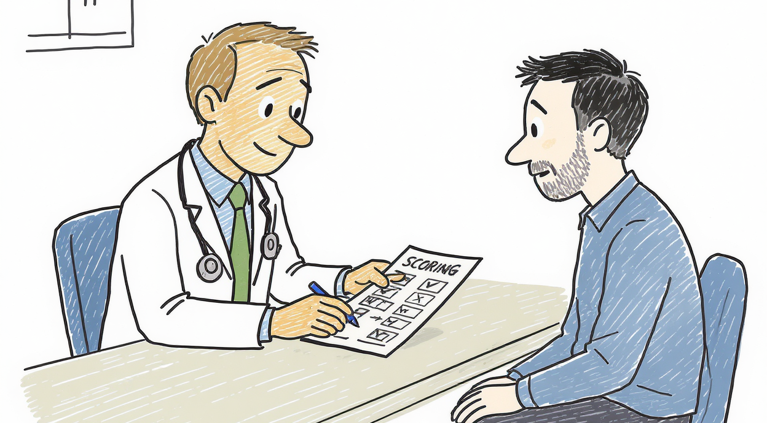


Risk Stratification Tools
Wells Score or Revised Geneva Score
PERC Rule (Pulmonary Embolism Rule-out Criteria)
sPESI (Simplified Pulmonary Embolism Severity Index)
Estimate pretest probability for pulmonary embolism to guide further testing and management.
Used to exclude pulmonary embolism in low-risk patients, reducing unnecessary testing.
Guides need for hospitalization by assessing severity of pulmonary embolism.

Slide 85
Virchow’s Triad:
  Venous stasis: Prolonged immobility, surgery, long travel, heart failure.
  Endothelial injury: Trauma, recent surgery, central lines.
  Hypercoagulability: Cancer, pregnancy, oral contraceptives, genetic thrombophilia (Factor V Leiden).
  Additional risks: Obesity, smoking, prior VTE, advanced age, hormone therapy.

Slide 86
Wells Criteria
Criterion | Points
Clinical signs of DVT | 3.0
PE more likely than alternative diagnosis | 3.0
Heart rate > 100 bpm | 1.5
Immobilization ≥3 days or surgery in last 4 weeks | 1.5
Previous DVT or PE | 1.5
Hemoptysis | 1.0
Active cancer (treatment ongoing, within 6 months, or palliative) | 1.0
PE unlikely (<4): Order D-dimer.
PE likely (≥4): Proceed directly to CT pulmonary angiography (CTPA).

Slide 87
PERC Rule
PERC Variables | Negative Threshold
Age < 50 years | ✅
Heart rate < 100 bpm | ✅
SpO₂ ≥ 95% (room air) | ✅
No hemoptysis | ✅
No estrogen use | ✅
No prior DVT or PE | ✅
No unilateral leg swelling | ✅
No recent surgery or trauma (within 4 weeks) | ✅

Slide 88
Management of Acute Pulmonary Embolism (PE)
Treatment
Initial Stabilization and Anticoagulation
Advanced Therapies and Monitoring
Oxygen
  SpO₂ > 94%.
IV access and cardiac monitoring
  Treat hypotension with IV fluids (cautiously) or vasopressors (norepinephrine)
  Anticoagulation
    Heparin
    LMWH
    Apixaban
    Rivaroxaban
Thrombolytic therapy (Alteplase) for massive
Catheter-directed thrombolysis
Surgical embolectomy or catheter thrombectomy
IVC filter only if anticoagulation is contraindicated.

Slide 89

Case #7

Slide 90



Aortic Dissection
Aortic Dissection: A tear in the intimal layer of the aorta allows blood to enter the vessel wall, creating a false lumen. This leads to separation of layers and can result in rupture or end-organ ischemia.
Classification: Stanford Type A involves the ascending aorta and is considered a surgical emergency. Stanford Type B involves the descending aorta and is often managed medically.
Pathology

Slide 91


Slide 92
Lower Blood Pressure!

Slide 93
Key Physical Exam Findings in Acute Aortic Syndromes
Vital Signs and Hemodynamic Instability
Cardiac and Peripheral Exam Findings

Slide 94
Classic Symptoms

Slide 95


Diagnostic Evaluation
Workup
Initial Assessment Tools
Definitive Imaging and Labs
ECG is often normal or nonspecific but helps rule out MI. Chest X-ray may show widened mediastinum or abnormal aortic contour.
CT Angiography is the gold standard. TEE for unstable
MRI Angiography is an option for stable patients
Labs may show elevated D-dimer

Slide 96

Aortic dissection with marked pleural effusion (blue arrow), left upper mediastinal mass (yellow arrow), and tracheal deviation (orange arrow)^{[5]}

Slide 97

EMT/Medic

Slide 98

Case #8

Slide 99



Pneumonia: Overview and Key Facts
Definition and Pathophysiology
Classification by Source and Setting
Common Pathogens
Pneumonia
Infection/inflammation of the alveoli/interstitial tissue
Alveolar fluid or pus
Impaired gas exchange
Types
Community-Acquired (CAP),
Hospital-Acquired (HAP),
Ventilator-Associated (VAP)
Aspiration Pneumonia
Streptococcus pneumoniae (most common CAP)
Haemophilus influenzae,
Mycoplasma pneumoniae
Staphylococcus aureus
Viral

Slide 100

Risk Factors for Increased Vulnerability
Key Risk Factors
Very young
Very Old
Very Strange
  Be Very Careful
Chronic illness
  COPD
  Asthma
  Diabetes
  Heart failure increase risk
  Immuno-compromise
  Smoking
  Alcohol use
  Poor nutrition

Slide 101



Classic Symptoms of Pneumonia
Fever, Chills, and Cough
Fever and chills are often the first signs, followed by a productive cough that may be purulent, rusty, or blood-streaked.
Breathing Difficulties and Chest Pain
Symptoms include dyspnea or shortness of breath, and pleuritic chest pain that worsens with inspiration or coughing.
Atypical Signs in Older Adults
Older adults may only show confusion, delirium, or functional decline instead of typical symptoms.

Slide 102
Physical Exam Findings
Finding | Physiologic Explanation
Fever | Systemic inflammatory response
Decreased chest expansion | Consolidation limits lung movement
Dullness to percussion | Alveoli filled with fluid or pus
Crackles (rales) | Air moving through fluid-filled alveoli
Egophony (“E to A” change) | Voice sounds transmitted abnormally through consolidation
Increased tactile fremitus | Dense lung transmits vibration better

Slide 103

Diagnostic Evaluation Process
Chest X-ray
Pulse Oximetry
CBC (Complete Blood Count)
COVID-19 / Influenza Testing/RSV
Gold Standard
Pulse oximetry trend chart
Bacterial (leukocytosis) Viral (lymphocytosis)
‘Nuff said

Slide 104


Slide 105


Slide 106



Complications
Sepsis / Septic Shock
Sepsis and septic shock are life-threatening complications that require immediate intervention to prevent organ failure.
Respiratory Failure / ARDS
Respiratory failure or Acute Respiratory Distress Syndrome (ARDS) can result in the need for mechanical ventilation and prolonged ICU stay.
Pericarditis or Endocarditis
Rarely, infection can spread hematogenously to the heart, causing pericarditis (outside sac) or endocarditis (inside sac).

Slide 107


Initial Management (Outpatient)
Management
Stabilize Oxygenation
Empiric Antibiotic Therapy
Assess oxygenation; give O₂ if SpO₂ < 94%. Early stabilization reduces complications.
Amoxicillin
Augmentin
Doxycycline
Macrolide (Z-Pack)
Fluoroquinolone (Levofloxacin)

Slide 108

Supportive Care
Hydration
Fever control (acetaminophen/NSAIDs)
Rest.

Slide 109


Pericarditis vs. Myocarditis
Clinical Review
Pericarditis Features
Myocarditis Features
Positional and pleuritic pain, diffuse ST elevation, and friction rub are key signs. Look for ECG changes and listen for pericardial friction rub.
Chest pain, elevated troponin, and ventricular dysfunction (often mimics MI). Both conditions may overlap as myopericarditis.

Slide 110
Pericarditis/Myocarditis
Feature | Pericarditis | Myocarditis
Definition | Inflammation of the pericardial sac (outer lining of heart) | Inflammation of the myocardial muscle layer
Typical Etiology | Viral (coxsackievirus, echovirus), post-MI (Dressler’s), autoimmune, uremia | Viral (coxsackievirus, adenovirus, influenza, COVID-19), autoimmune, drug/toxin-related
Pathophysiology | Friction between inflamed pericardial layers | Myocyte injury → impaired contractility, arrhythmia risk

Slide 111


We care Bear
Domino’s “The Noid”

Slide 112

Case #9

Slide 113

Shingles

Slide 114

Case #10

Slide 115
Psychiatric Causes of Chest Pain
Diagnosis
Psychological chest pain (also known as non-cardiac chest pain or functional chest pain) refers to chest discomfort not explained by structural heart, pulmonary, or gastrointestinal disease, but associated with psychological or emotional factors
Often presents in anxiety disorders, panic attacks, depression, or somatic symptom disorder.
Accounts for up to 20–30% of chest pain presentations to primary care or the ED after life-threatening causes are excluded.
Emphasizing mental health evaluation is important when no physical cause for chest pain is found.

Slide 116
Features
Feature | Typical Description
Pain character | Tightness, heaviness, or stabbing pain; may feel like “can’t catch my breath”
Location | Diffuse or central; often changes location or pattern
Duration | Variable — seconds to hours; may wax and wane throughout the day
Triggers | Emotional stress, anxiety, hyperventilation, panic, or interpersonal conflict
Relieving factors | Relaxation, distraction, reassurance, breathing control
Associated symptoms | Palpitations, dizziness, tremor, sweating, shortness of breath, sense of doom, paresthesias, lightheadedness
Pattern | Often occurs at rest, not related to exertion; may persist despite normal cardiac evaluation

Slide 117
Findings in Psychiatric Chest Pain
Assessment
Physical exam findings are usually normal.
Insomina
Tachycardia, tachypnea, or mild tremor
Nausea - Vomiting
Numbness and tingling in extremities or lips
Chest wall tenderness may be present from muscle tension.
Negtive workup
Symptoms transient and resolve as anxiety or panic subsides

Slide 118
Management of Acute and Chronic Non-Cardiac Chest Pain
Management
Acute Episode (in clinic or ED)
Reassure and validate symptoms
  Pain is real but not life-threatening
  Blushing.
Breathing Exercise
  Blow out slowly to ten
  Benzodiazepine (e.g. Valium, lorazepam)
  Goal planning for recurring visits.

Slide 119
Management of Acute and Chronic Non-Cardiac Chest Pain
Management
Long-Term Management
Cognitive Behavioral Therapy (CBT)
SSRIs / SNRIs: For anxiety or depression underlying chronic symptoms
Stress management. Lifestyle modifications
Education:
  Reassure about benign nature
  Discuss the mind–body connection openly

Slide 120
Common Associated Conditions
Overview
Panic disorder / generalized anxiety disorder (GAD)
Depression
Fibromyalgia
POTS
Post-traumatic stress disorder (PTSD)
Health anxiety / hypochondriasis

Slide 121
GI
Feature | GERD | Cardiac (Angina / ACS)
Relation to meals | Worse after eating or lying down | Often triggered by exertion or stress
Relief | Improved with antacids or sitting upright | Improved with rest or nitroglycerin
Pain character | Burning, localized, non-radiating | Pressure or squeezing, may radiate to jaw/arm
Associated symptoms | Regurgitation, sour taste | Dyspnea, diaphoresis, nausea
Risk factors | Dietary, lifestyle, obesity | HTN, diabetes, dyslipidemia, smoking

Slide 122
Management
  Lifestyle Modifications (First-Line)
    Weight reduction if overweight.
    Stop Marijuana
    Elevate head of bed 6–8 inches.
    Avoid lying down within 2–3 hours after meals.
    Avoid trigger foods and beverages.
    Stop smoking, limit alcohol and caffeine.
    Small, frequent meals instead of large meals.
  Pharmacologic Therapy
    Antacids (immediate relief).
    H₂ receptor blockers (famotidine, ranitidine) — for mild or intermittent symptoms.
    Proton Pump Inhibitors (PPIs) (omeprazole, pantoprazole) — most effective for healing and maintenance.
    Prokinetic agents (metoclopramide) — if motility disorder present.
  Surgical / Endoscopic
    Nissen fundoplication or magnetic sphincter augmentation (LINX) for refractory or severe cases.

Slide 123
Chest Pain Differential Diagnosis
Cardiac causes
Acute Coronary Syndrome (ACS)
  Angina
  Aortic dissection
  Pericarditis
  Myocarditis
Pulmonary causes
  Pulmonary Embolism (PE)
  Pneumothorax/tension
  Pneumonia
  Bronchitis
  Pleurisy
GI
  Gastroesophageal reflux disease (GERD)
  Esophageal spasm
Musculoskeletal causes
  Chest wall pain/costochondritis
  Muscle strain
  Contusion, Rib Fracture
Other
  Psychiatric
  Shingles (herpes zoster) affecting the chest wall

Slide 124


Chest Pain Differential Diagnoses
Differential Diagnosis
Causes and Work-up
Aortic aneurysm
  Chest X-ray (CXR) and CT Scan for diagnosis.
  Pneumonia
    Chest X-ray, elevated white blood cell count (WBC), and CT scan if needed.
  Chest wall pain
    ? Chest X-ray to rule out other causes.
  Pulmonary embolism (PE)
    PERC, D-dimer test and CT

Slide 125
Chest Pain Differential Diagnoses
Differential Diagnosis
Cardiac and Other Diagnoses with Tests
Myocardial infarction (MI)
  Electrocardiogram (EKG) and serial troponin measurements for confirmation.
  Congestive heart failure (CHF)
    Chest X-ray and brain natriuretic peptide (BNP) levels.
  Syncope related causes
    ECG, cardiac biomarkers, and echocardiogram to assess heart function and rhythm.

Slide 126
Chest Pain Differential Diagnosis
Cardiac causes
  EKG
  Troponin
Aortic dissection
    CXR
  Pulmonary Embolism (PE)
    CXR
    D-Dimer
    CT
  Pneumothorax/tension
    CXR
  Pneumonia
    CXR
  Bronchitis
    CXR
GI
  Don’t care
Musculoskeletal causes
  CXR
Psychiatric
  Don’t Care
Shingles
  Look

Slide 127
Chest Pain Differential Diagnosis
[-Chest pain-] evaluation contains a wide differential diagnosis. [-D-dimer to screen for pulmonary embolism-]. Electrolytes for baseline assessment and to guide management if CT scan becomes necessary. CBC to assess for infection or anemia that may contribute to presentation. [-BNP to evaluate for congestive heart failure. -] Chest x-ray to evaluate for pneumonia, pulmonary edema, or signs of CHF.
EKG and troponin to evaluate for cardiac injury. [-Will consider serial studies for evolving cardiac injury.-]
[-Prophylactic aspirin and nitroglycerin considered. Nebulizer for possible reactive airway process. Lasix for possible CHF.-]

Slide 128

Baskin Robbins
And just as I begin to flirt
I find 31 flavors upon my shirt
Background

Slide 129

Case #10

Slide 130

Syncope Differential Diagnosis
Syncope
Cardiac
  1
Pulmonary
  1
Neurological
  1
Electrolytes
  1

Slide 131
Syncope Differential Diagnosis
Syncope
Cardiac Causes
Pulmonary Causes
Neurological Causes
Electrolytes
Vasovagal
Arrhythmias
Aortic Stenosis,
Cardio-myopathies
Structural Heart Disease
Orthostatic Hypotension.
Pulmonary Embolism (PE) and
Hyper-ventilation
Seizures
Transient Ischemic Attack (TIA) or Stroke
Psychogenic
Hypoglycemia
Hyponatremia
Hypokalemia or Hyperkalemia

Slide 132
Workup for Syncope
POC Glucose to assess for hypoglycemia and metabolic causes.
ECG to evaluate arrhythmias, ischemia, or heart block.
Cardiac biomarkers (e.g., troponin) to rule out myocardial infarction.
CBC and blood cultures to check for anemia or infection.
Chest X-ray and brain imaging (CT or MRI) to assess pulmonary and neurological causes.
Workup

Slide 133
Syncope Medical Decision Making
Syncope
Syncope Contains a wide differential diagnosis
There are[-no risk factors such as Abnormal EKG, history of cardiac disease/heart failure, Persistently low blood pressure, shortness of breath with event. No family history of sudden cardiac death-]
[-Will consider EKG and cardiac chemistry evaluation to evaluate for a cardiac component.-]
[-Will consider CT Scan to look for trauma or irregularity-]
No tongue injury or incontinence to suggest seizure
CBC to look for anemia or evidence of infection. Electrolytes to look for evidence of end organ damage or acidosis.
Will discuss Anxiety. Will check a TSH to look for an atypical cause of syncope.
Common but with less mortality can include a neurocardiogenic, carotid sinus sensitivity, orthostasis, and medication-related or substance abuse process.

Slide 134
Smarter-Chart.com

Slide 135


Stuff we Taled about Already!
Arrhythmias
Aortic Stenosis
Cardiomyopathies
Pulmonary Embolism (PE)

Slide 136

Stuff We haven’t talked about yet
Overview
Neuro
Psychogenic
Hypoglycemia. TSH. Withdrawal.
Seizures and Transient Ischemic Attack (TIA). Vasovagal.
Electrolyte Imbalances
Hyponatremia, Glucose and Potas.sium

Slide 137


Neurological and Related Causes of Syncope
Key Causes and Symptoms
Causes
Neurological Causes
  Seizures
  Transient Ischemic Attack (TIA)
  Stroke
  Vasovagal
Metabolic and Endocrine Causes:
  Hypoglycemia
  Anemia
  Electrolyte imbalance
  Hyponatremia
  Hypokalemia
Psychogenic Syncope
  Hyperventilation Syndrome
  Pseudo Seizures

Slide 138
Seizure Response Timeline
Step 1
Step 2
Step 3
Step 4
Step 5
Assess Safety and Stabilize
Check ABCs
Protect Patient
Immediate Checks
If Still Seizing (>5 min)
Ensure the environment is safe for both the patient and bystanders. Begin initial stabilization.
Focus on Airway, Breathing, and Circulation (ABCs) to ensure vital functions are maintained.
Protect patient from injury — do not restrain or insert objects into mouth. Turn patient to side (recovery position if postictal).
Check blood glucose immediately. Try to establish onset and timing of seizure
If the patient is still seizing after 5 minutes, treat as status epilepticus

Slide 139



History in Seizure Assessment
Aura or Prodrome
Ask about visual, auditory, or olfactory changes before the event to identify possible auras.
Event Characteristics
Inquire about tongue biting, incontinence, or injury during the episode for clues to seizure activity.
Postictal and Medical History
Assess for postictal confusion or sleepiness, and review past medical history including epilepsy, trauma, infection, stroke, or withdrawal.

Slide 140



Seizures: Exam, Workup, and Imaging
Exam Findings
Key Workup Tests
Imaging & Advanced Diagnostics
Look for tongue injury
Prolonged postictal confusion
Witnessed tonic-clonic activity.
Glucose
Chemistry
Ca²⁺
Mg²⁺
CBC
TSH
? Pregnancy / Preeclampsia
ETOH / Toxicology screen.
Non-contrast head CT
MRI brain
EEG
Lumbar puncture for meningitis, encephalitis, or SAH.

Slide 141


Active Seizure Treatment
Treatment
Immediate and Escalation Steps
After Stabilization and Safety
Benzodiazepine (Lorazepam 0.1 mg/kg IV). (Do Not Reverse!)
Fosphenytoin, Phenytoin, or Levetiracetam
Phenobarbital or anesthetic (propofol, midazolam, intubate).
Treat underlying cause (electrolyte correction, infection, withdrawal)
Avoid driving, swimming, or heavy machinery until cleared
Educate patient and family about seizure safety and first aid

Slide 142
Summary
Rapid recognition and intervention are critical in emergent care within the clinic setting.
Emergent care demands immediate action for life-threatening conditions like respiratory emergencies, trauma, and anaphylaxis. Early symptom recognition and timely treatment improve outcomes and save lives.

Slide 143

Photoshop

Slide 144














Thank You
Ross Klein PA-C
Ross@smarter-chart.com

Slide 145
Anaphylaxis Case Presentation and Evaluation
Anaphylaxis
Problems Breathing — shortness of breath, wheezing, or respiratory distress.
Neck Swelling — indicates possible airway compromise.
Urticaria — widespread hives or skin rash.
Tongue Swelling and Angioedema — swelling around tongue and deeper tissues including periglottic and glottic areas.
Lightheadedness and Syncope — signs of systemic involvement and shock.

Slide 146
Anaphylaxis Treatment
Treatment
Call for help immediately when anaphylaxis is suspected.
Administer epinephrine injection intramuscularly, 0.3 to 0.5 mg, as the first-line treatment.
Prepare intravenous epinephrine infusion for severe or refractory cases.
Administer oxygen and establish IV access, preferably 18-gauge; consider intraosseous (IO) access if necessary.
Continuously monitor blood pressure and oxygen saturation; remove the inciting cause if possible.

Slide 147

Environmental and Food Allergies: Bites and Stings Assessment
Allergies
Assessment Focus for Bites and Stings
Look for signs of local vs. systemic reactions: swelling, redness, or necrosis at the site versus symptoms like breathing difficulty or angioedema.
Identify the type of bite or sting and time of occurrence to understand potential risks and progression.
Monitor progression of symptoms carefully for any escalation from local to systemic involvement.
Differentiating between local reactions (e.g., swelling) and systemic involvement (e.g., anaphylaxis, infection) is crucial for proper management.

Slide 148
Emergency Room Referral Criteria for Bites and Stings
Referral Criteria
Severe local reactions with rapid progression require urgent evaluation.
Infections not responding to outpatient management must be referred promptly.
Signs of systemic reaction such as difficulty breathing, swelling of the tongue or throat, and cardiovascular compromise necessitate emergency care.
Always assess for respiratory and cardiovascular symptoms indicating anaphylaxis or severe allergic response.
Early referral can prevent life-threatening complications associated with bites, stings, and allergic reactions.

