Slide 1






Sick vs Not Sick?!?
Who !!! Will !!! Win !!!
By Ross Klein

Slide 2
Acute Abdomen: Definitions & Urgency
Acute abdomen = recent (<7d) severe abdominal pain often requiring urgent evaluation
May be surgical or medical; high morbidity if missed
Prioritize ABCs, vitals, exam before labs/imaging
Notes:
Define acute abdomen; emphasize time sensitivity.

Slide 3
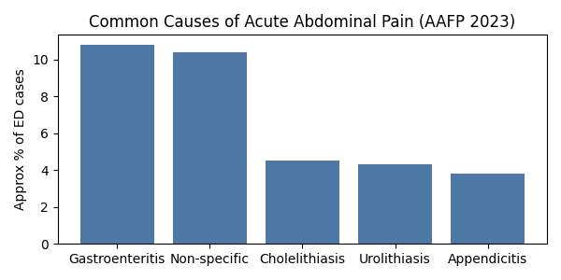
Epidemiology & Common Causes (AAFP 2023)
~10% of adult ED visits involve acute abdominal pain
Top ED diagnoses (approx %): gastroenteritis 10.8%, non-specific 10.4%, cholelithiasis 4.5%, urolithiasis 4.3%, appendicitis 3.8%
Primary care, approximately 3%
Urgent Care, top GI complaint of 12-15%
  Study ideas…
Over 150 potential etiologies—focus on high-yield causes
Notes:
Discuss AAFP data and clinical application.

Slide 4
Sick vs Not Sick
Non‑acute abdominal pain is abdominal discomfort without sudden onset or signs of an emergency condition, typically lasting longer than 48 hours and manageable in the outpatient setting.
Sick
  Hypotension
  Tachycardia
  Pain out of proportion
  Immunocompromised
  age>65
NOT SICK
  stable vitals
  reliable historian
  safe follow-up arranged
Sit ups
Jumping
Reassess often
? Bedside ultrasound
Ross Klein, PA-C | Acute Abdomen & CVA | AAFP 2023 | ACEP 2023
Notes:
Explain laminated tool and bedside application.

Slide 5
Comparison
Feature | Acute Abdominal Pain | Non‑Acute Abdominal Pain
Onset | Sudden, rapid (minutes–hours) | Gradual, persistent, or intermittent
Duration | < 24–48 hours | > 48 hours; often weeks–months
Urgency | Requires urgent evaluation to rule out surgical emergency | Usually outpatient evaluation; low immediate risk
Signs | Common: guarding, rigidity, rebound, fever, shock, GI bleeding | Typically absent
Workup | Immediate labs & imaging (CT is common); surgical consult possible | ? Nothing
Management Setting | ED or urgent surgical evaluation | Primary care, GI clinic, telehealth follow‑up
Examples | Appendicitis, cholecystitis, bowel obstruction, perforated ulcer | IBS, GERD, constipation, chronic pancreatitis

Slide 6
Not Sick
Observe for 12-24 hours.
To the emergency department if no change
Emergency immediately with worsening or changing symptoms.
Consider
  Specific Labs
    Lipase
    Stool studies
  Hydration
  Xray
  US
    Low likelihood to change plan

Slide 7
Not Sick Treatment
Do No Harm / Entertainment Treatment
  Miralax, Docusate, Fiber
  Zofran, Reglan, Benadryl
    Phenergan gets you high
  Omeprazole
  Bentyl
  Flexeril

Slide 8
Sick
NPO
To the emergency department
CBC, Electrolytes, LFT, Lipase
Urine
? Lactate, Blood cultures
Pregnancy
Hydration
Pain Meds, nausea meds
Imaging
  RUQ pain → Ultrasound first (cholecystitis)
  Generalized or lower quadrant pain → CT abdomen/pelvis with IV contrast (nonpregnant)
  Pregnancy: US first, then MRI if needed; CT only if necessary

Slide 9
Ross Rules
When I guess…
  I’m wrong about 20 % of the time
When I have done a complete work-up
  About 50% of the time, I am not sure what’s wrong with you
Why would you ever trust me after knowing this?
  I’m really good at defining sick vs not sick.
  I’m really good at not letting bad things happen to you.

Slide 10
What Do I Do?
Colitis : CBC, CT
Diverticulitis: CBC, CT
Mystery abdominal pain
Constipation: Never
Inflammatory bowel/irritable bowel Hx: GI
Renal colic : Urine, CT
Pyelonephritis Urine, CT
Hernia: Exam, US, CT
Pancreatitis: Lipase, CT
Appendicitis: CBC, CT
Obstruction: CBC, CT
Mesenteric Ischemia: CBC, CO2 (acidosis), Lactic Acid
AAA: CT, D-dimer
Hepatitis: LFT, Mono, Hep panel STD (Fitzhugh- Curtis, capsule around liver)
Pancreatitis: CT, Lipase
Cholelithiasis: CT, US, MRCP, ERCP
GERD/Gastritis: Hmmm.
SBO/LBO: CT
Male:
Testicular torsion: Urine, STD, US
Female:
Ovarian cyst/torsion/rupture: CBC, US
Pregnancy, ectopic, or corpus luteum cyst: Pregnancy/Quant HCG
PID: Vag Exam, CT (US)

Slide 11
What Shows What?
CBC:
  Colitis
  Diverticulitis
  Appendicitis
  Pyelonephritis
  Ischemia
Chemistry
  Acidosis
  Renal changes
LFT
  Hepatitis
  Chole
Lipase
  Pancreatitis
Urine
  Pyelo
  Urolith
CT
  Colitis
  Diverticulitis
  Appendicitis
  Pyelonephritis
  PID
  Urolith
  Ischemia
  Ovarian Path
  Pancreatitis
  Hernia

Slide 12
Renal colic
  Urine
  CT
Pyelonephritis
  Urine
  CT
Hernia
  US
  CT
Appendicitis
  CT
  CBC
Obstruction
  Xray
  CT
  Mesenteric ischemia
AAA
  CT
Hepatitis
  LFT
  Hep Panel
Cholelithiasis
  US
  CT
  MRCP
  HIDA Scan

Slide 13
The etc. part…
Female:
  Ovarian cyst/torsion/rupture
  Pregnancy/Quant HCG
  Ectopic or corpus luteum cyst
    US
    Preg test quant/qual
    Serial Testing
Male:
  Testicular torsion
  Hernia
  “Ball Pain”
    US
    STD
Mystery abdominal pain ?
Constipation
Xray, never diagnose
Inflammatory /irritable bowel
GERD
Gastritis.

Slide 14
Medical Decision Making
Acute Abdominal pain location is [-diffuse-]. Differential includes: atypical appendicitis, obstruction, mesenteric ischemia, AAA. Also may include hepatitis, cholelithiasis, GERD, Gastritis. Will also consider diverticulitis, colitis, inflammatory bowel, renal colic, pyelonephritis, hernia. Less concerning would be anterior abdominal wall pain, pain of unclear etiology/ functional abdominal pain.
[-In males: consideration for testicular torsion. In females: consideration for ovarian cyst, torsion, pregnancy including ectopic or corpus luteum cyst. Consider pregnancy testing-]
Work Up Includes: CBC to evaluate for infection or anemia. Electrolytes to screen for an imbalance and liver function testing with lipase to look for evidence of endorgan damage. Urine test will be obtained to screen for infection, renal stone, hematuria. [-Will consider advanced imaging.-]

Slide 15
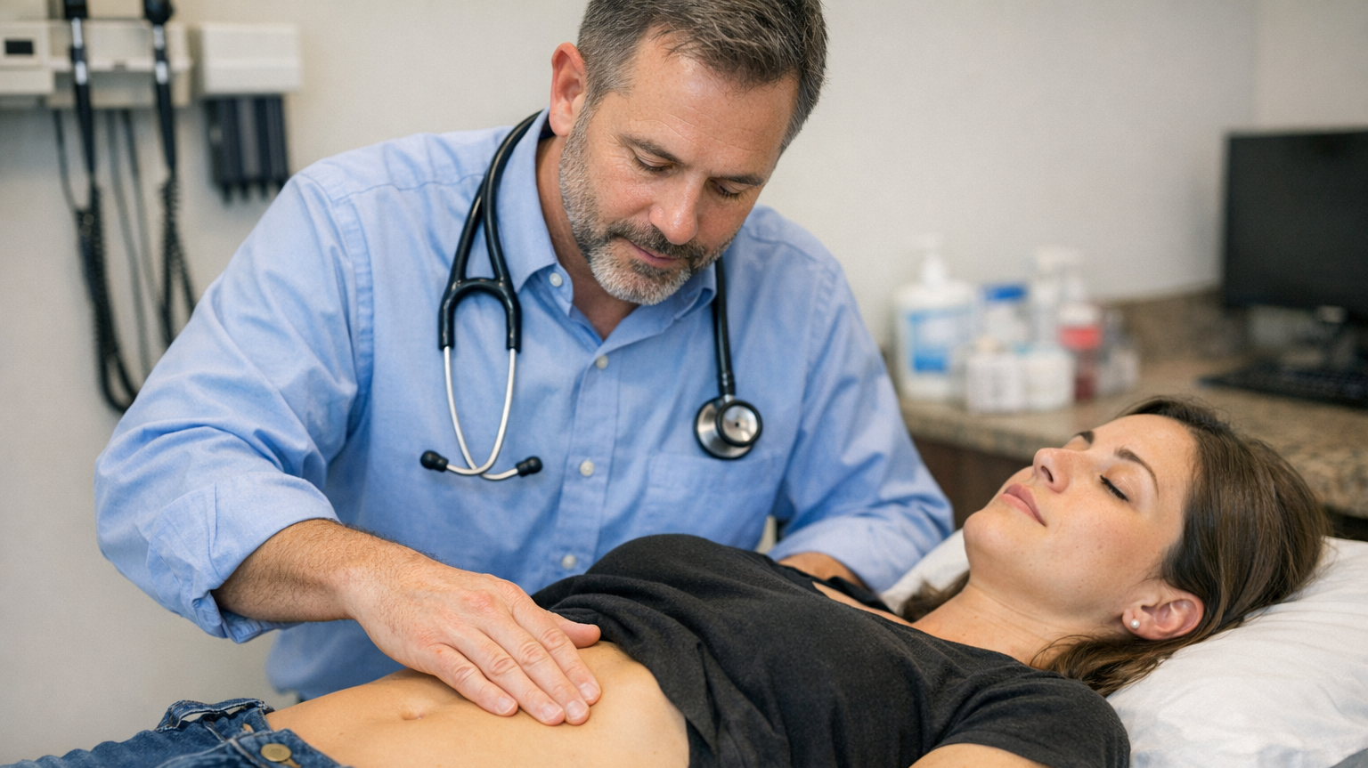
Exam

Slide 16
Visual
Distention
Scars
Hernias
Pulsations
Skin changes

Slide 17
Auscultation
Bowel Sounds
Every 30 seconds
Vascular Bruits​

Slide 18

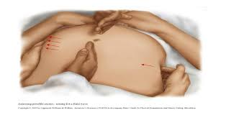
Percussion
Gas from fluid
Estimates organ size
Ascites
  Peristaltic Wave
Liver scratch Technique​

Slide 19
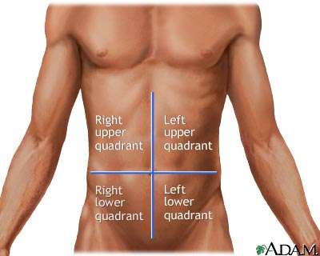

Slide 20
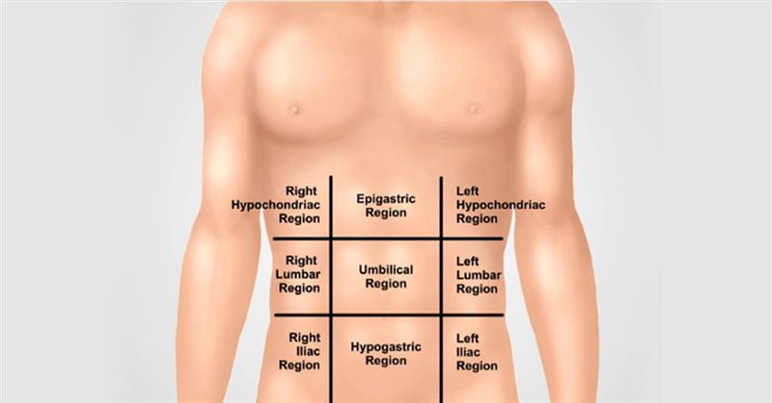
Location

Slide 21
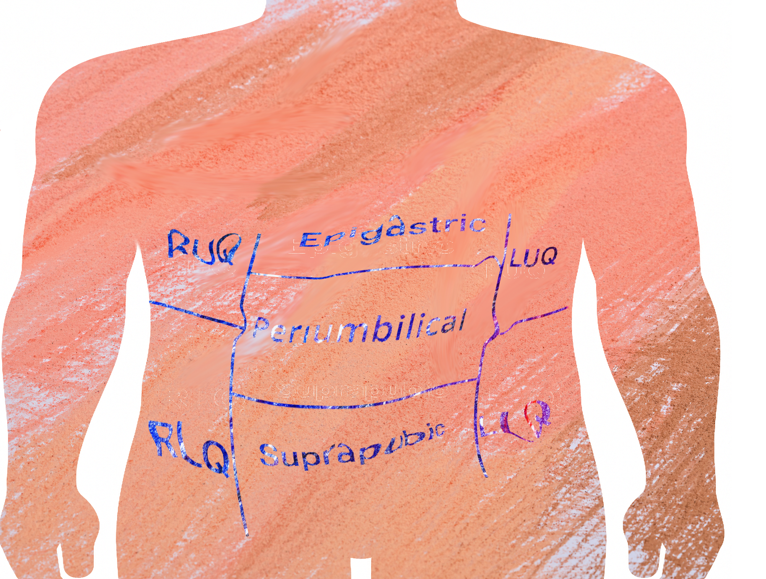

Slide 22
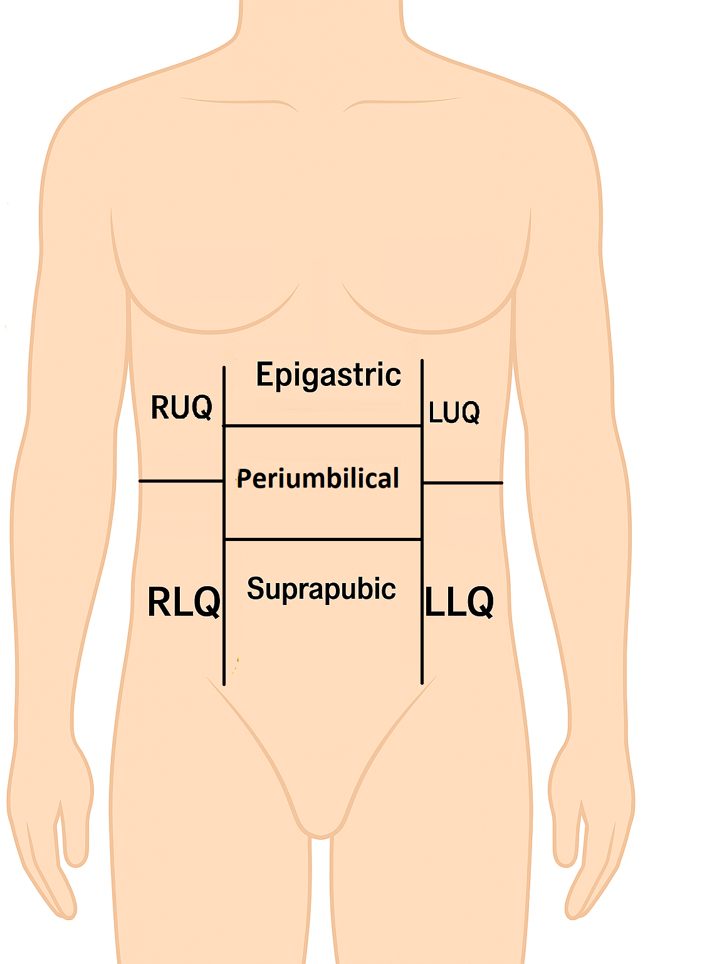

Slide 23
Palpation Methods​
Psoas Sign
  Ask the patient to raise the right leg against gentle resistance at the thigh.
Obturator
  Have the patient lie supine. Flex the right hip and knee to 90 degrees. Gently internally rotate the hip (i.e., move the ankle outward while keeping the knee stationary).
McBurney
  Focal, sharp RLQ tenderness at the point.
Rovsing
  Pain felt in the RLQ when the LLQ is pressed.
Peritonitis
  Shake table
Light and Deep Palpation
Murphy sign
  Push on RUQ while exhaling and hold. Patient can not inhale all the way.
CVA tenderness
  KaPow!
Guarding
Organomegaly

Slide 24
Right Upper Quadrant Biliary:
Cholecystitis
Colonic: colitis
  diverticulitis
Hepatic
  Abscess
  Hepatitis
  Mass
Pulmonary
  Plural effusion
  Pneumonia
  Embolus
Renal
  Nephrolithiasis
  pyelonephritis

Slide 25
Epigastric
Biliary
  Cholecystitis
Cardiac
  myocardial infarction
  pericarditis
Gastric
  Esophagitis
  Gastritis
  Peptic ulcer
Pancreatic
  Mass
  Pancreatitis
Vascular
  Aortic dissection
  Mesenteric ischemia

Slide 26
Left upper quadrant
Cardiac
  Angina
  Myocardial infarction
  Pericarditis
Gastric
  Esophagitis
  Gastritis
  Peptic ulcer
Pancreatic
  mass, pancreatitis
Renal
  Nephrolithiasis
  Pyelonephritis
Spleen
Vascular
  Aortic dissection
  Mesenteric ischemia

Slide 27
Periumbilical Colonic
Early Appendicitis
Esophagitis
Gastritis
Peptic ulcer
Small bowel
  Mass or obstruction
Vascular
  Aortic dissection
  Mesenteric ischemia

Slide 28
Right lower quadrant
Colonic
  Appendicitis
  Colitis
  Diverticulitis
Gynecologic
  Ectopic pregnancy
  Fibroids
  Ovarian
    Mass
    Torsion
    PID
Renal
  Nephrolithiasis
  Pyelonephritis

Slide 29
Suprapubic
Colonic
  Appendicitis
  Colitis
  Diverticulitis
  Irritable Bowel Disease (IBD)
Gynecologic
  Ectopic pregnancy
  Fibroids
  Ovarian
    Mass
    Torsion
    Pelvic Inflammatory Disease (PID)
Renal
  Cystitis
  Nephrolithiasis
  Pyelonephritis

Slide 30
Left lower quadrant
Colon
  Colitis
  Diverticulitis
Gynecologic
  Ectopic pregnancy
  Fibroids
  Ovarian
    Mass
    Torsion
    PID
Renal
  Nephrolithiasis
  Pyelonephritis

Slide 31
Any location
  Abdominal Wall
        Herpes Zoster
                Muscle strain
              * Hernia

Slide 32
MDM
Acute Abdominal pain location is [-diffuse-]. Differential includes: atypical appendicitis, obstruction, mesenteric ischemia, AAA. Also may include hepatitis, cholelithiasis, GERD, Gastritis. Will also consider diverticulitis, colitis, inflammatory bowel, renal colic, pyelonephritis, hernia. Less concerning would be anterior abdominal wall pain, pain of unclear etiology/ functional abdominal pain.
[-In males: consideration for testicular torsion. In females: consideration for ovarian cyst, torsion, pregnancy including ectopic or corpus luteum cyst. Consider pregnancy testing-]
Work Up Includes: CBC to evaluate for infection or anemia. Electrolytes to screen for an imbalance and liver function testing with lipase to look for evidence of endorgan damage. Urine test will be obtained to screen for infection, renal stone, hematuria. [-Will consider advanced imaging.-]

Slide 33
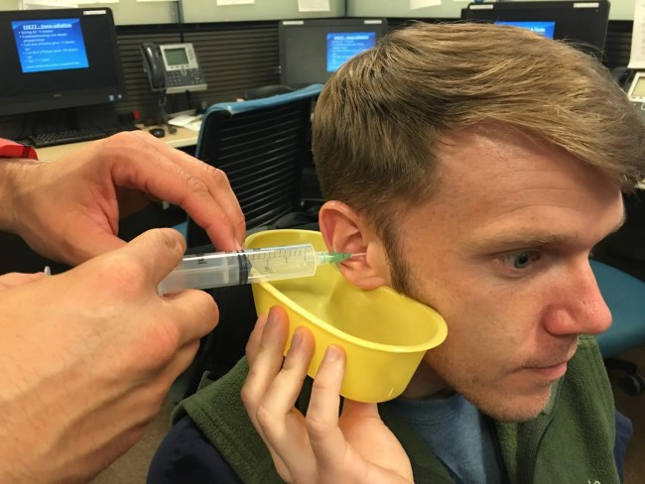
Advice #1
Water as hot as they can stand it
Add some soap or hydrogen peroxide
It takes about 20x longer than you think

Slide 34
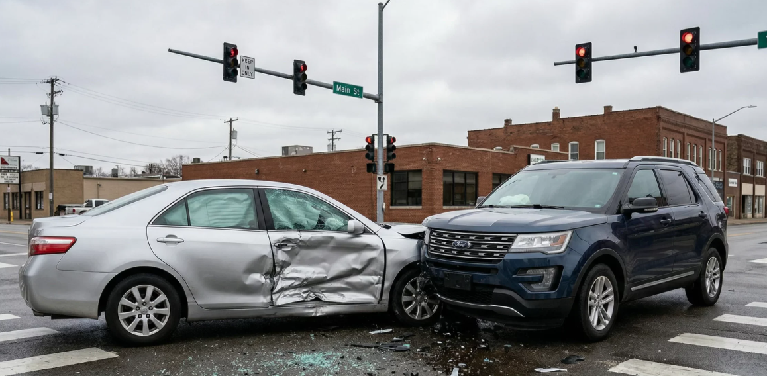
Advice #2
Look at pictures:
  Car Accident
  Skateboard injury
  Poop

Slide 35
What About the Culture?
Legend:
S = Susceptible
I = Intermediate
R = Resistant
Antibiotic Tested | E. coli | Drug Class | Outpatient Oral Equivalent | Appropriate for Pyelo?
Amoxicillin/Clavulanic Acid | S | Aminopenicillin + β-lactamase inhibitor | Augmentin® | ✅ Yes
Ampicillin | S | Aminopenicillin | Amoxicillin | ❌
Cefazolin | s | 1st Gen Cephalosporin | Cephalexin (Keflex®) | ✅ Yes
Cefepime | S | 4th Gen Cephalosporin (IV) | None (IV only) | IV only
Ceftriaxone | S | 3rd Gen Cephalosporin (IV) | Vantin®, Suprax® | ✅ Yes
Cefuroxime | S | 2nd Gen Cephalosporin | Ceftin® | ✅ Yes
Ciprofloxacin | S | Fluoroquinolone | Cipro® | ✅ Yes
Levofloxacin | S | Fluoroquinolone | Levaquin® | ✅ Yes
Ertapenem | S | Carbapenem (IV) | None (IV only) | IV only
Gentamicin | S | Aminoglycoside (IV) | None (IV only) | IV only
Imipenem | S | Carbapenem (IV) | None (IV only) | IV only
Nitrofurantoin | S | Nitrofuran | Macrobid® | ❌ (Cystitis only)
Piperacillin | S | Extended-spectrum penicillin | IV only | IV only
Tetracycline | S | Tetracycline | Doxycycline | ❌ Not first-line for UTI
Tobramycin | S | Aminoglycoside (IV) | None (IV only) | IV only
Trimethoprim/Sulfa | S | Folate inhibitor combo | Bactrim DS® | ✅ Yes

Slide 36

Advice #3
Write something personal in the chart
  New child
  Recent or upcoming vacation
  Favorite hobby

Slide 37

Advice #4
Always prescribe 2 things

Slide 38

Advice #5
Compliment something crazy about the patient.

Slide 39
Abdominal Pain Questions?

