Slide 1
Burn Overview

Slide 2
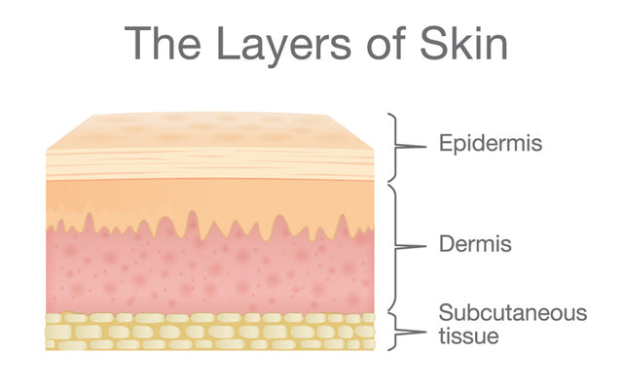
Introduction
Let’s dive into the basics of burns
      Physics!
  Thermal (heat transfer)
  Electrical (current flow)
  Chemical (chemical reactions)
  Radiation (electromagnetic energy)
Classification
Care

Slide 3
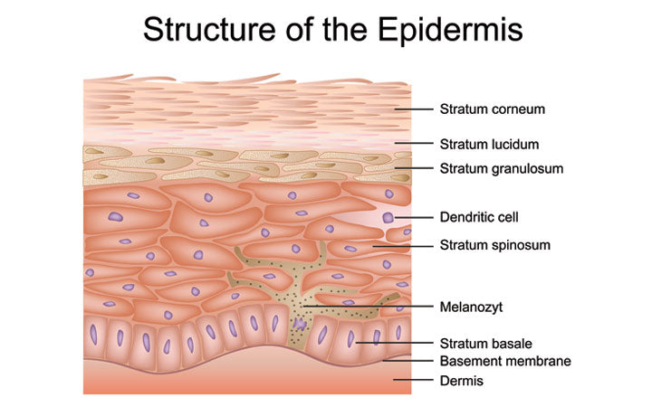

Slide 4
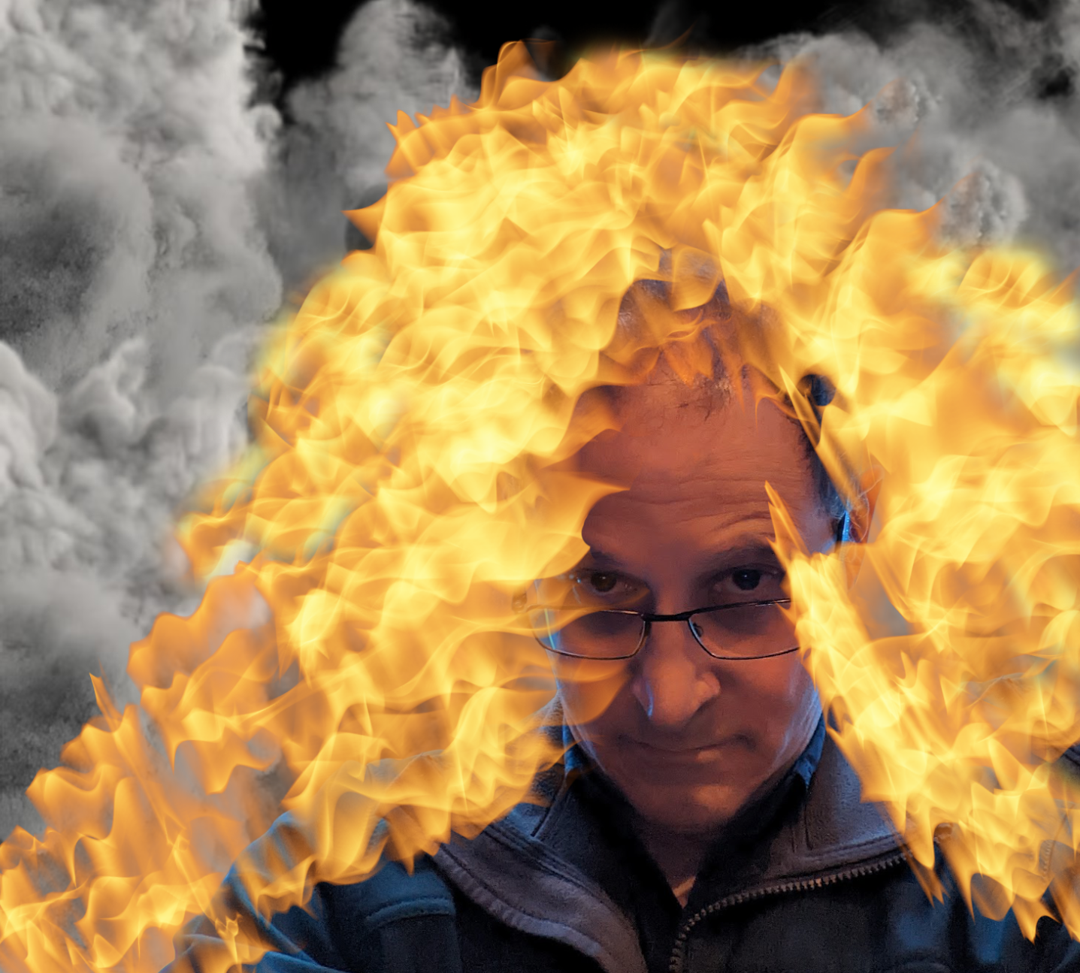
Burn Pathophysiology

Slide 5
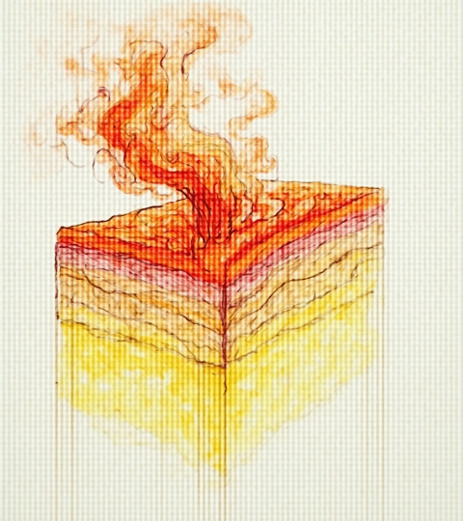
Local tissue effects vs systemic response
Local Vs Systemic
Watch for both
Determining factors:
Depth
Time
Mechanism

Slide 6
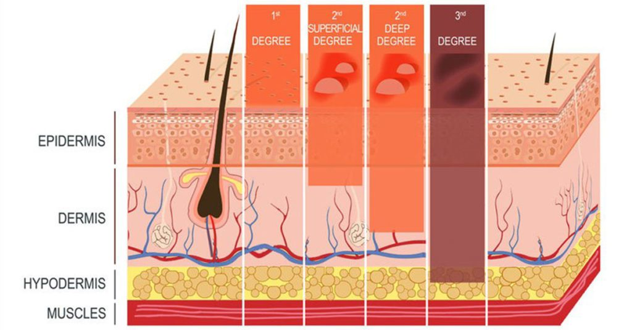
1st Degree = Superficial
2nd Degree = Partial Thickness
3rd Degree = Full Thickness
Key determinants of depth and progression
Superficial
  Top skin
Partial-thickness
  …More
Full-thickness
  All skin layers

Slide 7
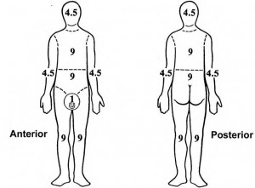
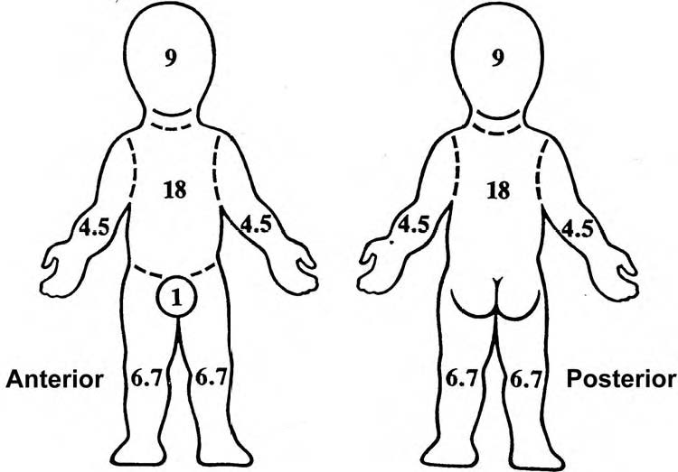
By Extent: Rule of 9s, palm method

Slide 8
Test Question
A 32-year-old patient presents with second-degree burns involving the entire right arm and the anterior trunk. Using the Rule of Nines for adults, what is the total body surface area (TBSA) burned?
18%
27%
36%
45%
Ross is messing with you…

Slide 9
Advice #7
Charting
  HPI
  PE
  Assessment/Plan

Slide 10
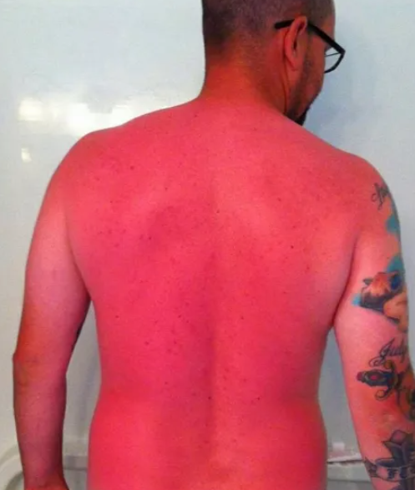
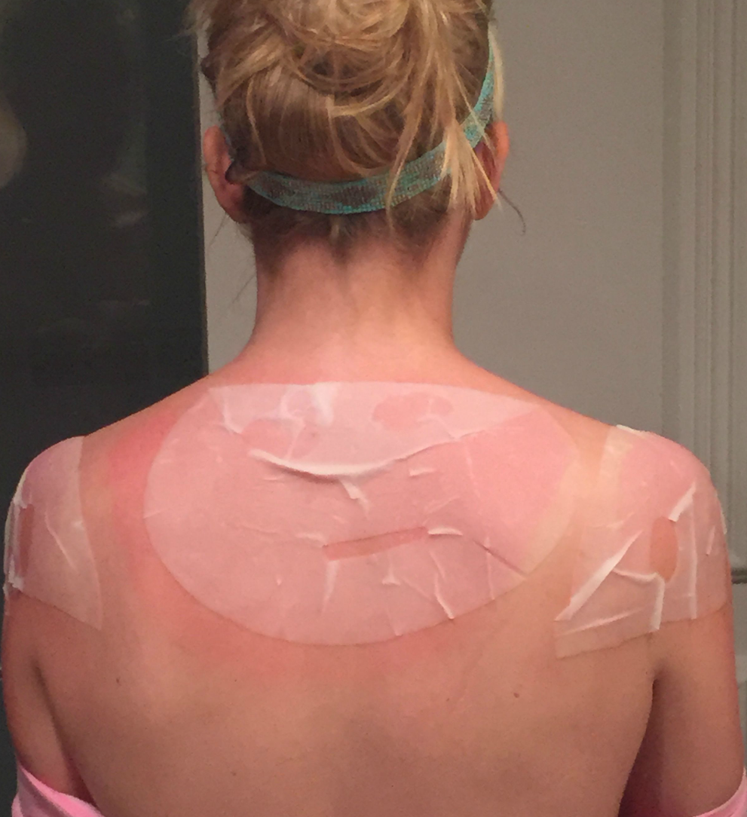

Slide 11
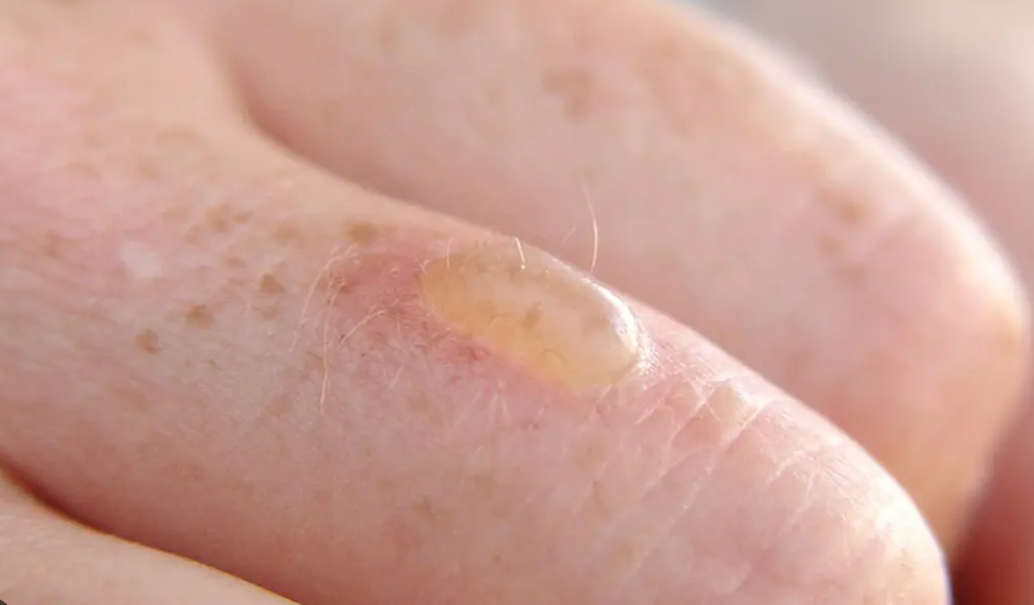
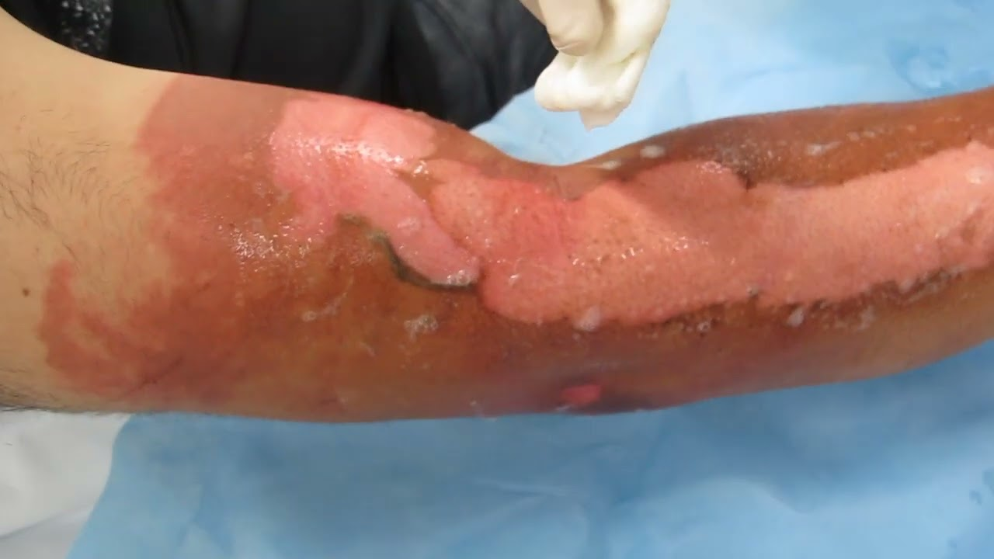

Slide 12
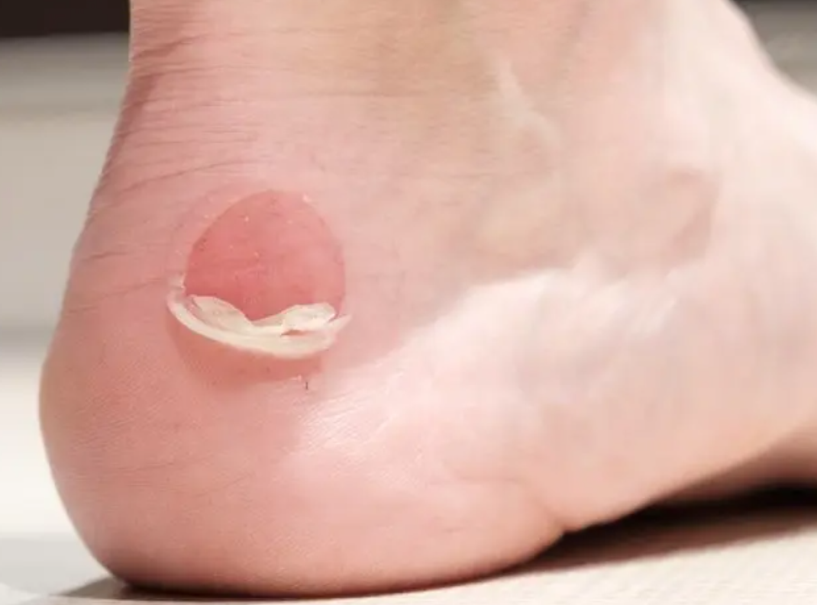
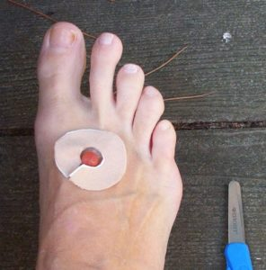
Management

Slide 13
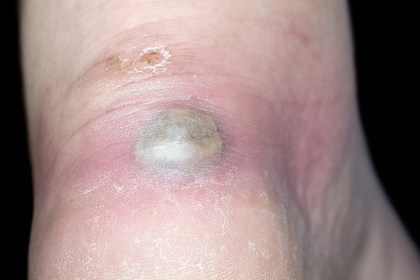
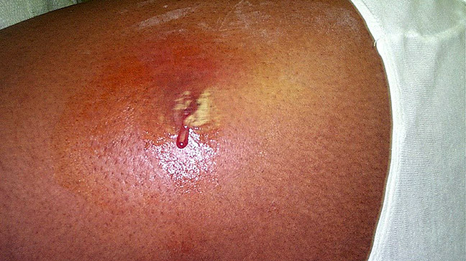

Slide 14
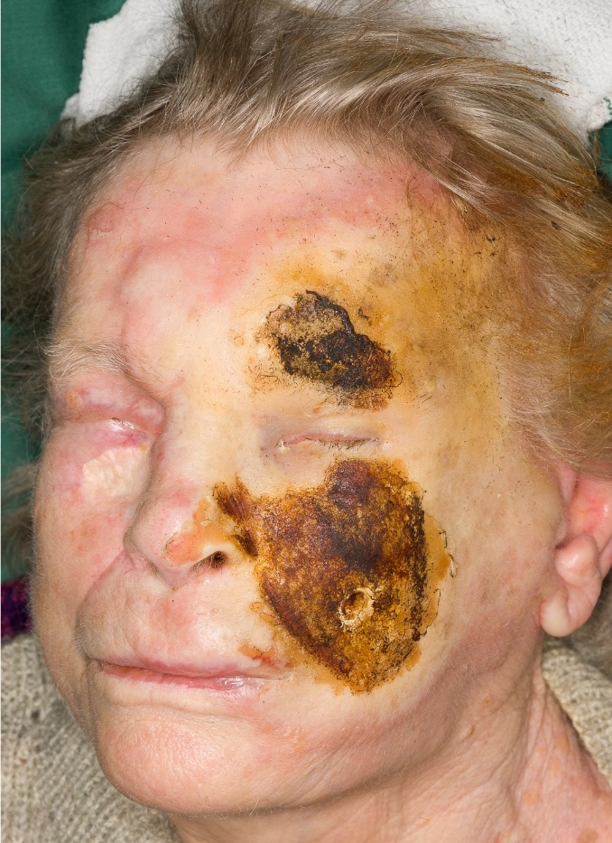
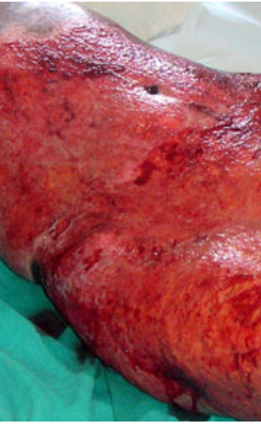

Slide 15
First aid steps: cooling, dressing, analgesia, tetanus review
Treatment:
  Cooling with running water for about 20 minutes (no ice!)
  Remove rings, tight clothes
  Cover with clean, non-stick dressings.
  Antibiotic Ointment (Less often Silvadene Cream)
  Pain meds as needed
Hydration
  Oral
  IV
Watch for Hypothermia
Tetanus shots
Monitor for infection

Slide 16
Severe Burn Considerations
 | Immediate consultation with consideration for transfer | Consultation recommendation
Thermal burns | Full thickness burns Partial thickness ≥10% TBSA* Any deep partial or full thickness burns involving the face, hands, genitalia, feet, perineum, or over any joints Patients with burns and other comorbidities Patients with concomitant traumatic injuries Poorly controlled pain | Partial thickness burns <10% TBSA* All potentially deep burns of any size
Inhalational injury | All patients with suspected inhalation injury | Patients with signs of potential inhalation such as facial flash burns, singed facial hairs, or smoke exposure
Pediatrics (≤14 years, or <30 kg) | All pediatric burns may benefit from burn center referral due to pain, dressing change needs, rehabilitation, patient/caregiver needs, or non-accidental trauma
Chemical injuries | All chemical injuries
Electrical injuries | All high voltage (≥1000V) electrical injuries (transformers, Lightning injury | Low voltage (<1000V) electrical injuries should receive consultation and consideration for follow-up in a burn center to screen for delayed symptom onset and vision problems

Slide 17
Electrical Low voltage (usually household) complications
Localized Contact Burns
Involuntary muscle contraction (tetany)
Mouth Burns in Children
Cardiac Arrhythmias
Rhabdomyolysis
Tetanic Contraction Injuries
  Bone Fractures
  Tendon Ruptures.

Slide 18
Electrical complications High Voltage (Transformer, lightning)
Deep Tissue and Muscle Necrosis
Extensive tissue destruction
  Protein coagulation
  Muscle necrosis.
Rhabdomyolysis / Kidney Failure
  Massive muscle destruction releases myoglobin
Amputations and Vascular Damage
Cardiac Arrest and Arrhythmias
Traumatic Injuries from Thrown Victim.
Neurological Damage
  Paresthesia
  Seizures
  Gait Ataxia.
Compartment Syndrome

Slide 19
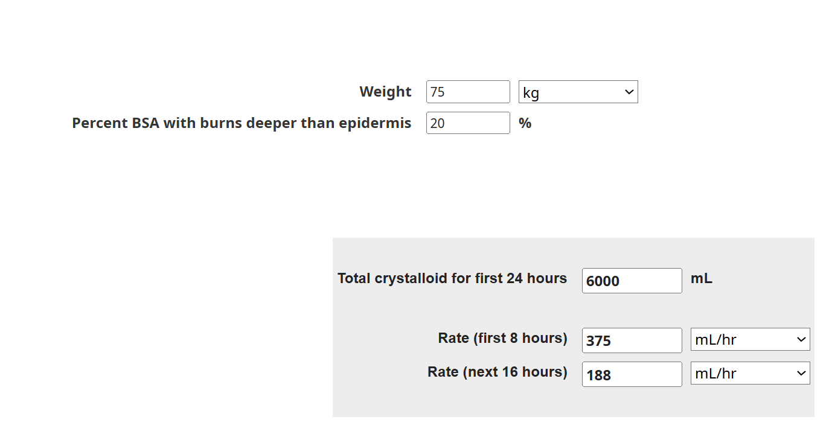
Severe Burn Considerations
Total crystalloid for first 24 hours = 4 * Weight[kg] * Percent BSA with burns deeper than epidermis
Rate (first 8 hours) = Total crystalloid for first 24 hours / 16
Rate (next 16 hours) = Total crystalloid for first 24 hours / 32

