Slide 1
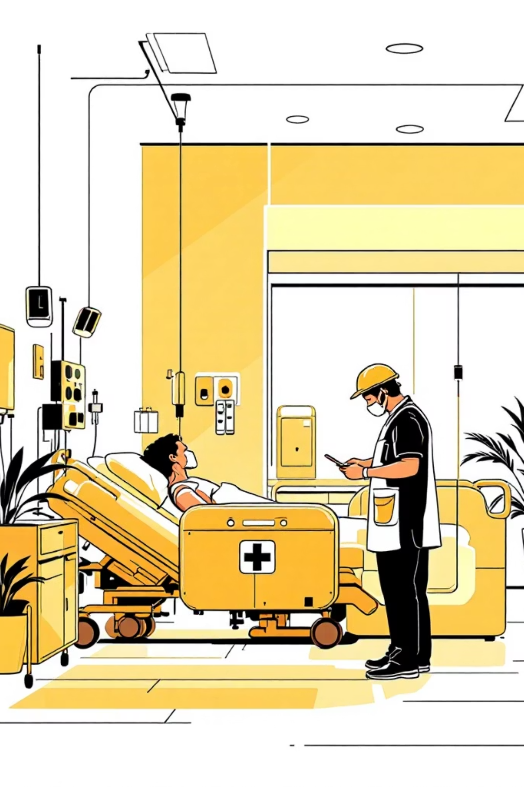
Acute Stroke Management for Primary Care
Evidence-based protocols for frontline identification, assessment, and rapid intervention in acute stroke care
Ross Based Protocols, because he’s the one talking
Doesn’t this presentation look fancy?

Slide 2
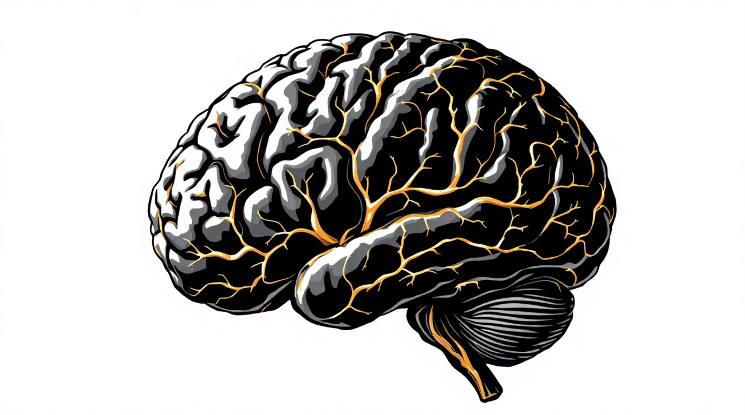
Why Stroke
800,000 Americans experience stroke annually
Leading cause of long-term disability
$56 billion yearly in direct medical costs and lost productivity
  $185 Billion projected for Seattle Light Rail
Early recognition and rapid intervention dramatically improve functional outcomes. Every minute without treatment results in loss of 1.9 million neurons.

Slide 3






Stroke Types & Pathophysiology
Ischemic Stroke
Hemorrhagic Stroke
Subarachnoid Hemorrhage
~87% of cases
~10% of cases
~3% of cases
Thrombotic: local vessel occlusion
Embolic: traveling clot from distant source
Large vessel occlusion (LVO) causes major deficits
Small vessel lacunar strokes present subtly
Intracerebral hemorrhage from vessel rupture
Often hypertensive or anticoagulation-related
Requires different management than ischemic
Sudden severe headache ("thunderclap")
Often from ruptured aneurysm
High mortality requires urgent neurosurgical consultation
Understanding stroke mechanisms guides appropriate therapy selection and predicts treatment response.

Slide 4
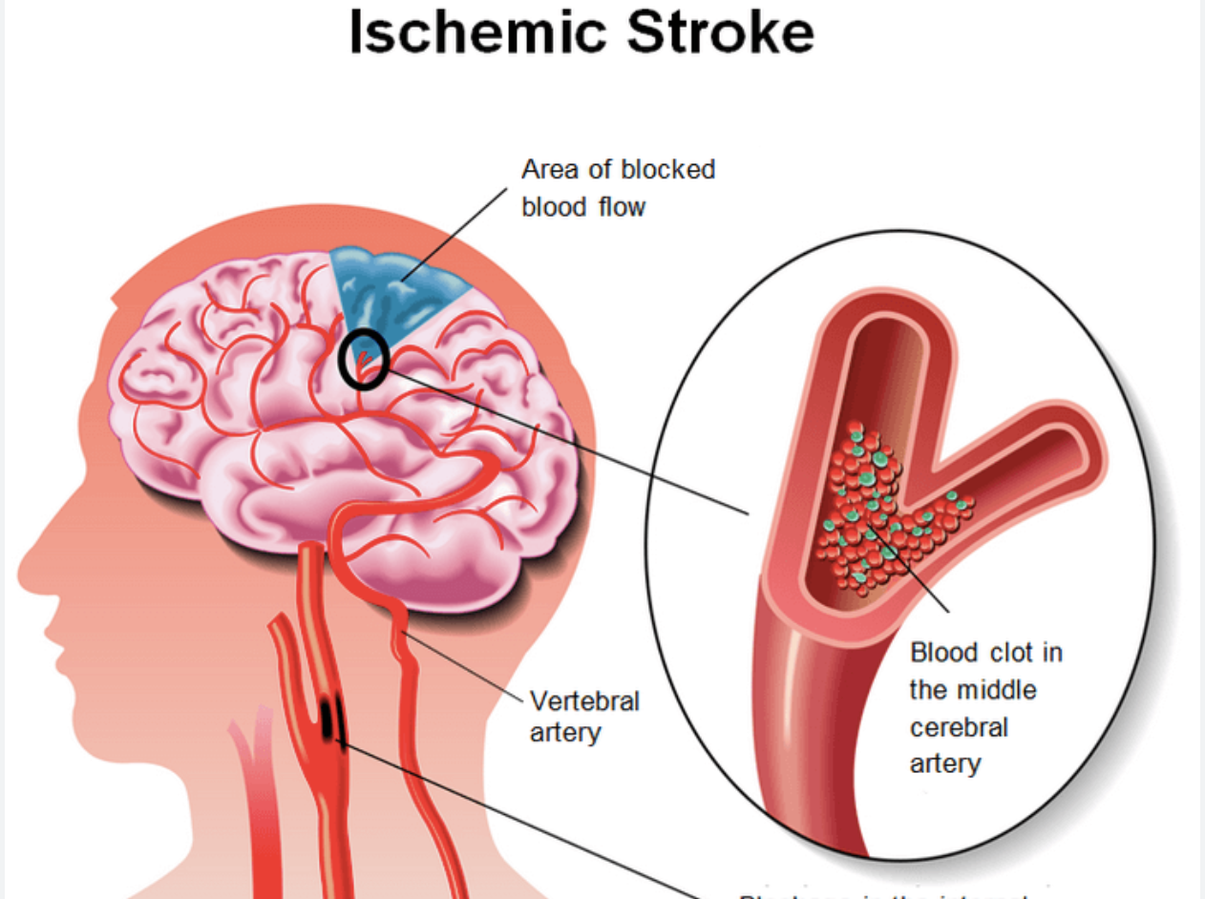

Slide 5
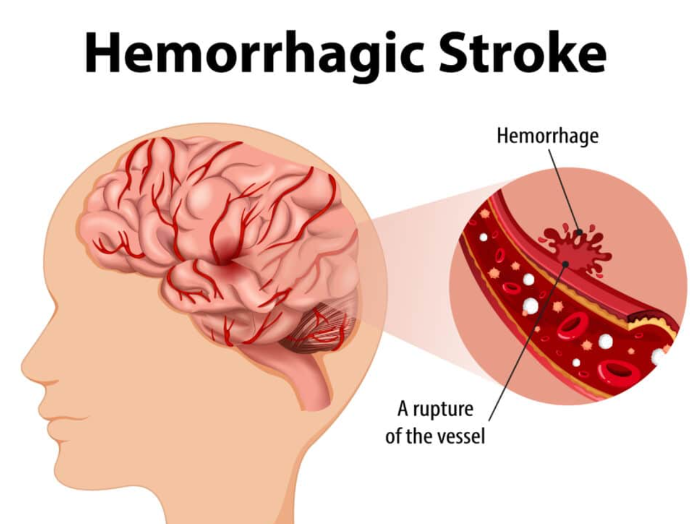

Slide 6
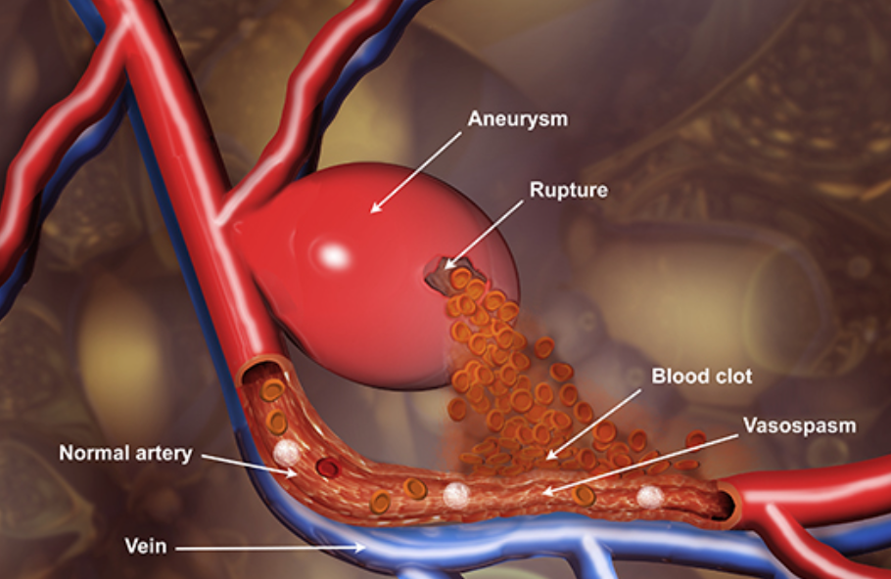
Subarachnoid Hemorrhage

Slide 7
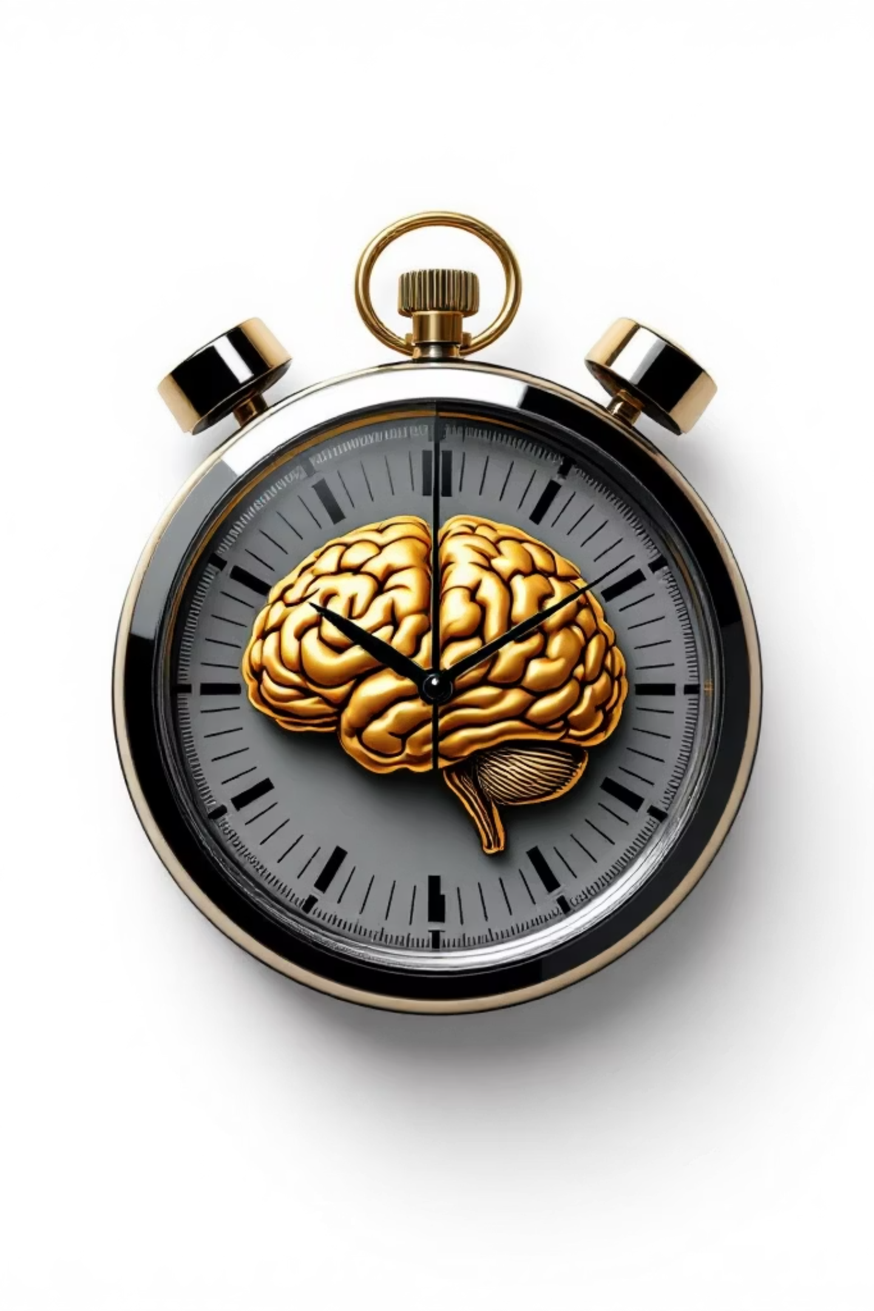
Time Is Brain: Therapeutic Windows
1
0-4.5 Hours
IV Alteplase Window
Recombinant tissue plasminogen activator (rt-PA)
2
6-24 Hours
Extended Thrombectomy Window
Mechanical thrombectomy for selected patients with perfusion mismatch
Critical Action
3
Document Last Known Well
Time of last normal function determines treatment eligibility. Witness accounts essential when onset unknown

Slide 8
Initial Stroke Assessment
Glucose
  Treat if < 60
  Can mimic a stroke
ABCs
  Establish IV
  O2
VS
  Fever
  Sepsis
Neuro Exam
  Alert
  Responds to voice
  Stimuli
  Unresponsive
FAST Exam
Last Known Well!!!
Document Baseline

Slide 9
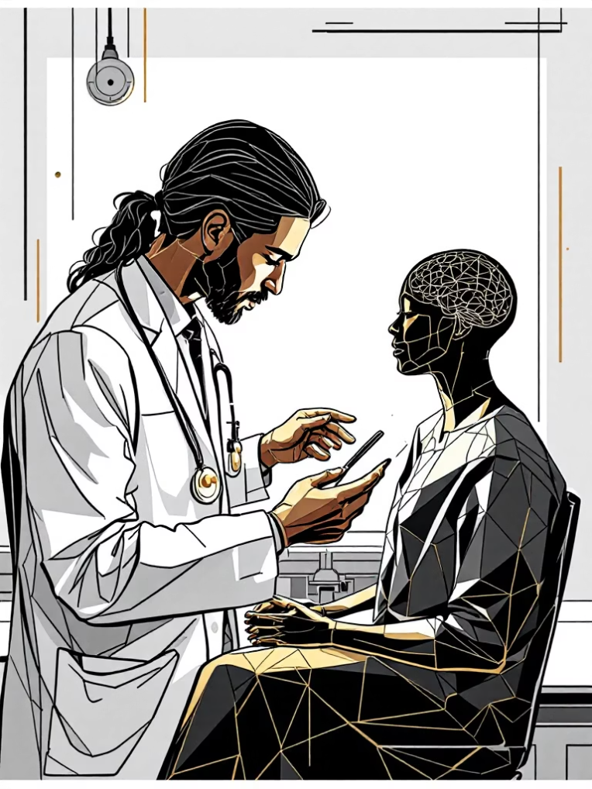

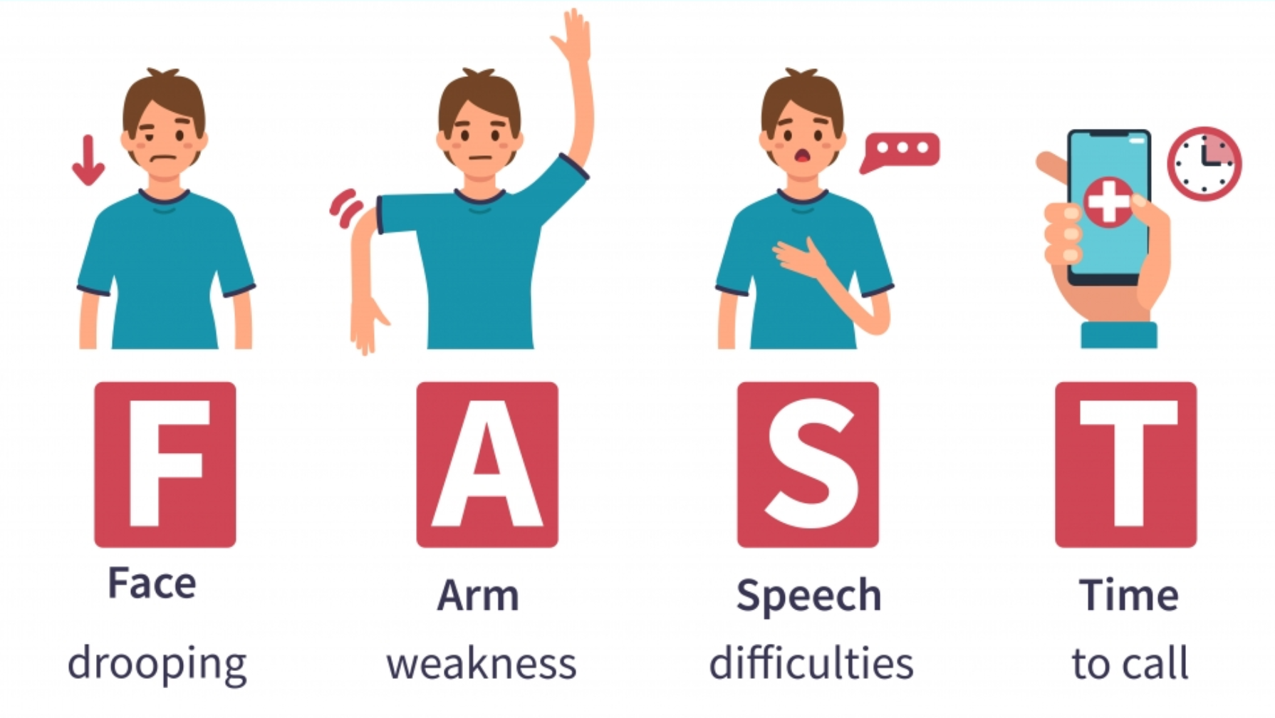
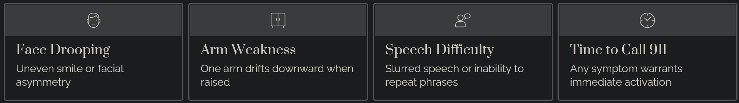
Posterior Stroke Alert:
May present with vertigo, ataxia, diplopia without hemiparesis.
FAST

Slide 10
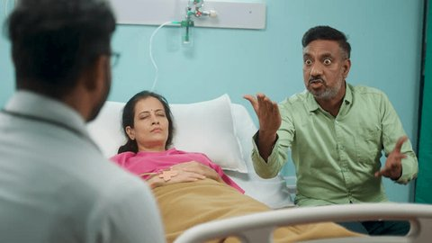
Advice #6
Don’t argue.
Explain potential bad outcomes
AMA does not mean do no care.

Slide 11
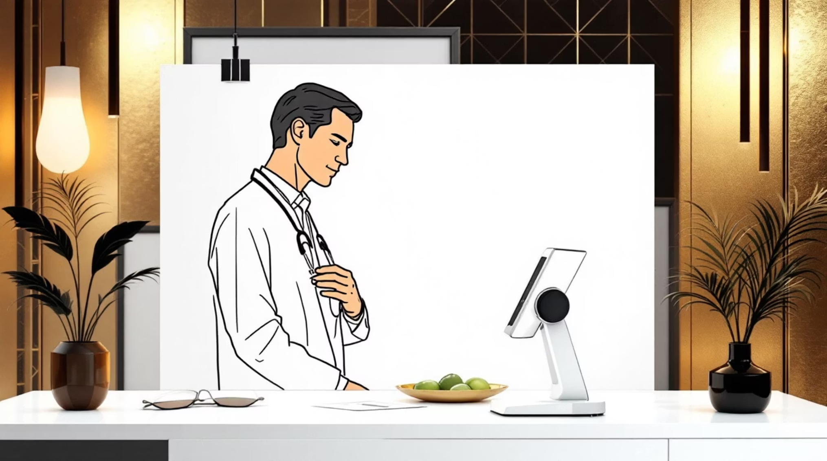

NIH Stroke Scale Overview
Structured Quantification Tool
The NIHSS provides objective measurement of stroke severity, guiding treatment decisions and predicting outcomes. Score ranges from 0 (no deficits) to 42 (most severe).
Key Components:
Level of consciousness (LOC)
Extraocular movements and gaze
Visual field testing
Motor strength (face, arms, legs)
Language and dysarthria
Sensory neglect
Higher NIHSS scores correlate with worse functional outcomes and mortality. Scores ≥6 suggest LVO and eligibility for thrombectomy.
Documentation: Document exact patient responses for legal clarity and accurate inter-rater reliability.

Slide 12
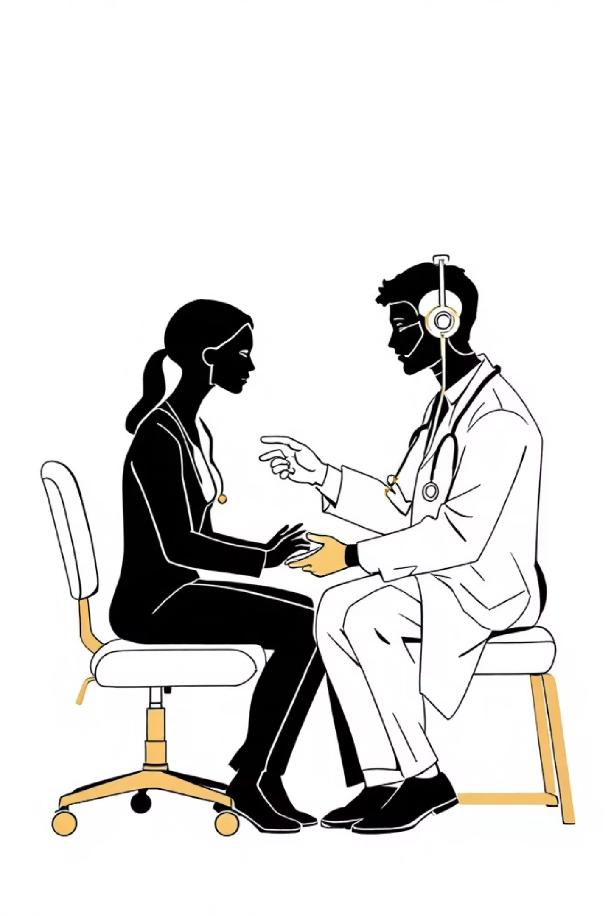



Administering NIHSS: Practical Tips
Standardized Administration
Follow exact item order. Allow no coaching or hints. Document verbatim responses for aphasia assessment.
Avoid Common Pitfalls
Distinguish aphasia (language comprehension deficit) from dysarthria (motor speech impairment). Misclassification affects score.
Posterior Circulation
Vertigo, ataxia, and diplopia may occur without hemiparesis. Screen cranial nerves systematically for subtle deficits.

Slide 13
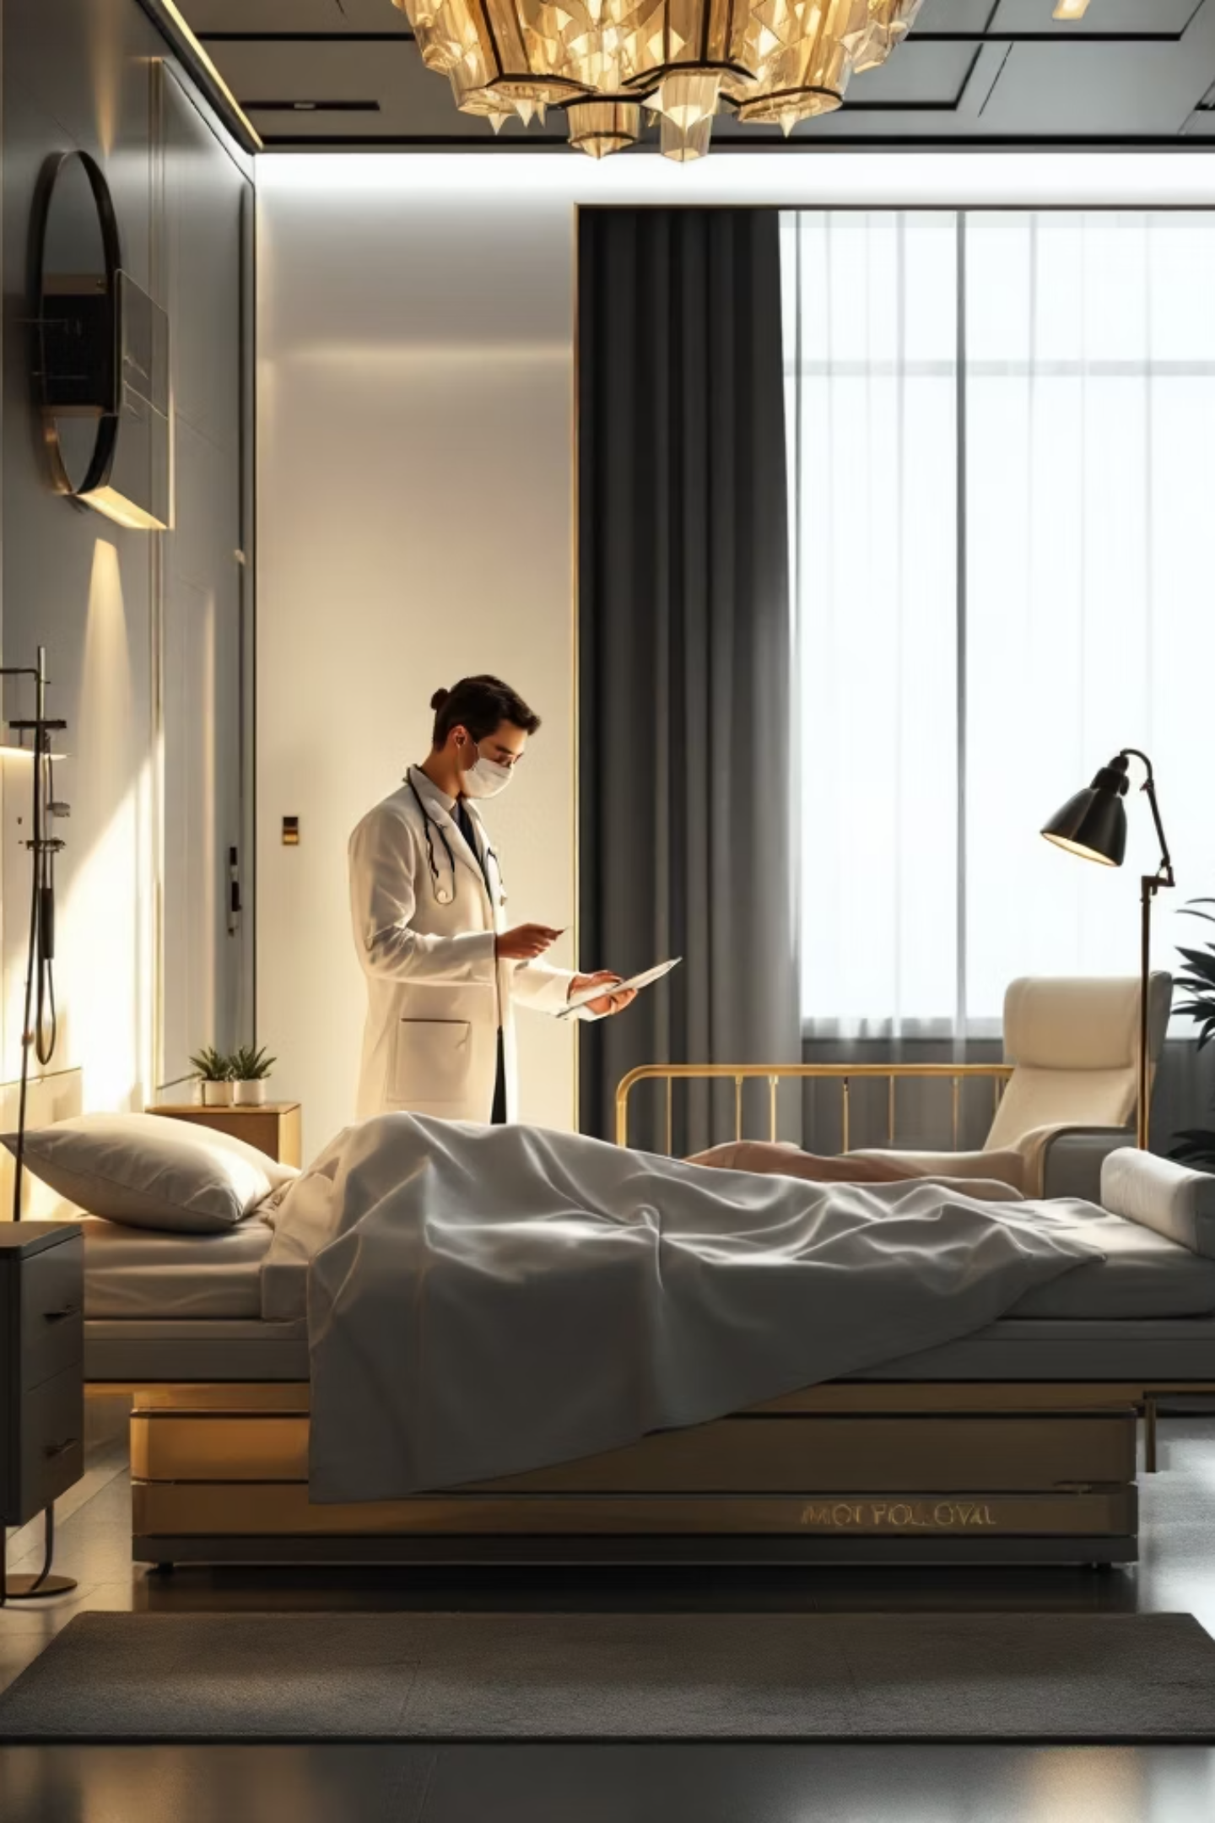
Level of Consciousness
0 - Alert
Keenly responsive to environment
1 - Arousable
Responds to minor stimulation
2 - Obtunded
Requires strong stimulation
3 - Unresponsive
Only reflex movements present

Slide 14
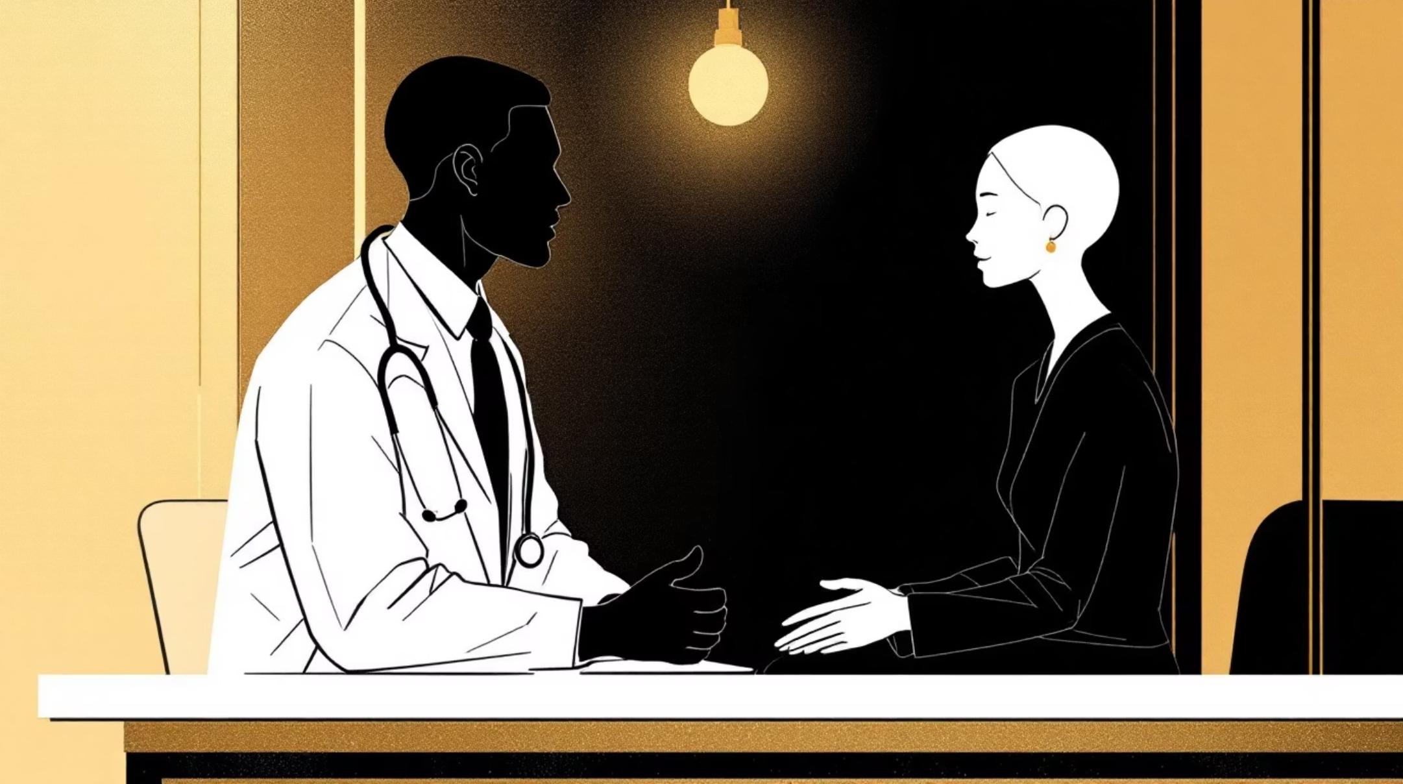
LOC Questions
Testing Procedure
What month is it?
How old are you?
01
02
03
Both Correct
One Correct
Neither Correct
Score: 0
Score: 1
Score: 2

Slide 15
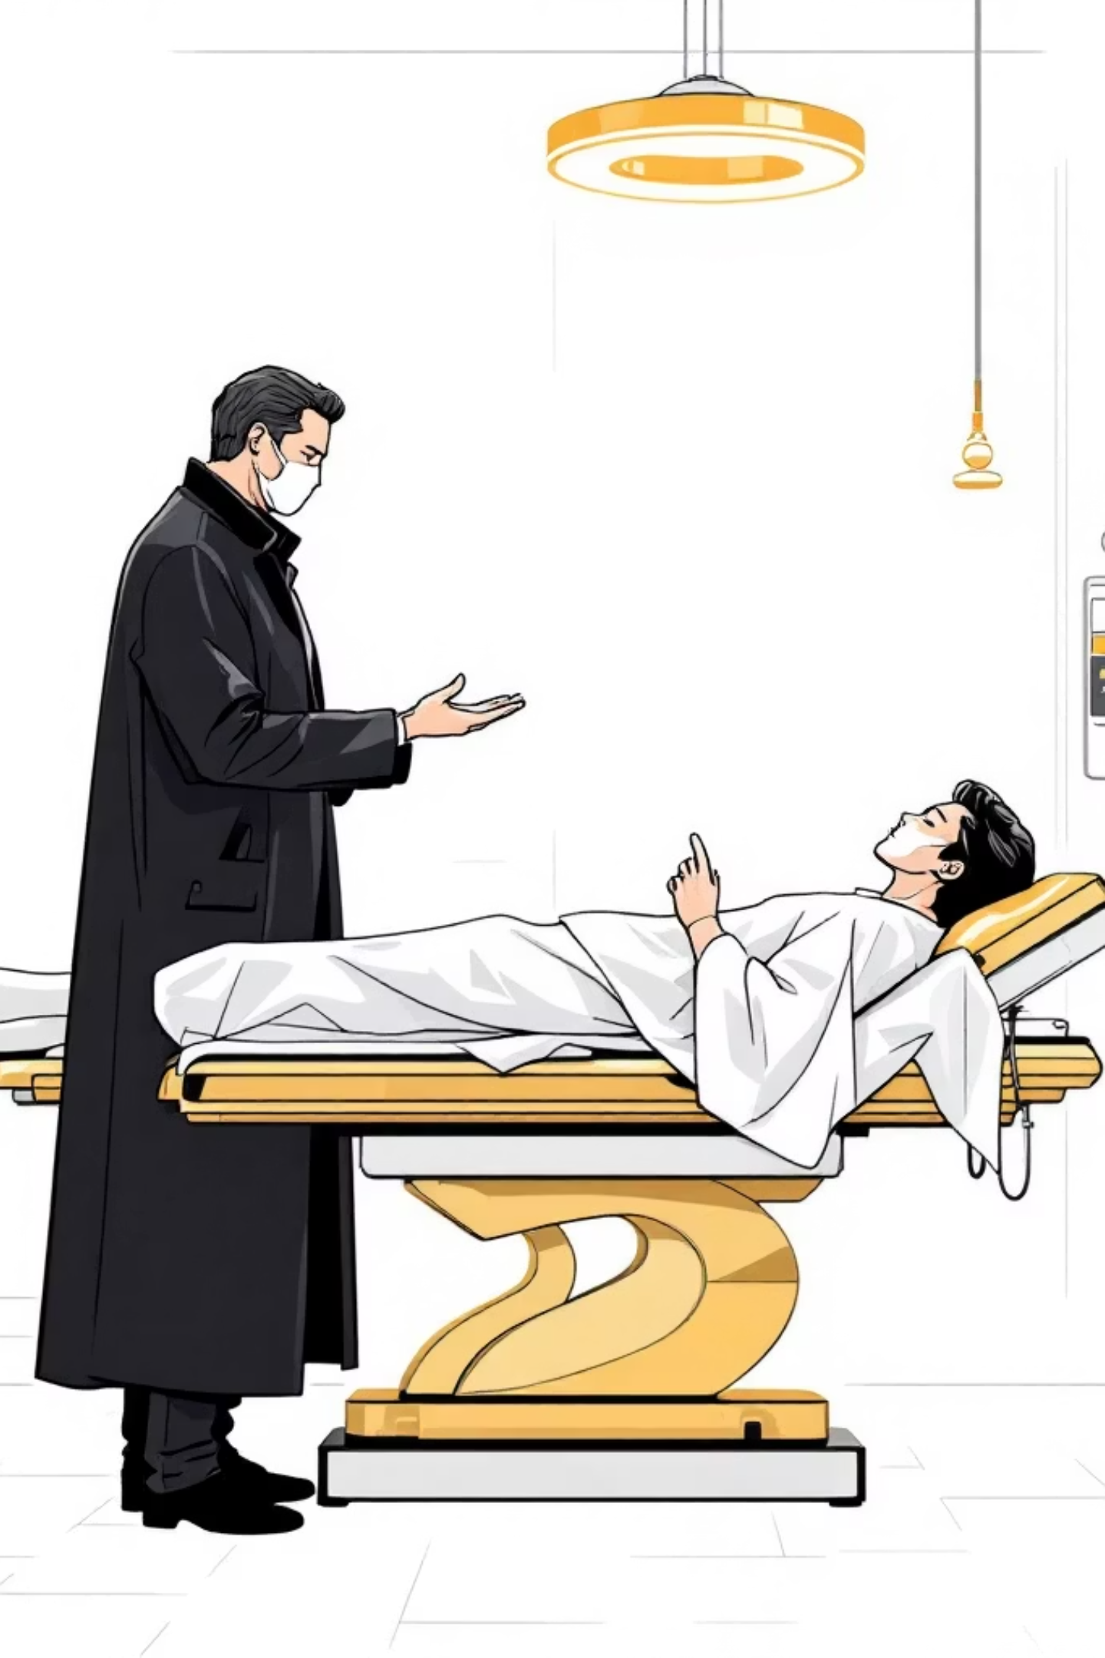



LOC Commands
Open/Close Eyes
Test voluntary movement
Grip/Release Hand
Assess motor response
Evaluate Performance
Score first attempt only
0 - Both Tasks
1 - One Task
Performs both correctly
Performs one correctly
2 - Neither Task
Performs neither correctly

Slide 16
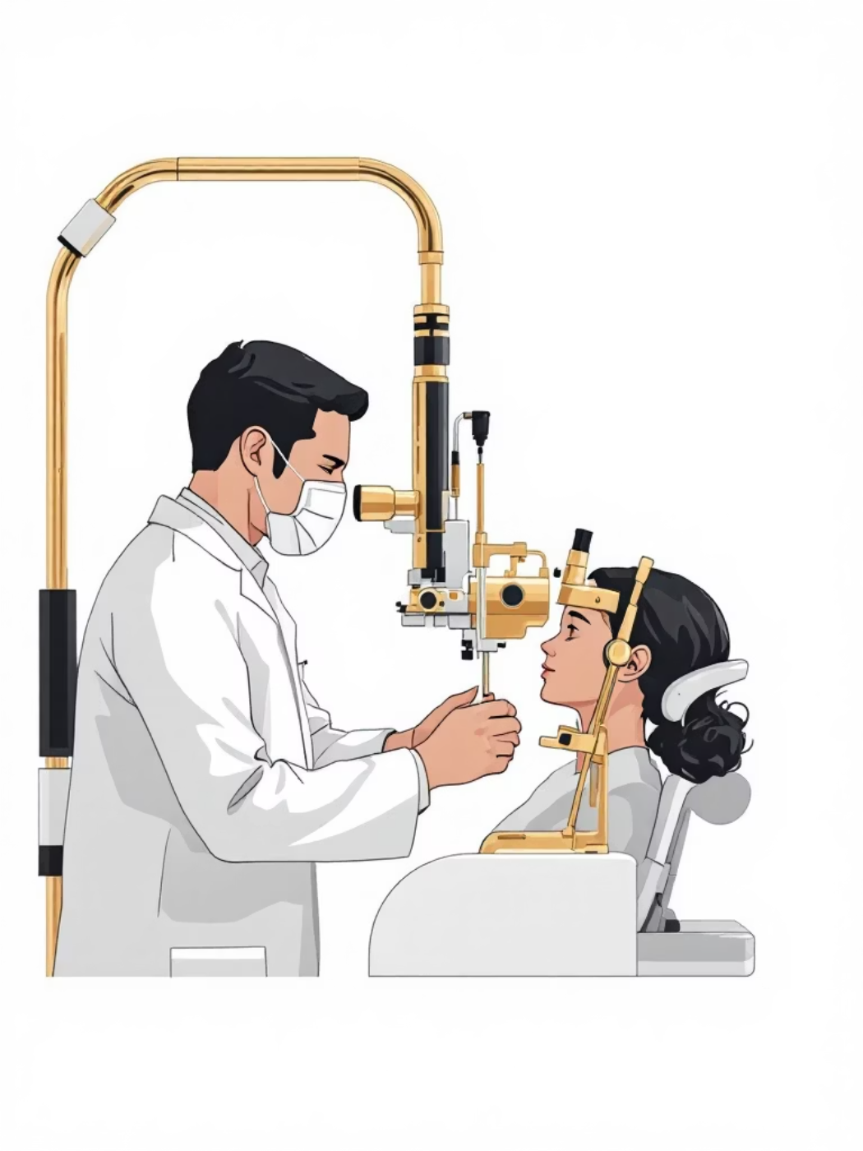
Best Gaze
Horizontal Eye Movements
Look for a googly eye.
“Partial” is a googly eye they can fix when they try.
Forced deviation is a persistent googly eye.
Normal
Partial Gaze Palsy
Forced Deviation
Score: 0
Score: 1
Score: 2

Slide 17
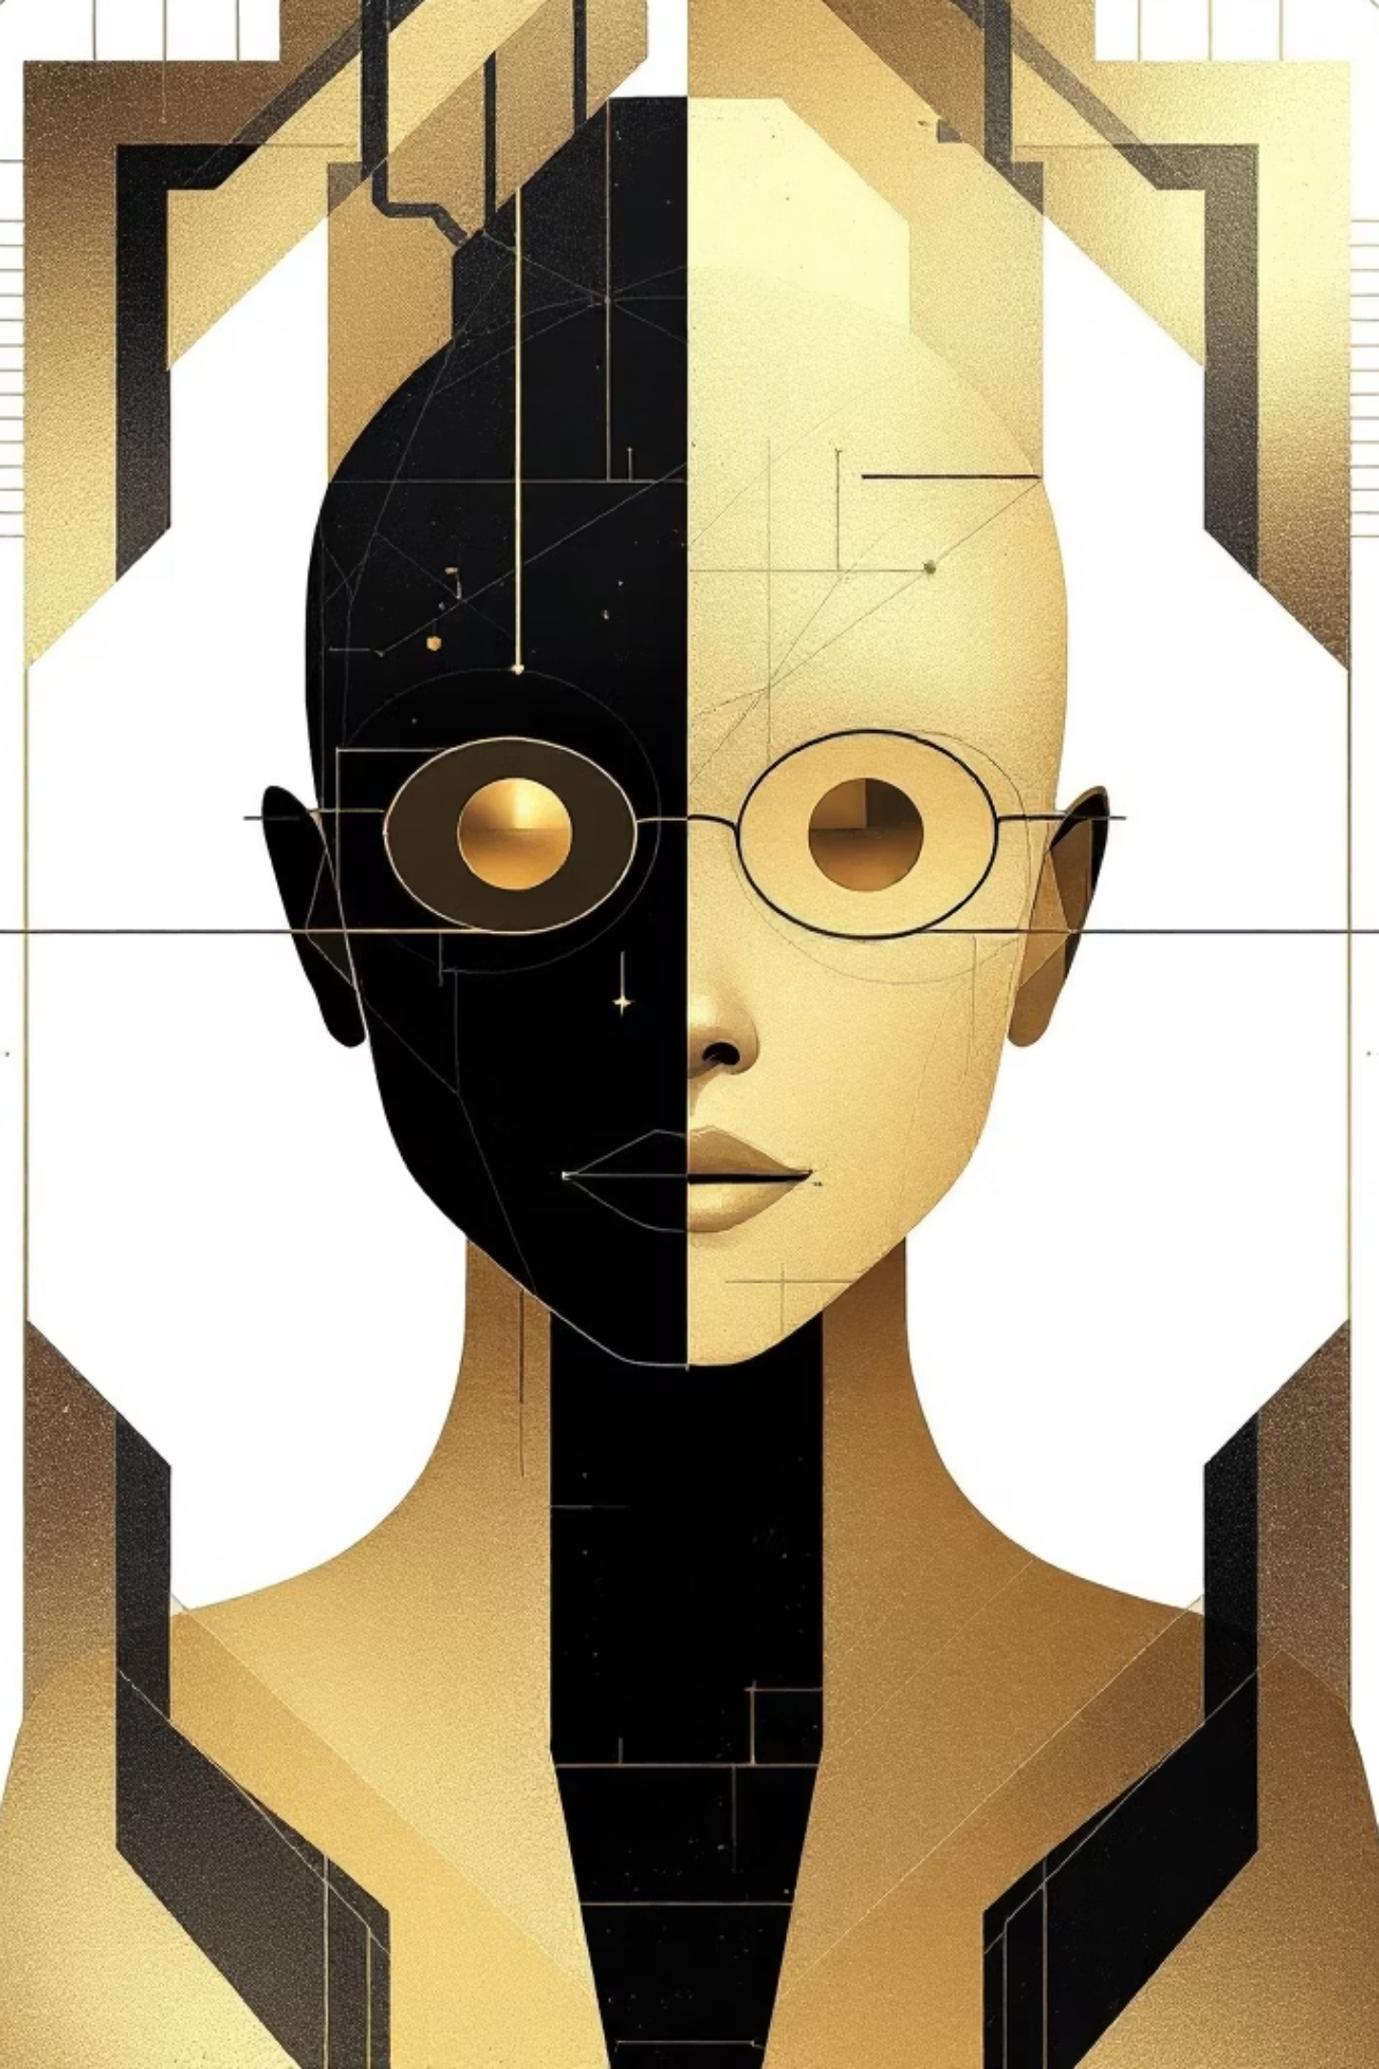

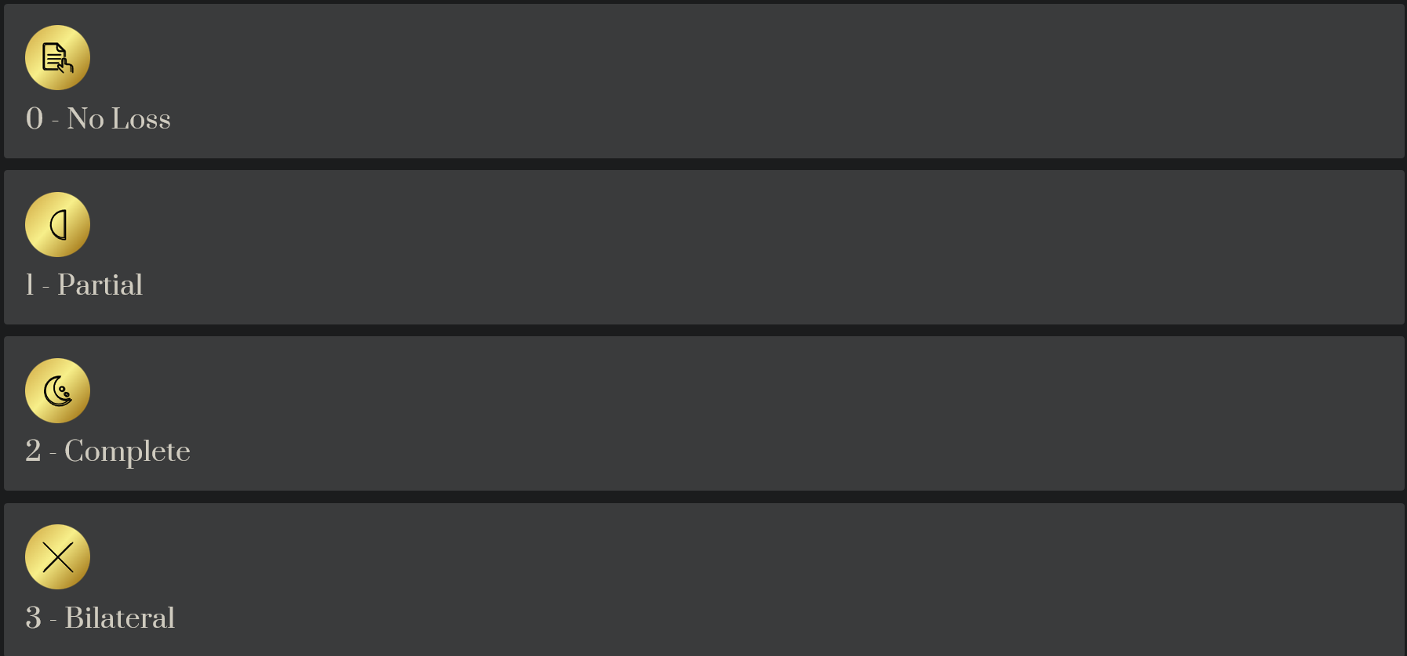
Visual Fields
Test by Confrontation
Finger counting or visual threat in upper and lower quadrants
I only do one of these

Slide 18
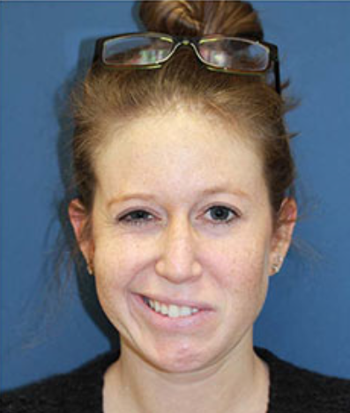
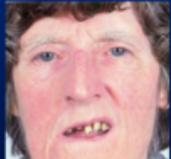
Facial Palsy
Testing Method
Show teeth
Raise eyebrows
0 - Normal
1 - Minor
2 - Partial
3 - Complete
Symmetrical movements
Flattened nasolabial fold
Near-total lower face paralysis
Absence of facial movement

Slide 19
Motor Arm Testing
Position Limb
Test Both Arms
90° sitting or 45° supine
Start with non-paretic side
1
2
3
Observe 10 Seconds
Score drift if arm falls
0 - No Drift
1 - Drift
2 - Some Effort
Holds position 10 seconds
Drifts down before 10 seconds
Cannot maintain position
3 - No Gravity
4 - No Movement
Immediate fall
Complete paralysis

Slide 20
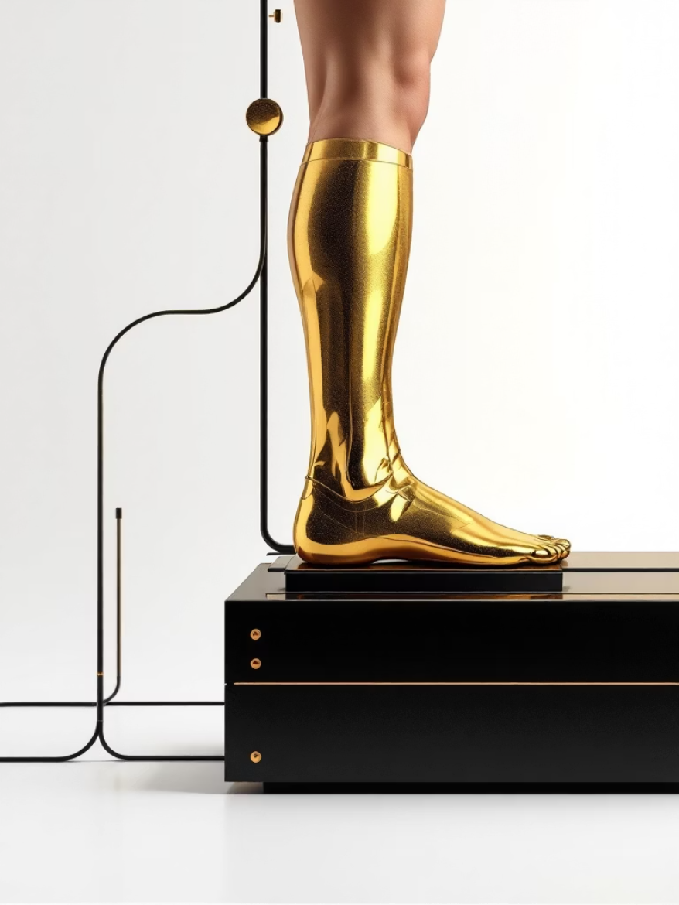
Motor Leg Testing
Procedure
Hold leg at 30° (supine). Observe 5 seconds. Score drift if leg falls. Test both legs, starting with non-paretic side.
01
02
03
No Drift
Drift
Some Effort
Holds 30° for 5 seconds
Falls by 5 seconds
Against gravity
04
05
No Gravity
No Movement
Immediate fall
Complete paralysis

Slide 21
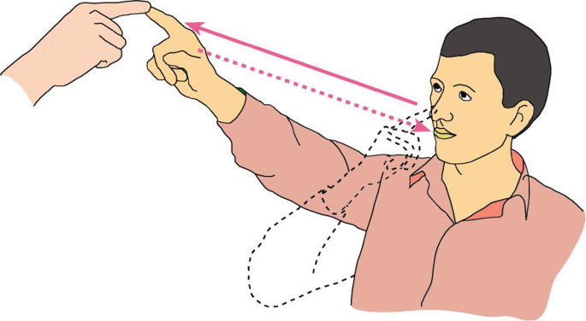



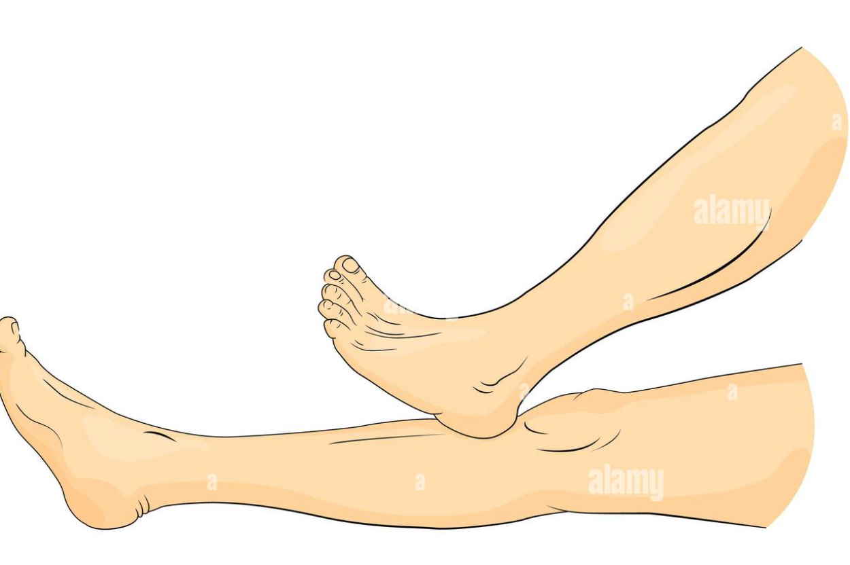
Limb Ataxia
Unilateral Cerebellar
Test finger-nose-finger and heel-shin on both sides
Eyes Open
Ensure testing in intact visual field if defect present
Score Ataxia
Only if present out of proportion to weakness
0 - Absent
1 - One Limb
2 - Two Limbs
UN - Untestable

Slide 22








Sensory Testing
Assessment Method
Sensation or grimace to pinprick. Withdrawal from stimulus in obtunded patient. Test multiple body areas to check for hemisensory loss.
0 - Normal
1 - Mild-Moderate
2 - Severe-Total
No sensory loss
Less sharp or dull sensation
Not aware of being touched
Note: Only sensory loss attributed to stroke is scored as abnormal. Comatose patients automatically score 2.

Slide 23
Dysarthria Testing Protocol
01
02
Obtain Speech Sample
Severe Aphasia Consideration
Ask patient to read or repeat words from the list
Rate clarity of spontaneous speech if patient has severe language impairment.
03
04
Physical Barriers
Blind Testing
Record as untestable (UN) only if intubated or has other physical barriers to speech.
Do not inform patient why they are being tested.

Slide 24
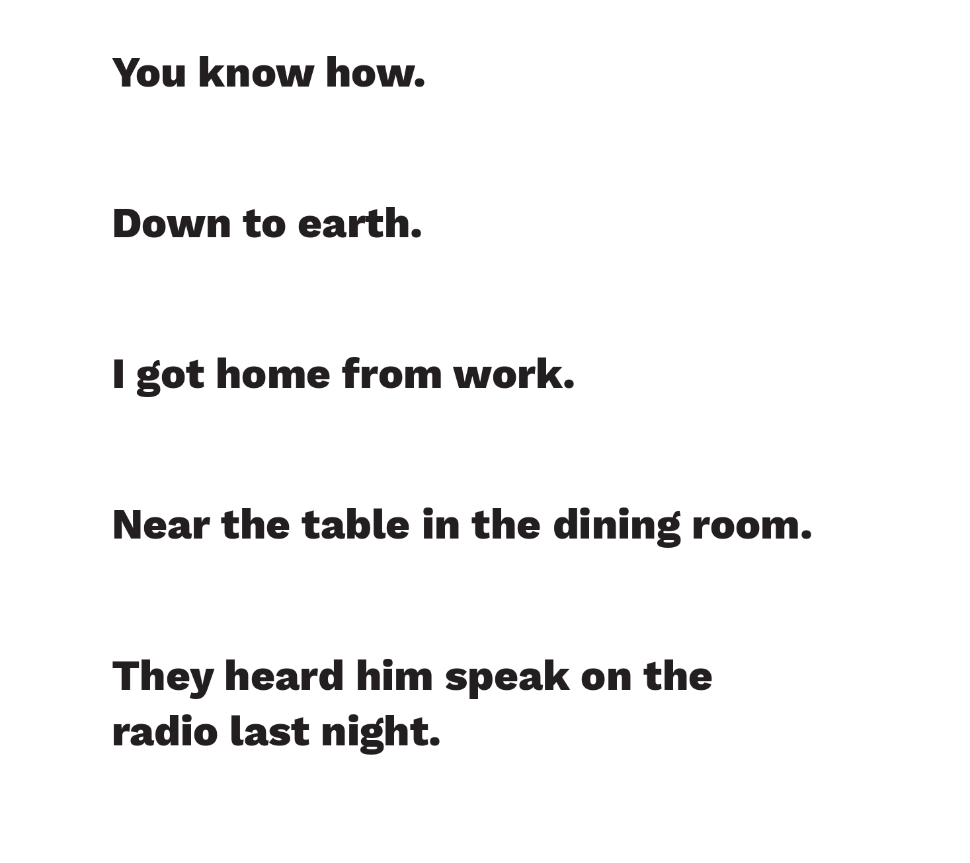

Slide 25
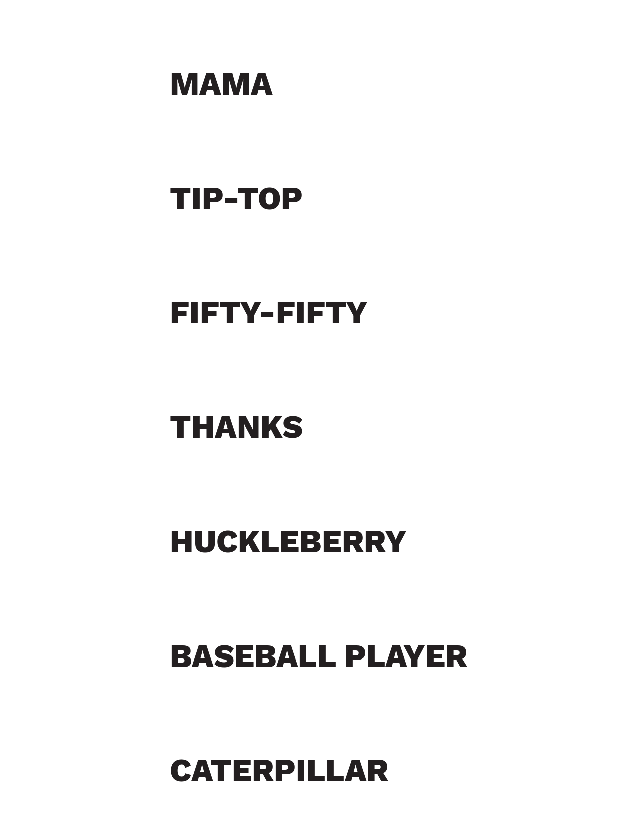

Slide 26
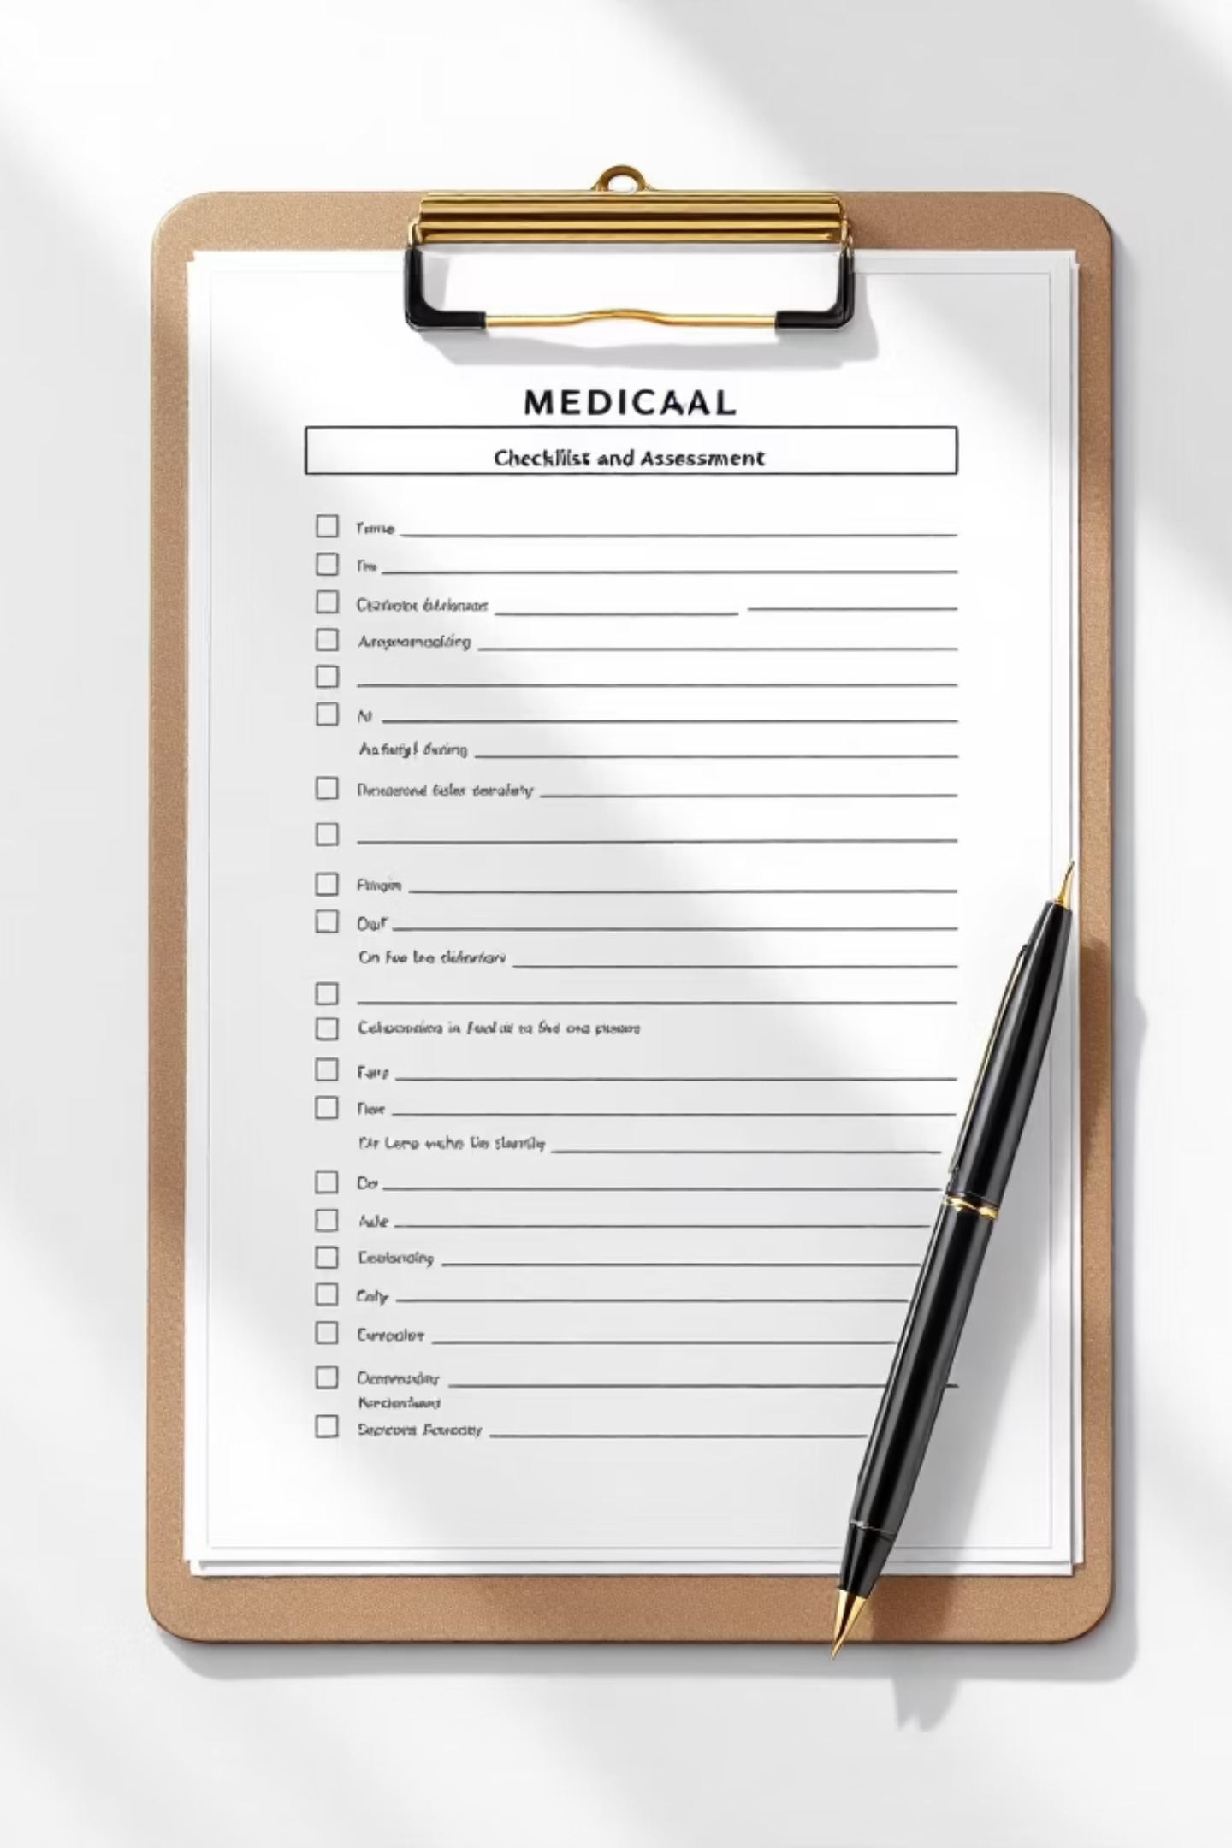
Key Assessment Guidelines:
AKA Stuff Ross Doesn’t Care About
Dysarthria Testing
Inattention Testing
Never untestable due to aphasia alone
Use spontaneous speech for severe aphasia cases
Document physical barriers clearly
Blind testing maintains assessment integrity
Abnormality scored only if present
Never untestable
Visual spatial neglect indicates abnormality
Anosagnosia (Poor insight) taken as evidence

Slide 27








Dysarthria Scale
0 - Normal
1 - Mild-to-Moderate
Clear, articulate speech with no discernible impairment.
Some words slurred; speech understandable with some difficulty.
2 - Severe
UN - Untestable
Speech unintelligible or mute/anarthric, disproportionate to any dysphasia.
Intubated or other physical barrier preventing speech production.

Slide 28
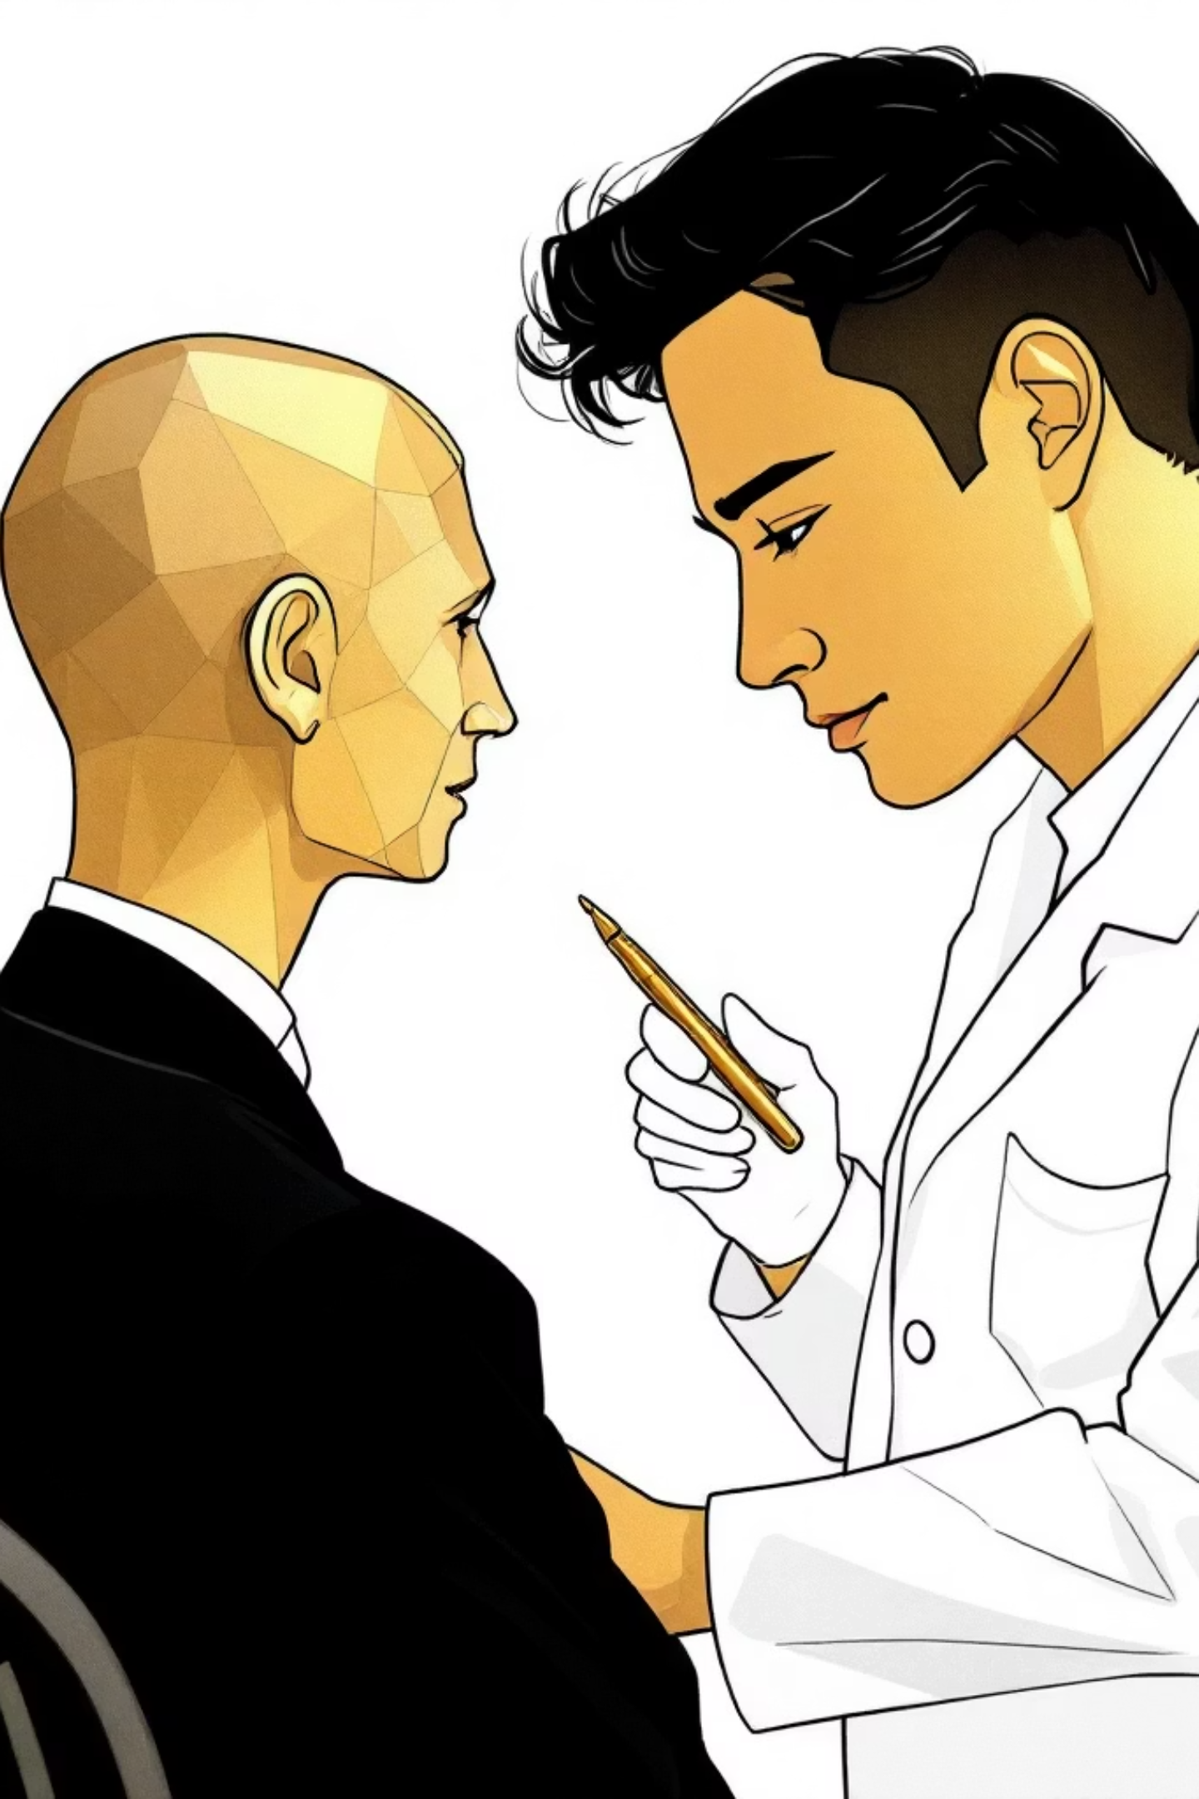
Extinction and Inattention Assessment
Formerly known as Neglect. Sufficient information may be obtained during prior testing phases.
Visual Loss Consideration
Aphasia Factor
If patient has aphasia
DOCUMENT
If severe visual loss
DOCUMENT
Abnormality Indicators
Visual spatial neglect or anosagnosia (lack of insight)
DOCUMENT

Slide 29
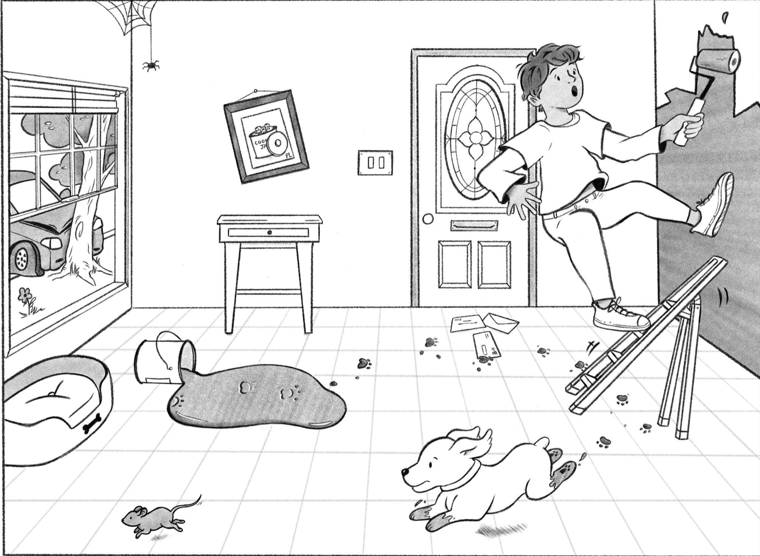

Slide 30


Slide 31



Inattention Scale
2 - Profound Hemi-inattention
1 - Mild Inattention
0 - No Abnormality
Visual, tactile, auditory, spatial, or personal inattention. Extinction to bilateral simultaneous stimulation in one sensory modality.
Extinction to more than one modality. Does not recognize own hand or orients to only one side of space.
Full awareness and attention to all sensory stimuli.

Slide 32
Special Considerations
Severe Visual Loss
Aphasia with Normal Attention
Physical Barriers to Speech
If patient has severe visual loss preventing visual double simultaneous stimulation, but cutaneous stimuli are normal, the score is normal.
If patient has aphasia but appears to attend to both sides, the score is normal.
Only if patient is intubated or has other physical barriers to producing speech should examiner record score as untestable (UN) with clear explanation.

Slide 33



Acute Stroke Imaging Pathway
Non-Contrast CT Head
CT Angiography
Perfusion Imaging
Hemorrhage
Large vessel occlusion
(LVO)
CT perfusion (CTP) or MR perfusion.
Tissue viability. Core vs penumbra (hypoperfused brain)
Mismatch identifies salvageable tissue in late window.
Local telestroke programs and transfer agreements determine imaging availability. Know your facility's capabilities and regional stroke center protocols.

Slide 34
Key Clinical Pearls
Time Is Brain
Team Coordination
Door-to-needle time <60 minutes for tPA administration. Every 15-minute delay reduces good outcome probability by 10%.
Activate stroke alert immediately. Radiology, lab, pharmacy, and neurology must function as integrated unit for optimal outcomes.
Reversal Readiness
Documentation
Pre-order reversal agents for anticoagulated patients
Complete NIH Stroke Scale, last known well time, and informed consent discussions.
Bottom Line: Watch for mimics, Last known well, transfer, document.

Slide 35

Thrombolysis: Patient Selection Criteria
Inclusion Criteria
Absolute Contraindications
Window (typically 4.5 hours from symptom onset)
No Bleed
NIH Stroke Scale score ≥4 recommended for benefit
Not Improving
Active internal bleeding or known bleeding diathesis
Recent intracranial hemorrhage, surgery, or trauma (within 3 months)
Severe uncontrolled hypertension (SBP >185 mm Hg or DBP >110 mm Hg despite treatment)
Clinical judgment: Weigh risks versus benefits for off-label scenarios. Obtain informed consent when feasible, documenting discussion of intracranial hemorrhage risk (approximately 6%)

Slide 36




Mechanical Thrombectomy: Expanding the Window
Large Vessel Occlusion
Penumbra Assessment
Extended Window
Identify LVO in anterior circulation (ICA, MCA M1/M2 segments) using CT angiography or CTA
Perfusion imaging demonstrates salvageable tissue with core-penumbra mismatch favorable for intervention
Selected patients benefit up to 24 hours from last known well per DAWN and DEFUSE-3 trial criteria
Action Item: Activate neurointerventional team immediately upon LVO identification. Door-to-groin time targets remain critical (<90 minutes optimal).

Slide 37
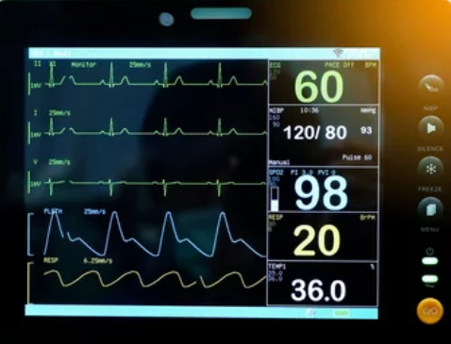

Blood Pressure Management: Protocol-Driven Targets
What a fun Mystery!
1
Ischemic Stroke: Permissive Hypertension
Allow SBP up to 220 mm Hg or DBP 120 mm Hg if NOT receiving thrombolytics, maintaining cerebral perfusion to ischemic penumbra
2
Pre-tPA Requirements
Reduce BP to <185/110 mm Hg before administration through antihypertensive therapy (labetalol, nicardipine preferred)
3
Post-tPA Monitoring
Maintain SBP <180/105 mm Hg for 24 hours post-infusion with hourly checks; aggressive control if hemorrhagic transformation suspected
4
Hemorrhagic Stroke
Target approximately SBP 140 mm Hg per

Slide 38
Anticoagulation Reversal Strategies
Document Essential Information
Reversal Agents by Agent
Most important! What Medicine?!?!
  Warfarin (coumadin)
  Pradaxa (dabigatran)
  Xarelto (rivaroxaban)
  Eliquis (apixaban)
Last administered dose and timing
Baseline INR, creatinine clearance, liver function
Why are they on it!?!?
Warfarin: Vitamin K 10 mg IV + 4-factor prothrombin complex concentrate (PCC) 25-50 U/kg
Dabigatran: Idarucizumab 5g IV (Praxbind®) - immediate reversal
Factor Xa inhibitors: Andexanet alfa (Andexxa®) if available; PCC empirically if unavailable
Ischemic stroke patients on anticoagulants generally excluded from thrombolysis due to hemorrhage risk. Consider thrombectomy if LVO present.

Slide 39



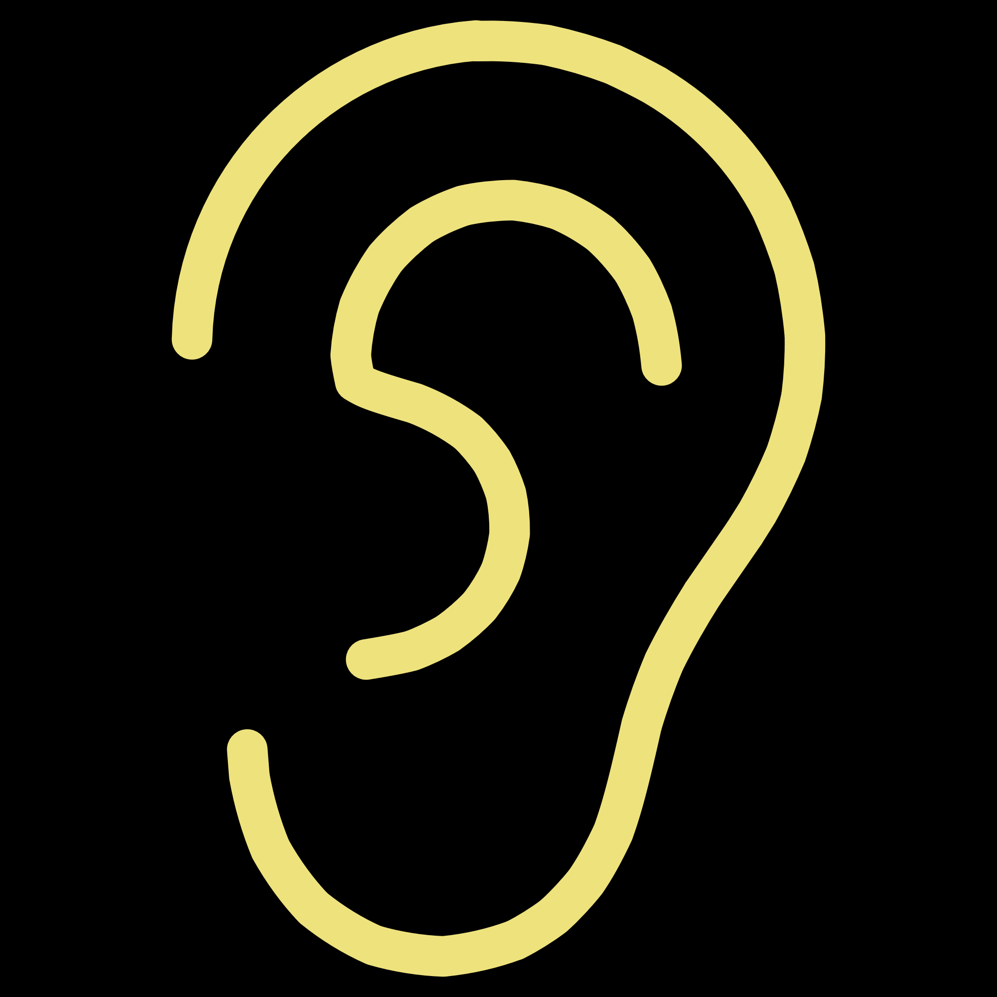
Stroke Mimics: Avoiding Diagnostic Pitfalls
Hypoglycemia
Post-Ictal Paralysis
Point-of-care glucose testing mandatory before stroke imaging. Rapid dextrose 50% 50mL IV reverses symptoms immediately if glucose <60 mg/dL.
Recent seizure history with unilateral weakness resolving over 48 hours. EEG if clinical suspicion high despite negative imaging.
Complex Migraine
Peripheral Vestibulopathy
Aura with prolonged hemiparesis (hemiplegic migraine), basilar-type symptoms. Often younger patients with migraine history and family pattern.
Acute vertigo, nausea, nystagmus without stroke signs. Dix-Hallpike maneuver exam differentiate peripheral from posterior stroke.
Key Point: Careful history and targeted testing prevent inappropriate thrombolytic administration in mimics.

Slide 40
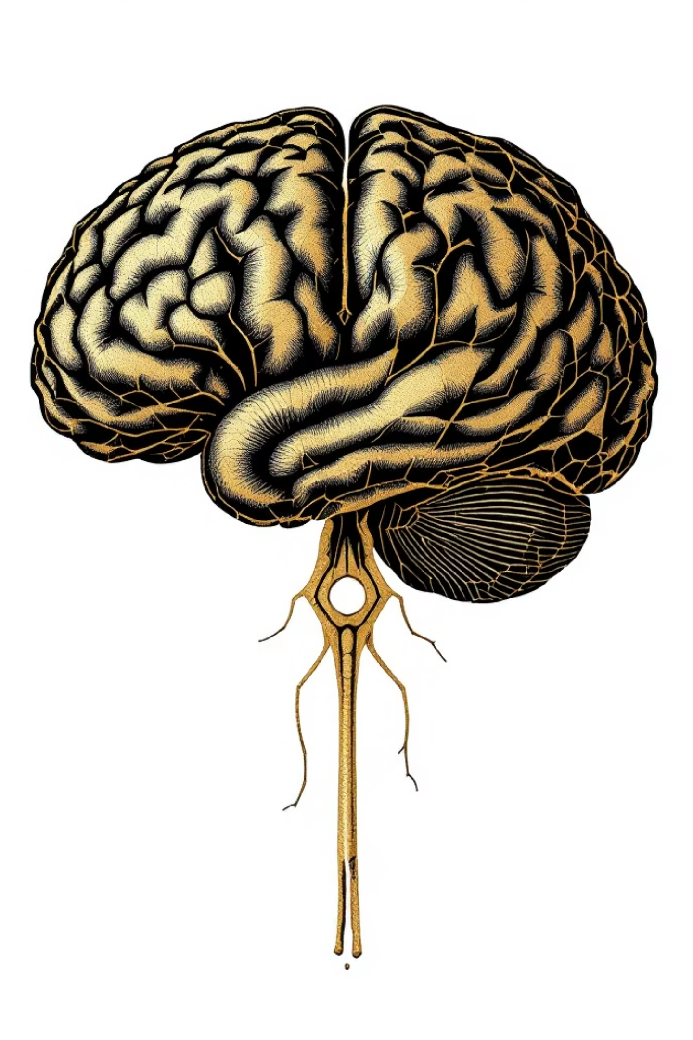

Posterior Circulation Stroke: High Miss Rate
Classic Presentation Triad
Vertigo and Vomiting
Acute onset severe vertigo out of proportion to examination findings
Diplopia and Cranial Nerve Deficits
VI, VII, or III nerve palsies with binocular double vision
Ataxia and Gait Disturbance
Truncal or limb ataxia without corresponding hemiparesis
Dysarthria
Pure speech articulation difficulty without hemiparesis
Posterior strokes frequently lack classic limb weakness, leading to 10-15% misdiagnosis rate in emergency settings. Maintain high clinical suspicion.

Slide 41
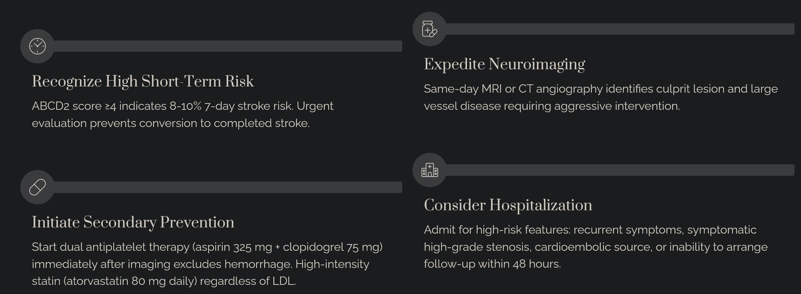

Transient Ischemic Attack: Immediate Management
Consider Echo

Slide 42
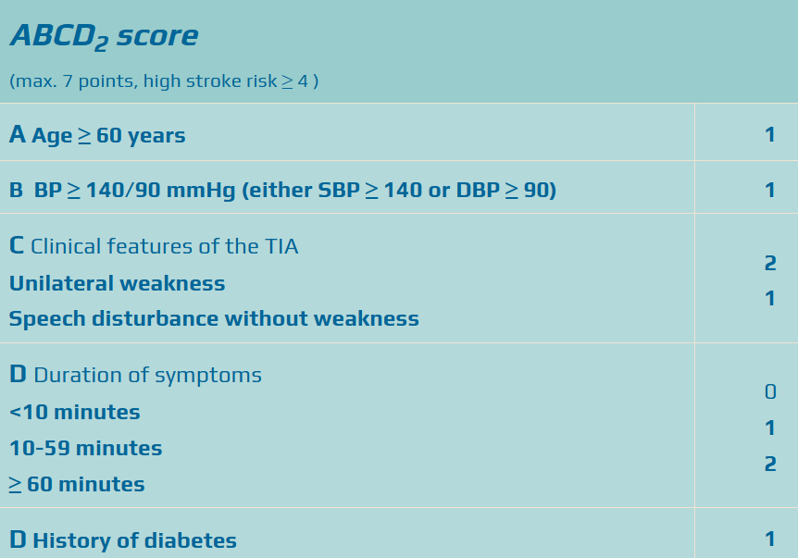
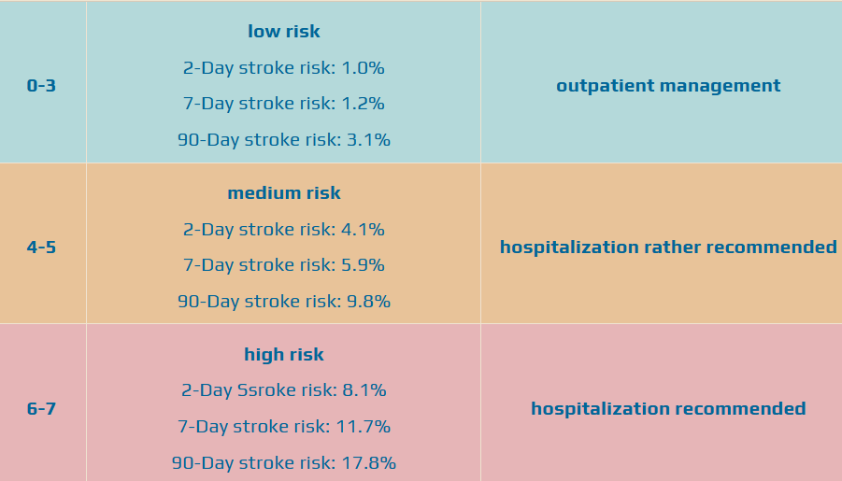

Slide 43
Assessment of the 12 Cranial Nerves

Slide 44
Cranial Nerves II-XII Intact
Lawyer’s Will Love You

Slide 45
Patient is alert, lucid and oriented times 3
Extraocular movements are intact
Facial and jaw muscle strength intact
Hearing grossly intact
Speech is without dysarthria
Shoulder shrug is strong
No focal motor, sensory or cerebellar deficits are noted
Speech and gait are normal
Patient has 5/5 muscle strength in the upper and lower extremities. Sensory exam is intact to lite touch on arms and legs bilaterally
Cerebellar exam is intact on "finger to nose" ,"heel shin" and gait is stable.

Slide 46
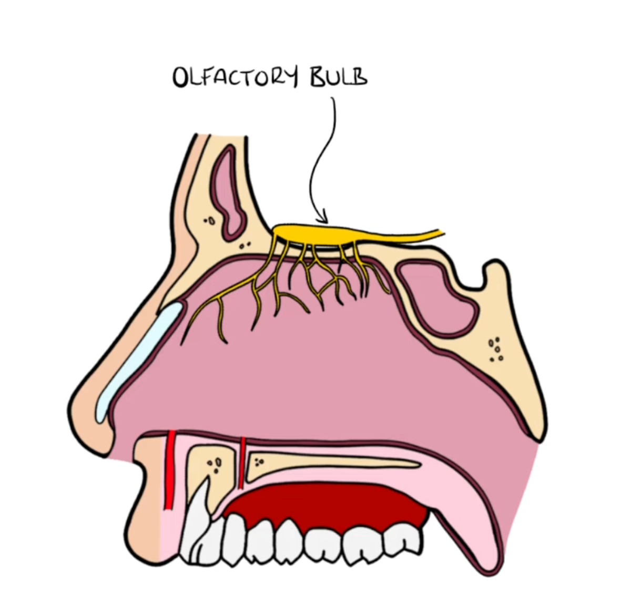
Cranial Nerve I: Olfactory
Testing Smell Function
Smell evaluation is performed after head trauma, when anterior fossa lesions are suspected, or if patients report abnormal olfaction.
Procedure: Patient identifies odors (soap, coffee, cloves) presented to each nostril while the other is occluded. Trigeminal irritants like alcohol or ammonia test for malingering only.

Slide 47
Cranial Nerve II: Optic
Visual Acuity
Color Perception
Visual Fields
Tested using Snellen chart or distance chart.
Evaluated with embedded numbers in colored dot fields.
Tested by directed confrontation in all 4 quadrants. Pupillary responses and funduscopic examination completed.

Slide 49
What to do…
Sensory only
  Distance chart
  Snellen's chart
  Grossly intact
  Name badge
  Count Fingers
  Finger wiggles
  Light dark.
Wear glasses
Accommodation
  Focus change
Swinging light test ?

Slide 50
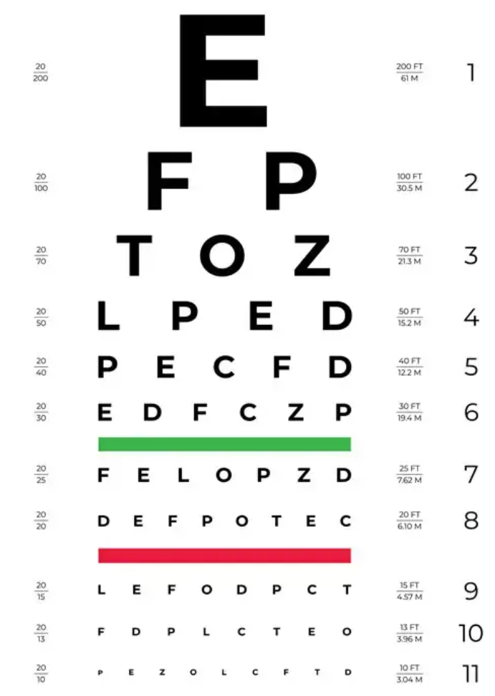
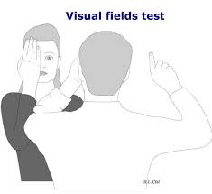

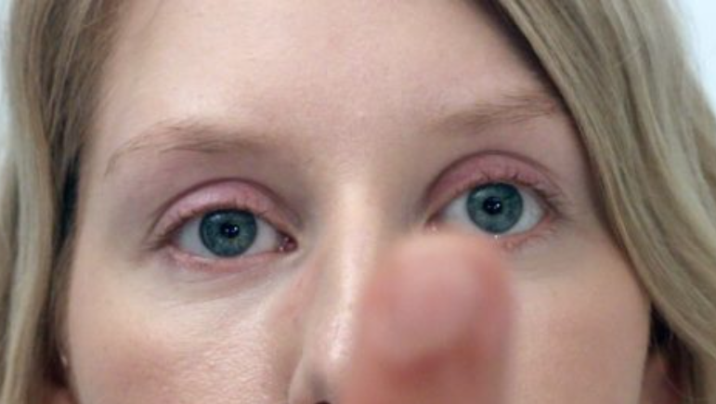

Slide 51

Cranial Nerves III, IV, VI: Oculomotor, Trochlear, Abducens
Observation
Extraocular Movements
Eyes checked for symmetry of movement, globe position, eyelid droop (ptosis), and twitches
Patient follows moving target through all 4 quadrants and toward nose to detect nystagmus and palsies
Pupil Testing
Anisocoria (unequal pupil) noted in dim light. Pupillary light response tested for symmetry

Slide 52
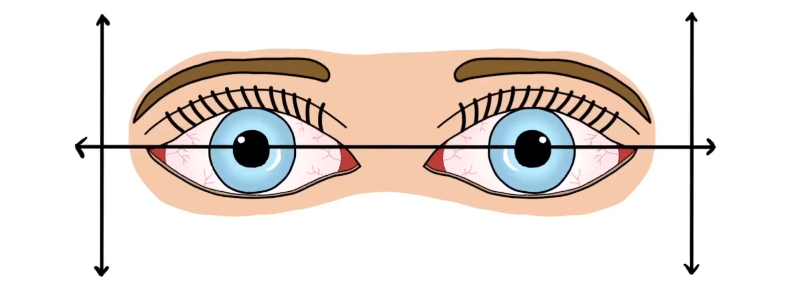
Double vision
Ptosis upper eyelid droop
Are they winking…
Down and out eye gaze:
AKA Googly

Slide 53
Cranial Nerve V: Trigeminal
Sensory Function
Motor Function
Sharp Dull Testing
Three divisions
  Ophthalmic
  Maxillary
  Mandibular
Jaw Clench (show teeth)
Open mouth (while showing tongue, CN IX)
Blink

Slide 54
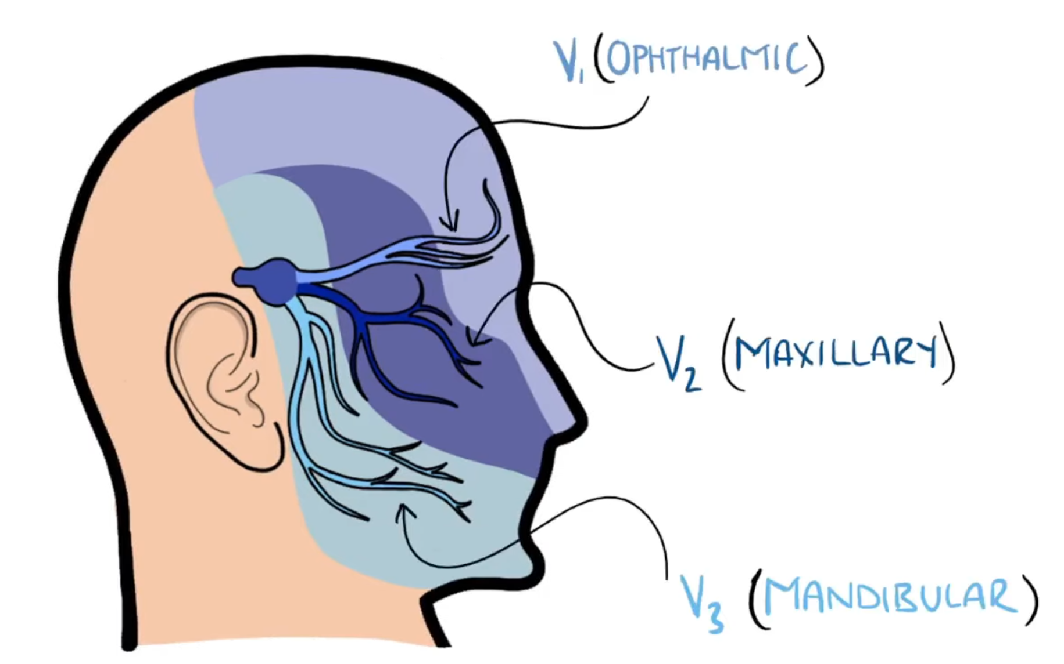

Slide 55
Cranial Nerve VII: Facial
Facial Movement Assessment
Check for hemifacial weakness. Asymmetry most obvious during spontaneous conversation and smiling. Depressed nasolabial fold and widened palpebral fissure on weakened side.
Taste Testing ?
Upper vs. Lower Facial Weakness
If only lower facial weakness present (forehead furrowing preserved), etiology is central (stroke) rather than peripheral (Bell’s Palsy).

Slide 56
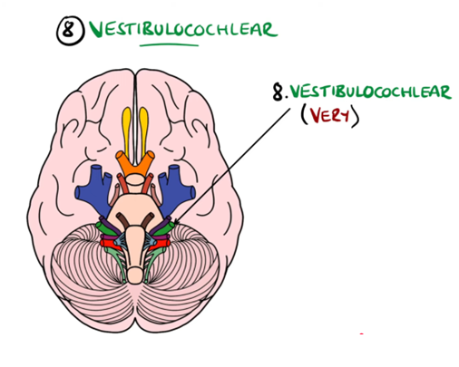


Cranial Nerve VIII: Vestibulocochlear
Hearing Assessment
Whispering
Finger rubbing
Weber and Rinne tests
Vestibular Function Testing
Nystagmus Evaluation
Dix-Hallpike Test

Slide 57
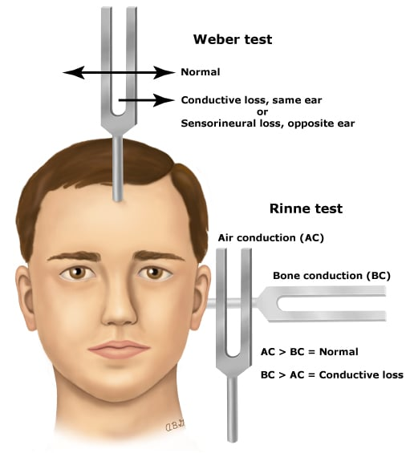

Slide 58
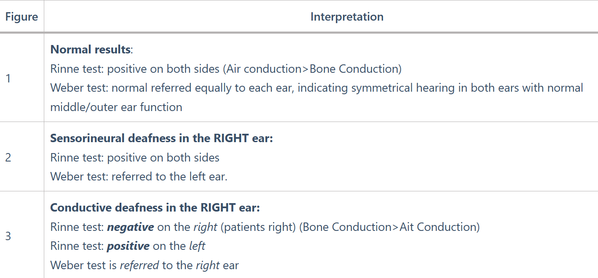

Slide 59



Cranial Nerves IX & X: Glossopharyngeal & Vagus
Palate Elevation
Say “Aaaah."
Yawn
Gag Reflex ?
Vocal Cord Exam ?
How about just listen to them talk…

Slide 60
Cranial Nerve XI: Spinal Accessory
Sternocleidomastoid Testing
Patient turns head to one side and maintains position
against examiner's resistance. Examiner palpates active
muscle opposite the turned side.
Upper Trapezius Testing
Patient elevates shoulders against examiner's resistance. Weakness indicates nerve dysfunction.

Slide 61
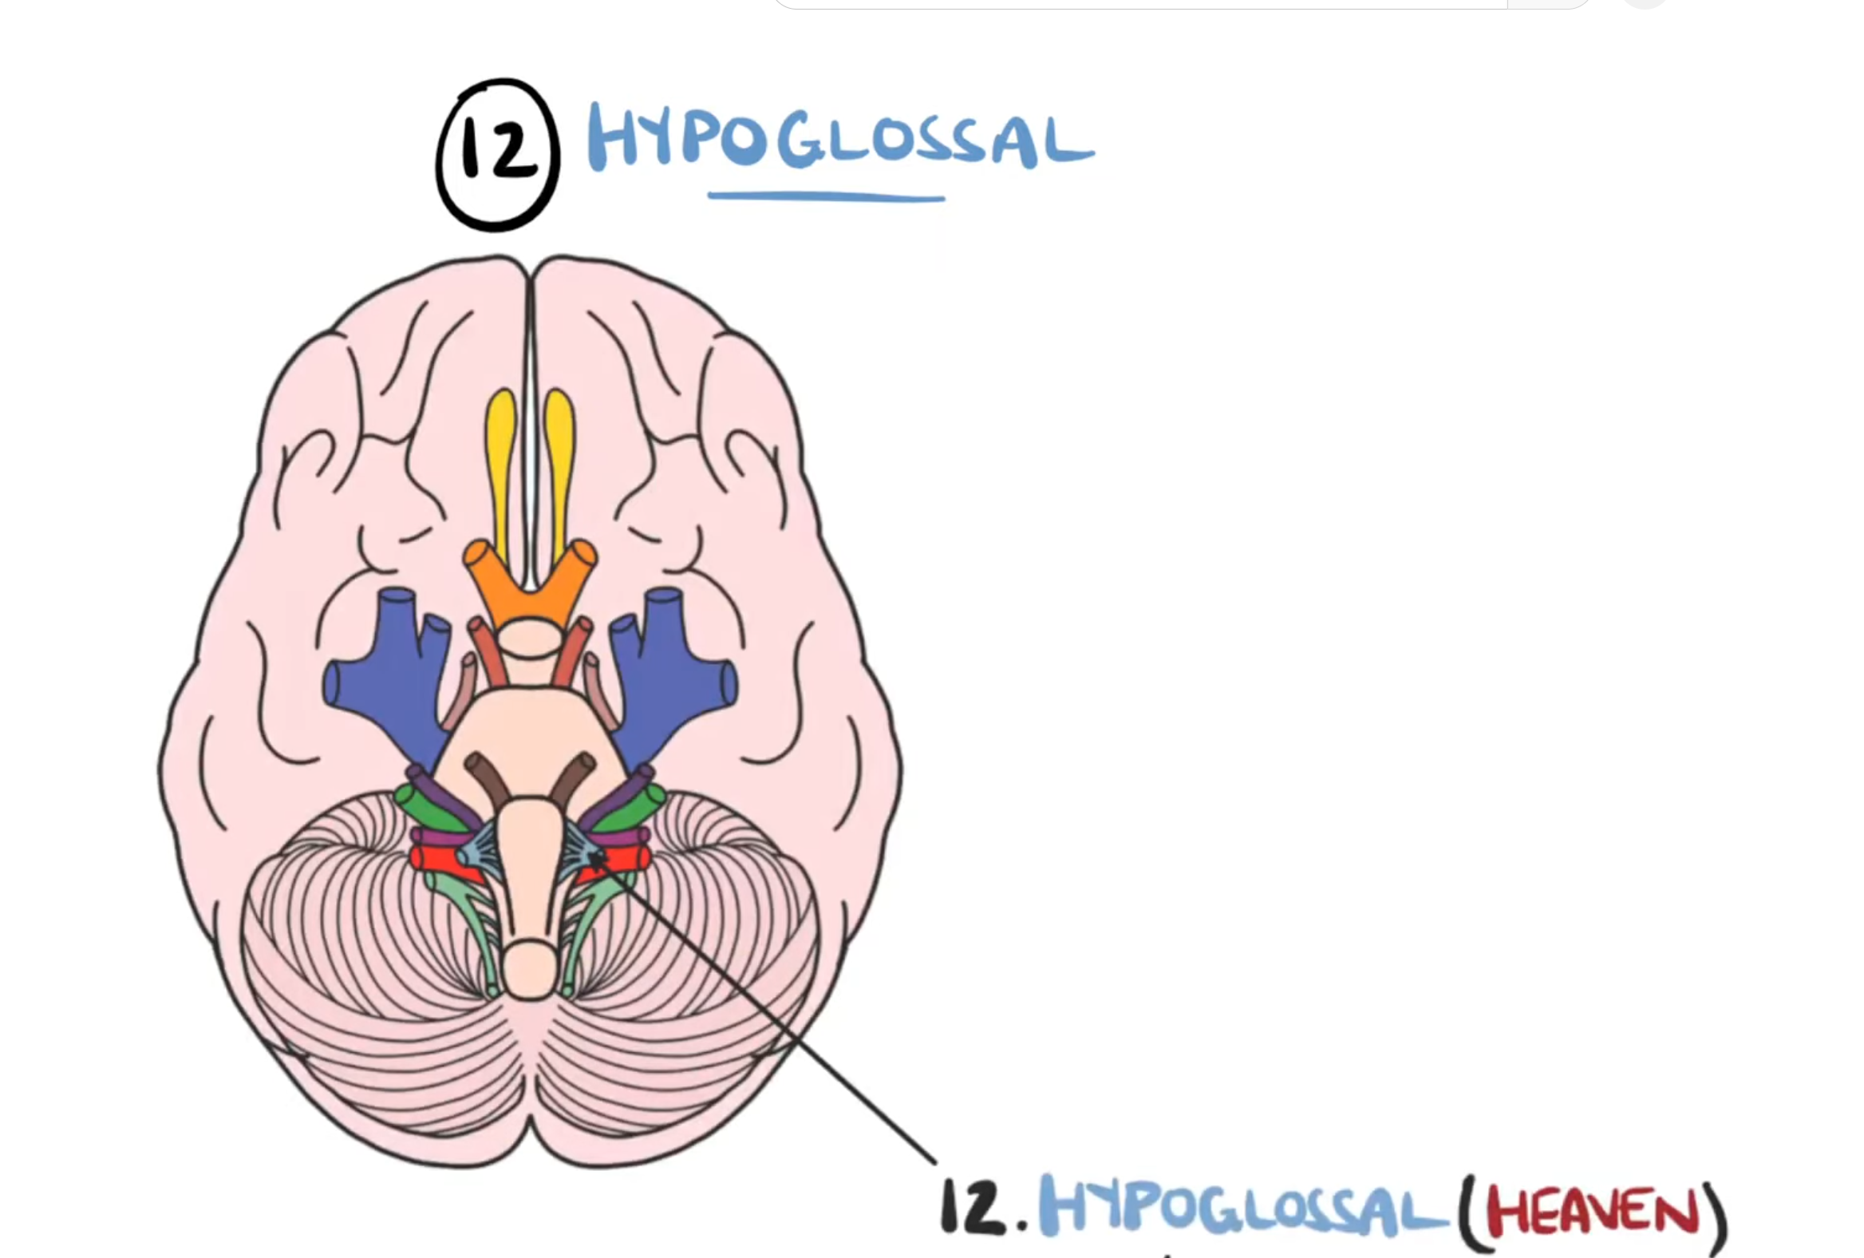








Cranial Nerve XII: Hypoglossal
Inspection
Atrophy
Ask patient to extend tongue fully
Look for visible muscle wasting
Fasciculations
Deviation
Observe fine muscle twitches
Tongue deviates toward side of lesion

Slide 62
Patient is alert, lucid and oriented times 3
Extraocular movements are intact
Facial and jaw muscle strength intact
Hearing grossly intact
Speech is without dysarthria
Shoulder shrug is strong
No focal motor, sensory or cerebellar deficits are noted
Speech and gait are normal
Patient has 5/5 muscle strength in the upper and lower extremities. Sensory exam is intact to lite touch on arms and legs bilaterally
Cerebellar exam is intact on "finger to nose" ,"heel shin" and gait is stable.

Slide 63
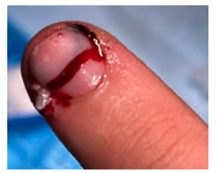
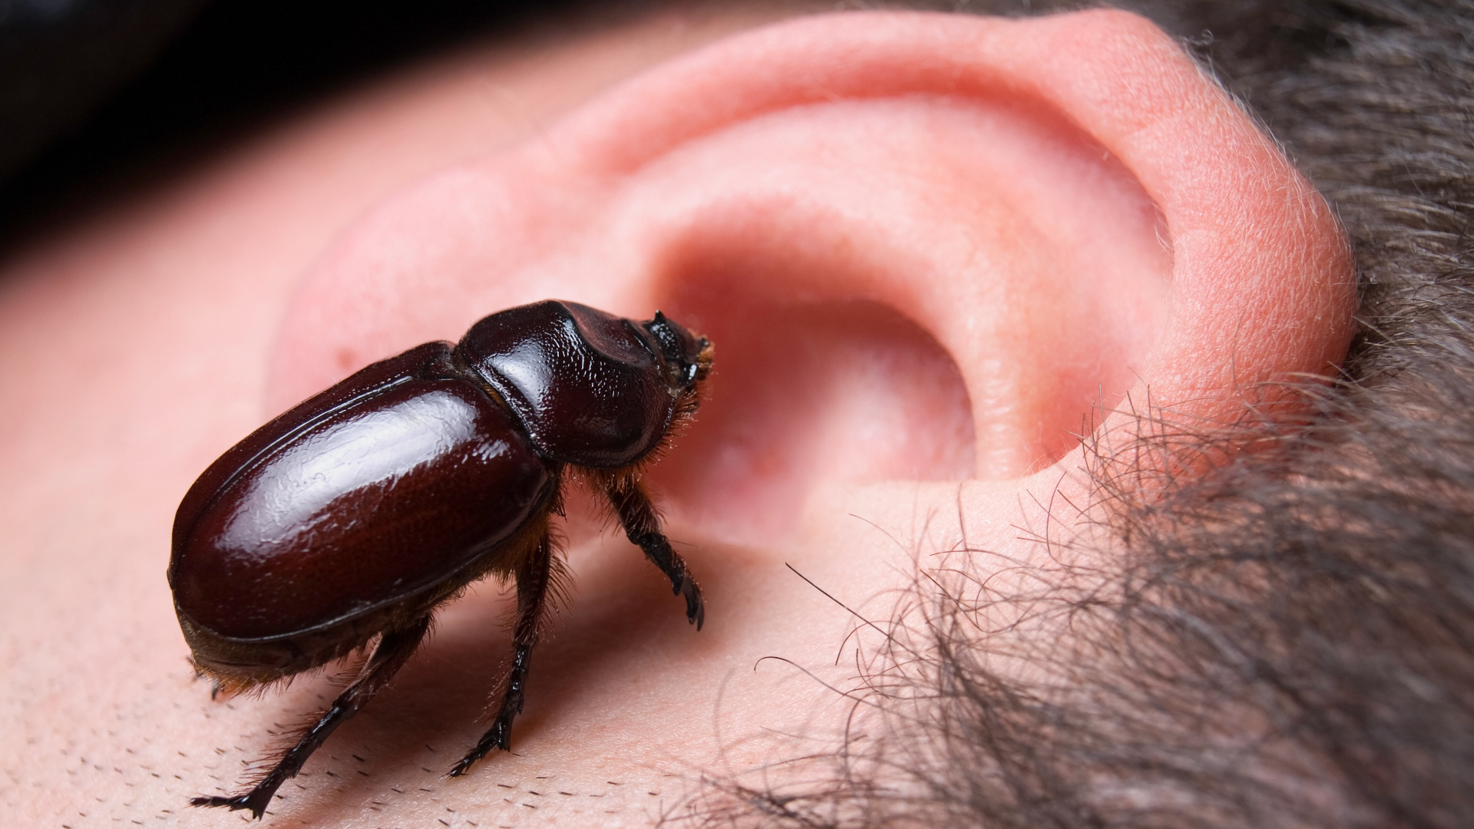
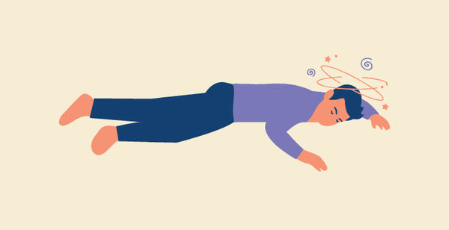
Advice #6
Be Afraid, But Do It Anyway.

Slide 64

Reflexes

Slide 65
Deep Tendon Reflexes by Root Level
Deep tendon reflexes assess the integrity of motor pathways and specific spinal nerve roots. Each reflex corresponds to distinct neurological levels.
Biceps & Brachioradialis
Triceps
Root Level: C5/C6
Root Level: C7
Evaluates cervical nerve roots responsible for elbow flexion
Primarily involves C7, though some references include C6 or C8
Patellar
Ankle
Root Level: L2-L4
Root Level: S1
Tests lumbar nerve roots controlling knee extension
Assesses sacral nerve root function for plantar flexion

Slide 66
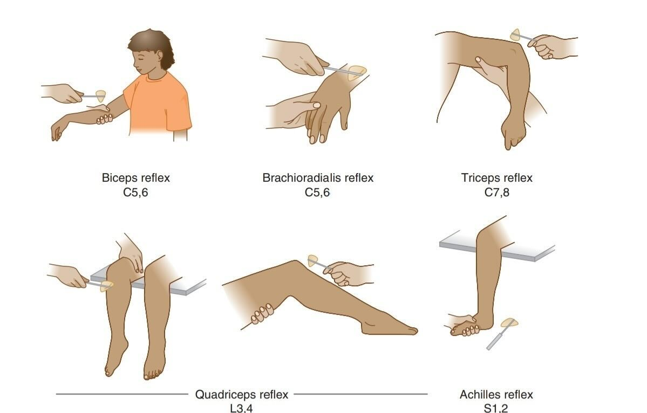

Slide 67

Superficial Reflexes Overview
Superficial reflexes trigger involuntary muscular responses.
Corneal reflex
Cremaster reflex
Plantar reflex

Slide 68
Corneal Reflex (Blink Reflex)
01
Stimulus
Involuntary blinking occurs in response to corneal stimulation, typically using a cotton wisp or air puff

Slide 69
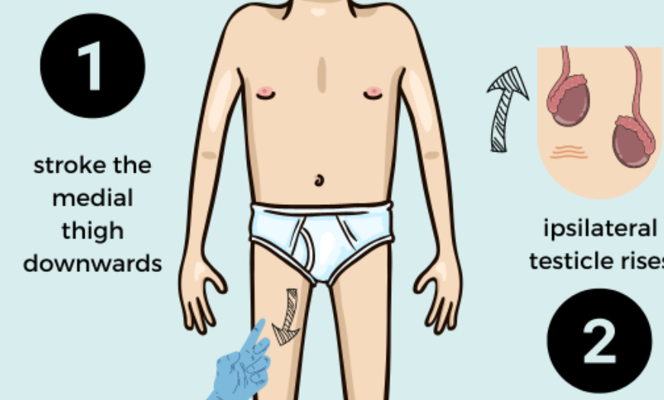
Cremaster Reflex
Clinical Significance
Absent reflex indicates:
Testicular torsion
Upper or lower motor neuron lesions
L1/L2 spinal cord injury
Ilioinguinal nerve injury (common during hernia repair)

Slide 70
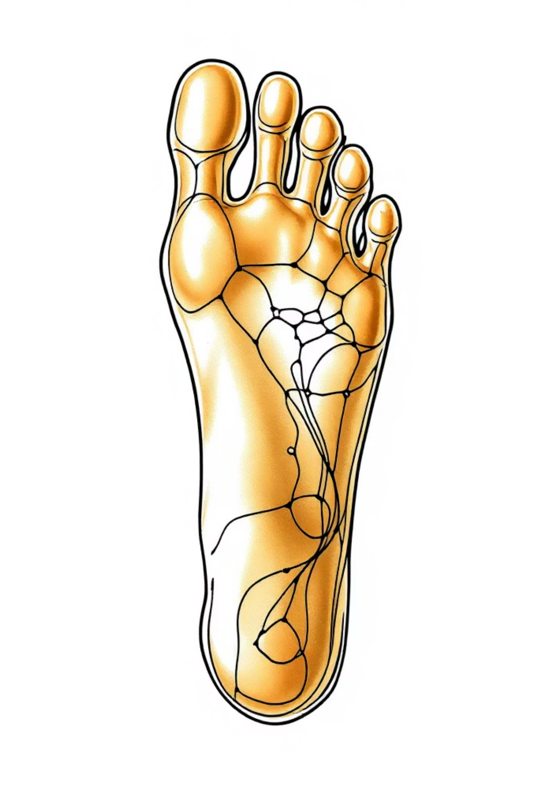



Plantar Reflex Assessment
Normal Response
Toes move downward (plantar flexion)
Absent Response
No toe movement occurs
Abnormal Response
Toes extend upward (Babinski present)
Important: It is incorrect to say "negative Babinski." The reflex is either normal (down-going) or abnormal (Babinski present).

Slide 71

Normal for babies.
Positive is a Central Nerve Process
  Lou Gehrig’s disease
  Brain tumor
  Meningitis
  Multiple sclerosis
  Neurodegenerative condition (such as Alzheimer’s disease)
  Spinal cord injury or disease
  Stroke

Slide 72

Deep Tendon Reflex Scale
Grading reflexes provides objective documentation, though clinical utility is limited compared to muscle strength assessment. Use descriptive terms when possible.
0: Absent
No reflex response despite reinforcement
1+: Trace
Response seen only with reinforcement techniques
2+: Normal
Average reflex response
3+: Brisk
Exaggerated but normal response
4+: Non-sustained Clonus
Initial rhythmic oscillations that stop
5+: Sustained Clonus
Continuous rhythmic oscillations
Critical: If hyperactive reflex present, always check for clonus by maintaining pressure on the tendon.
Criticism of Crititical: Really?

Slide 73

Abdominal Reflex
Testing Technique
Basically tickling
Clinical Interpretation
A waste of time

Slide 74
Visceral Reflexes
These reflexes assess autonomic nervous system function and sacral spinal cord integrity
People will ask about this… Patient Deferred
Anal Reflex (Anal Wink)
Bulbocavernosus Reflex
Response: Reflexive contraction of external anal sphincter
Response: Anal sphincter contraction
Stimulation: Squeeze glans penis or tug Foley catheter
Stimulation: Lightly stroke perianal skin
Pathway: Mediated by S2-S4
Pathway: Afferent via pudendal nerve; efferent S2-S4
Clinical Use: Evaluates spinal cord injury patients and sacral reflex arc integrity

