Slide 1
Clinical Emergencies:
Some other stuff
Ross Klein, PA-C

Slide 2
The Dangerous Groin and Back
Fournier's Gangrene
Cauda Equina Syndrome (CES)
Spinal Epidural Abscess

Slide 3
Fournier's Gangrene
Necrotizing fasciitis of the perineum – Surgical Emergency
  Triad: Perineal pain, swelling, systemic toxicity
  Pain out of proportion; crepitus is late sign
  Risk: Diabetes, immunocompromised, alcoholism
  Management: Emergent surgical debridement + IV antibiotics
  Disposition: ICU, serial debridement

Slide 4
Cauda Equina Syndrome (CES)
Presentation
  Severe low back pain.
  Saddle anesthesia (perineal numbness).
  Bowel/Bladder dysfunction (retention/incontinence).
  Urinary retention (e.g., 800cc on catheterization).
Workup: Urgent MRI lumbar spine.
Treatment: Neurosurgical decompression.

Slide 5
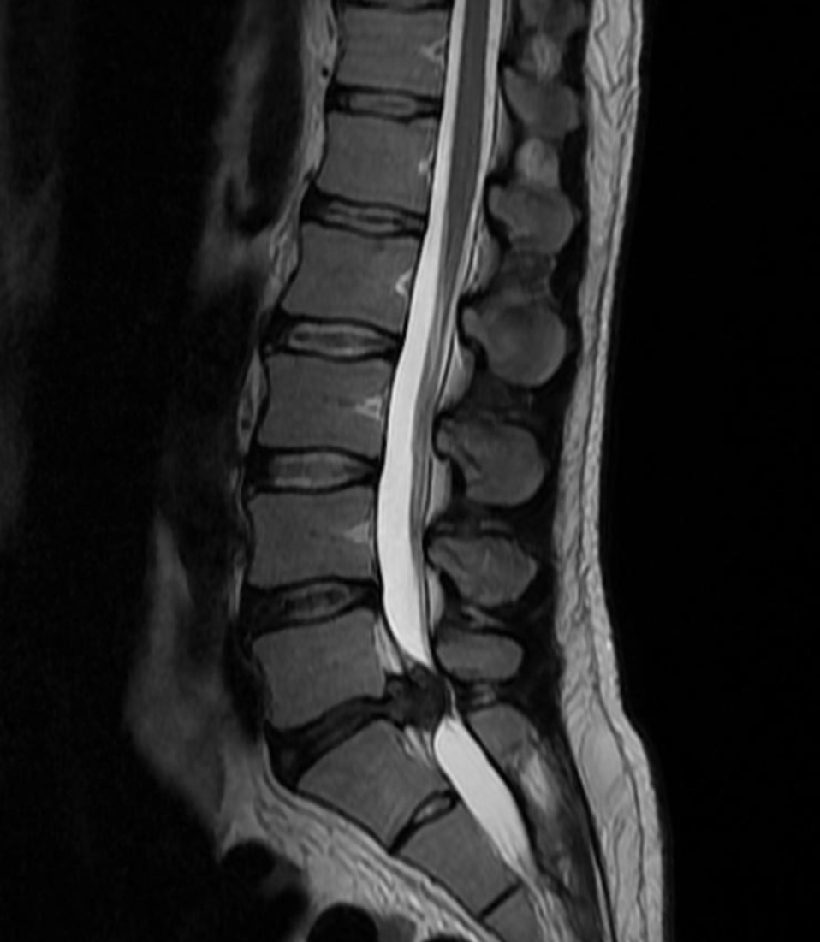

Slide 6
Spinal Epidural Abscess
Back pain + fever + neurologic deficit (late finding)
Pain out of proportion
Risk: IVDU, recent spinal procedures
MRI diagnostic
Blood cultures + IV antibiotics
Surgical drainage if deficit or sepsis

Slide 7
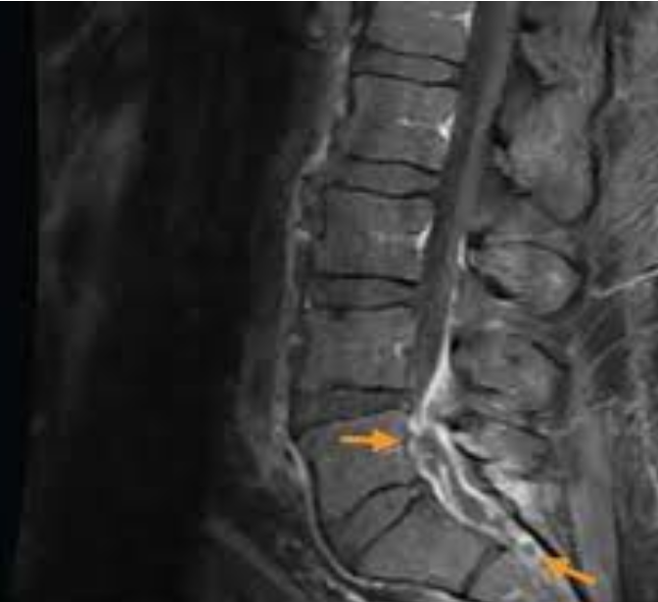

Slide 8
Advice #7
Anxiety
  Sleep
  ETOH
  Drugs

Slide 9
Joint and Vascular
Septic Arthritis vs Crystal Arthropathy
Temporal (Giant Cell) Arteritis

Slide 10
Septic Arthritis
Cannot Move Joint
Hot swollen joint
  Septic until proven otherwise
Arthrocentesis is key
Synovial WBC >50,000 → assume septic
Start antibiotics AFTER aspiration
Orthopedic consult for washout

Slide 11
Temporal (Giant Cell) Arteritis
Age >50 + new headache
Jaw claudication (highly specific)
Visual changes = impending blindness
Elevated ESR/CRP
Start high-dose steroids immediately
Biopsy confirms diagnosis later

Slide 12
Dermatologic & Soft Tissue Emergencies
SJS/TEN
Compartment Syndrome

Slide 13
Stevens-Johnson Syndrome / TEN (Toxic Epidermal Necrolysis)
Drug reaction
Mucosal erosions + epidermal sloughing (Nikolsky sign)
Stop offending drug immediately
ICU/Burn unit management
High mortality with TEN

Slide 14
Compartment Syndrome
Post-fracture or crush injury
Severe pain with passive stretch (earliest sign)
Tense/wooden compartment
Late: Paresthesia, pulselessness
Emergent fasciotomy

Slide 15
Metabolic & Endocrine Crashes
DKA
Thyroid Storm
Adrenal Crisis

Slide 16
Diabetic Ketoacidosis (DKA)
Polyuria, polydipsia, abdominal pain
Kussmaul respirations
Fluids FIRST
Insulin drip
Check & replace potassium before insulin if low
Check Magnesium. Often mirrors K+
Identify and treat trigger

Slide 17
Thyroid Storm
Hyperthermia, tachycardia, AMS, GI distress
Therapy Sequence:
  Beta-blocker
  Thionamide (PTU/Methimazole)
  Iodine (1 hour later)
  Glucocorticoids
Treat underlying trigger

Slide 18
Adrenal Crisis
Hypotension refractory to fluids
Hyponatremia, hyperkalemia (Check Mg)
Risk: Chronic steroid use or adrenal insufficiency
Treatment: IV Hydrocortisone 100mg + fluids
Do NOT wait for labs…
  Ross says wait for labs, just not the crazy specific ones I don’t understand…

Slide 19
Electrolyte, Neuro
Hyperkalemia
Meningitis

Slide 20
Hyperkalemia
ECG changes: Peaked T waves, widened QRS, sine wave
IV Calcium (cardiac stabilization)
Insulin + D50 (shift K+)
Albuterol nebs
Removal: Diuretics, Kayexalate, Dialysis
Continuous ECG monitoring
Check Magnesium…

Slide 21
Meningitis
Fever, neck stiffness, altered mental status
Has it been more than 3 days?
  If they are alive, It’s not Bacterial
Blood cultures
Empiric IV antibiotics ± dexamethasone
Do not delay antibiotics for LP
Add Listeria coverage if immunocompromised

Slide 22
Closing Summary
Recognize the RED FLAGS
  Pain out of proportion
  Saddle anesthesia
  Rash + mucosal sloughing → SJS/TEN
If the patient looks sick, assume they are sick

